Slide 1
Schools’ HR Update September 2024

Slide 2
What we will cover:
Schools’ HR Update
Safeguarding
SFSP
Pay and Performance Management Guidance
Teachers’ Pay
Support Staff Pay
Industrial Action Ballot
SBM School to School Working Survey
New SBM induction
Schools’ HR Training Dates
Sexual Harassment – New Law
Minimum Service Levels
Learning Point – References

Slide 3
Schools’ HR Update
Policy update – in consultation with trade unions
Model Code of Conduct Probation Policy (Support Staff)
Recruitment and Selection Toolkit
Advisory pay scales and model pay policy
Equalities update
Inclusive recruitment panels – working on online training that will be available to all schools
Inclusive panels – working with governance and legal on training to upskill governors from a diverse background
Page x • Presentation main heading here • date

Slide 4
Safeguarding (1)
Keeping Children Safe in Education for September 2024
https://www.gov.uk/government/publications/keeping-children-safe-in-education--2
Two changes:
Safer Recruitment for individuals who have lived or worked outside the UK
The following line has been removed from paragraph 286: 'applicants [who have lived or worked outside the UK] can also contact the UK Centre for Professional Qualifications who will signpost them to the appropriate EEA regulatory body'. This has been removed because the 'UK Centre for Professional Qualifications’ no longer provide an advisory service on behalf of the UK Government in regard to regulated professions and recognition of professional qualifications.
Definition of Safeguarding
The definition of safeguarding has been updated to 'reflect' the changes to the definition in Working Together to Safeguard Children that was updated in December 2023. However, whilst this change reflects the WT definition, it doesn't use it piecemeal.
Keeping Children Safe in Education (2024) Definition
The new definition in KCSIE (2024) paragraph 3 is as follows (new wording in bold):
"Safeguarding and promoting the welfare of children is defined for the purposes of this guidance as:
providing help and support to meet the needs of children as soon as problems emerge
protecting children from maltreatment, whether that is within or outside the home, including online
preventing the impairment of children’s mental and physical health or development ensuring that children grow up in circumstances consistent with the provision of safe and effective care taking action to enable all children to have the best outcomes“.
Page x • Presentation main heading here • date

Slide 5
Safeguarding (2)
KCSIE Translations - London Grid for Learning
The London Grid for Learning has translated the KCSIE 2024 Part I into: Arabic, Bengali, Chinese, Gujarati, Polish, Portuguese, Punjabi, Romanian, Somali, Spanish, Ukrainian and Urdu.
https://lgfl.net/safeguarding/kcsietranslate
Page x • Presentation main heading here • date

Slide 6
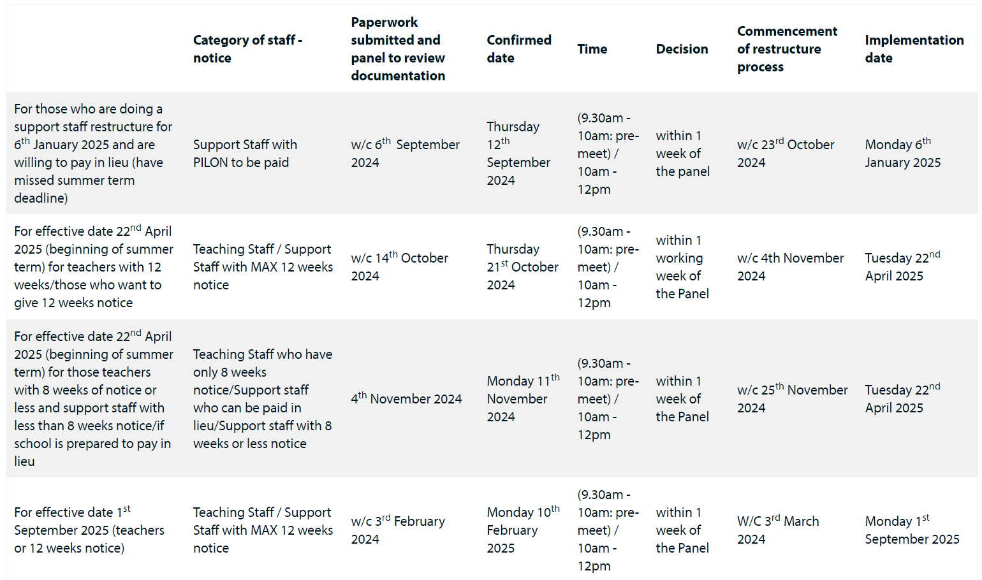
School’s Financial Support Panel (1)
The SFSP have set out the submission and panel meeting dates for the next academic year:
The dates, along with further information including the application form and checklist can be found on our website.
Page x • Presentation main heading here • date

Slide 7
School’s Financial Support Panel (2)
The SFSP have set out the submission and panel meeting dates for the next academic year:
The dates, along with further information including the application form and checklist can be found on our website.
Page x • Presentation main heading here • date

Slide 8
Updated DfE Guidance on Pay and Performance Management
Teacher and Leadership Pay
The DfE has recently published the new Managing teachers' and leaders' pay (valid from Sep 2024), which replaces the previous document Implementing your school's approach to pay (valid until July 2024).
Teacher Appraisal and Capability
The DfE has published the revised Teacher Appraisal and Capability model policy.
Page x • Presentation main heading here • date

Slide 9
Teachers’ Pay (1)
STRB Pay Award Increase Accepted
The Government has accepted the School Teachers' Review Body's (STRB) recommendation of a 5.5% pay increase for teachers, including all associated allowances. This decision will provide an additional £1.1 billion in funding for schools.
To view the updated pay scales, which are based on the Department for Education's (DfE) advisory pay points, visit the Schools’ HR Pay and Conditions page on the website:
https://education.southwark.gov.uk/schoolshr/pay-and-conditions
Page x • Presentation main heading here • date

Slide 10
Teachers’ Pay (2)
STPCD 2024
The DfE is expected to publish the final, updated School Teachers’ Pay and Conditions Document (STPCD) 2024 around 18 October 2024 (backdated to 1 September 2024).
The Government has accepted the School Teachers’ Review Body's recommendations in full for 2024, which includes the 5.5% uplift to all pay points and allowances for both teachers and leaders.
The Government’s deadline for statutory consultee’s to respond to the proposed pay award is 12 pm on 7 October 2024. Once the Government has had time to consider the consultation responses, the final STPCD 2024 will be laid in parliament for a 21-calendar day ‘praying period’ to enable Members of Parliament (MPs) to raise any objections. The DfE have estimated this will take place around 8 November 2024.
Page x • Presentation main heading here • date

Slide 11
Teachers’ Pay (3)
Schools’ HR Model Schools Pay Policy
The Model Pay Policy has been amended to reflect the updated teacher pay award.
This is available to all schools in Southwark.
Visit the Pay and Conditions page on the website to view the policy:
https://education.southwark.gov.uk/schoolshr/pay-and-conditions
Page x • Presentation main heading here • date

Slide 12
Support Staff Pay
NJC LGS Pay 2024
The National Employers made the following full and final, one-year (1 April 2024 to 31 March 2025) offer:
With effect from 1 April 2024, an increase of £1,290 (pro rata for part-time employees) to be paid as a consolidated, permanent addition on all NJC pay points 2 to 43 inclusive. The equivalent percentage increases to each pay point are shown at Annex A
With effect from 1 April 2024, an increase of 2.50 per cent on all pay points above the maximum of the pay spine but graded below deputy chief officer (in accordance with Green Book Part 2 Para 5.4[2])
With effect from 1 April 2024 an increase of 2.50 per cent on all allowances (as listed in the 2023 NJC pay agreement circular dated 1 November 2023)
Unite and UNISON voted to reject the employer’s pay offer to NJC ‘Green Book’ employees. GMB accepted the offer.
Page x • Presentation main heading here • date

Slide 13
Support Staff Pay
NJC LGS Pay 2024
The National Employers made the following full and final, one-year (1 April 2024 to 31 March 2025) offer:
With effect from 1 April 2024, an increase of £1,290 (pro rata for part-time employees) to be paid as a consolidated, permanent addition on all NJC pay points 2 to 43 inclusive. The equivalent percentage increases to each pay point are shown at Annex A
With effect from 1 April 2024, an increase of 2.50 per cent on all pay points above the maximum of the pay spine but graded below deputy chief officer (in accordance with Green Book Part 2 Para 5.4[2])
With effect from 1 April 2024 an increase of 2.50 per cent on all allowances (as listed in the 2023 NJC pay agreement circular dated 1 November 2023)
Unite and UNISON voted to reject the employer’s pay offer to NJC ‘Green Book’ employees. GMB accepted the offer.
Page x • Presentation main heading here • date

Slide 14
Unite and UNISON Ballot for Industrial Action
Unite
Following Unite members’ vote to reject the employers’ full and final pay offer, the union has just announced it will ballot for industrial action. The ballot will run from 27 August to 15 October.
To read more from Unite:
https://www.unitetheunion.org/news-events/news/2024/july/unite-members-reject-local-government-pay-offer
UNISON
UNISON will conduct a ballot for industrial action that will run from 4 September to 16 October.
To read more from UNISON:
https://www.unison.org.uk/news/article/2024/07/council-and-school-workers-in-england-wales-and-northern-ireland-asked-to-vote-on-possible-strike-action-says-unison/
Page x • Presentation main heading here • date

Slide 15
SBM School to School Working Survey
We are keen to promote schools working together and to offer opportunities for our SBMs to develop through supporting others. In order to facilitate this, we have created a survey for SBMs to complete. Once we have gathered the survey results, we will put together a spreadsheet containing useful information that we feel SBMs will benefit from and share this with SBMs.
The survey includes questions on:
areas of expertise
areas SBMs are happy to support other SBMs with
systems SBMs/the school use and contracts you have
work contact details for a contact list on the SBM website
We have asked SBMs to speak with their Headteachers about them supporting other SBMs and potentially supporting another school that requires SBM support
https://docs.google.com/forms/d/1y7Mmo2TMwvwGkDon8sGyMVrhLmhsL_Ho-5MuxYN8gfw/edit?usp=forms_home&ths=true
Page x • Presentation main heading here • date

Slide 16
New SBM Induction
We are running a NEW SBM Induction for SBMs who have joined in the last two years or for existing SBMs who would like a refresher on different areas of their work.
There will be six sessions in the year.
Purpose of these sessions is to strengthen the role of the School Business Manager, encourage partnership working between schools and sharing of good practice.
This will support you in your capacity as Headteachers.
Request: we would like you to release your SBMs to attend the sessions.
Page x • Presentation main heading here • date

Slide 17
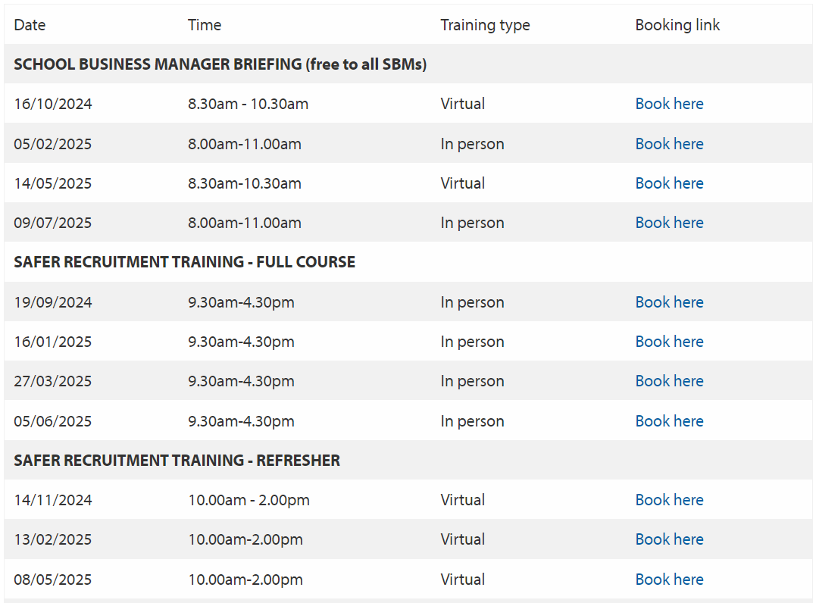
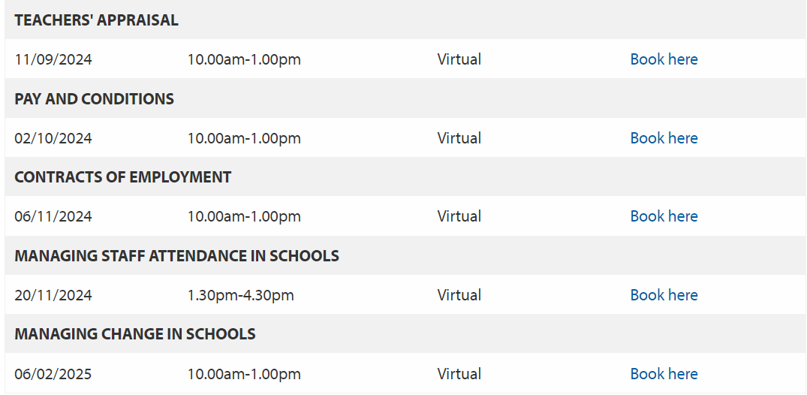
Southwark Schools’ HR Training Dates
We have updated our Training & Events page with new training dates for academic year 24/25. To view the training dates, head to the Training and Events Page.
Page x • Presentation main heading here • date

Slide 18
Sexual Harassment – New Law (1)
The Worker Protection (Amendment of Equality Act 2010) Act 2023 comes into force on 26 October 2024.
This introduces a duty for employers to take reasonable steps to prevent sexual harassment of employees in the course of their employment.
The new law will place a new duty on employers to take ‘reasonable steps’ to prevent sexual harassment. Tribunals will have the power to increase compensation by up to 25% if they find an employer has breached this duty.
Page x • Presentation main heading here • date

Slide 19
Sexual Harassment – New Law (2)
Schools HR Action:
Developing a new policy, which we will consult on and share with all schools.
Creating online training on sexual harassment.
Overlap with health and safety – as sexual harassment is part of the proposed violence and aggression policy and schools will need to report incidents on Assure.
Page x • Presentation main heading here • date

Slide 20
Sexual Harassment – New Law (3)
School considerations:
Organisational culture – senior leaders influence the working culture and set the tone for expectations around behaviour and workplace civility.
Policies and procedures: A formal policy won’t change culture on its own but it is still important to have written policies and guidance.
Training and development: Deliver training sessions for all staff so that they understand what sexual harassment is and their role in preventing / addressing it.
Reporting: Make it clear what the reporting channels are. Any evidence of discriminatory behaviour or harassment among staff needs to be investigated and acted on swiftly.
Line management capability: Line managers play an important role in identifying, challenging and dealing with unfair treatment including sexual harassment. Line managers need to have the training, education and guidance to give them the confidence to tackle sexual harassment.
Monitoring and review: Carry out your workforce monitoring. Carry out staff surveys to collect feedback in areas like gender equality and bullying and harassment.
Page x • Presentation main heading here • date

Slide 21
Minimum Service Levels
Minimum Service Levels will be repealed through the Employment Rights Bill, which will be introduced within the first 100 days of the new Government.
Deputy Prime Minister, Angela Raynor, explained the reasoning behind this repeal:
“Attempting to clamp down on the fundamental freedom of working people has got us nowhere and this was targeted at sectors who dedicate their lives to serving us all. That’s why we’re scrapping this pointless law and creating a new partnership between business, trade unions and working people through our New Deal.”
Business Secretary, Jonathon Reynolds, highlighted the benefits this repeal will bring:
“By removing minimum service levels, we will reset industrial relations, so they are based on good faith negotiation and bargaining, ending the chaos and restoring trust in public services. This is about restoring politics as public service ensuring government acts to fix problems not cause them.”
To find out more, see the below link:
https://www.gov.uk/government/news/public-services-back-on-track-as-strikes-act-to-be-repealed
Page x • Presentation main heading here • date

Slide 22
Learning point – references
QUESTION: you receive a request to release a reference request? What do you do?
Page x • Presentation main heading here • date

Slide 23
Learning point – references
ANSWER: confidential references are exempt from data access requests.
ICO Exemption for Confidential References:
https://ico.org.uk/for-organisations/uk-gdpr-guidance-and-resources/individual-rights/right-of-access/what-other-exemptions-are-there/
From time to time you may give or receive references about an individual. The personal data included in a confidential reference is exempt from the right of access for the purpose of prospective or actual:
education, training or employment of an individual;
placement of an individual as a volunteer;
appointment of an individual to office; or
provision of any service by an individual.
The exemption applies regardless of whether you have given or received the reference.
Page x • Presentation main heading here • date

Slide 24
Thank you Shereen Moussa Head of Schools HR, Southwark Council Email: shereen.moussa@southwark.gov.uk T: 020 7525 0050 M: 07841 867 956

