Slide 1


Duty to Prevent Sexual Harassment [School Training – School Name]
Add school logo
Notes:
NOTE: ADD SCHOOL LOGO - To change the image, right click on the picture and select Change Picture > from file. Choose your new image and once inserted, use Picture format > Crop to adjust

Slide 2
Sexual harassment and the new law
Legal responsibilities
Employers’ duty
Employees’ rights
Preventing sexual harassment
Reporting sexual harassment
Learning points
Welcome and objectives
Add school logo
Notes:
NOTE: SCHOOL LOGO: To change the image, right click on the picture and select Change Picture > from file. Choose your new image and once inserted, use Picture format > Crop to adjust

Slide 3
Aims of the session
Commitment to a safe, respectful workplace free from sexual harassment.
Alignment with the Worker Protection Act 2023 and Equality Act 2010.
Awareness of policy, procedures, and resources to prevent and address sexual harassment.
[School Name] • Duty to Prevent Sexual Harassment • Page 3
Notes:
SCHOOL ACTION: to link the aims of the session to the school’s policies and procedures.

Slide 4
The Equality Act 2010
Notes:
To change the image, right click on the picture and select Change Picture > from file. Choose your new image and once inserted, use Picture format > Crop to adjust

Slide 5
Talking Point – The Equality Act 2010
How many protected characteristics does the Equality Act 2010 set out?
How many can you name?
[SCHOOL NAME] • Duty to Prevent Sexual Harassment • Page 4
Notes:
TRAINER ACTION: this is to be used as an ice breaker – to get the group talking.
Give them up to five minutes for them to discuss this in groups.
Ask them how many?
Ask them how many they can name.
Go to the next slide.

Slide 6
The Equality Act 2010 – Protected Characteristics
The nine protected characteristics are:
Sex
Race
Religion or belief
Age
Sexual orientation
Disability
Gender reassignment
Pregnancy or maternity
Marriage and civil partnership
[School Name] • Duty to Prevent Sexual Harassment • Page 5

Slide 7
Understanding harassment
Notes:
To change the image, right click on the picture and select Change Picture > from file. Choose your new image and once inserted, use Picture format > Crop to adjust

Slide 8
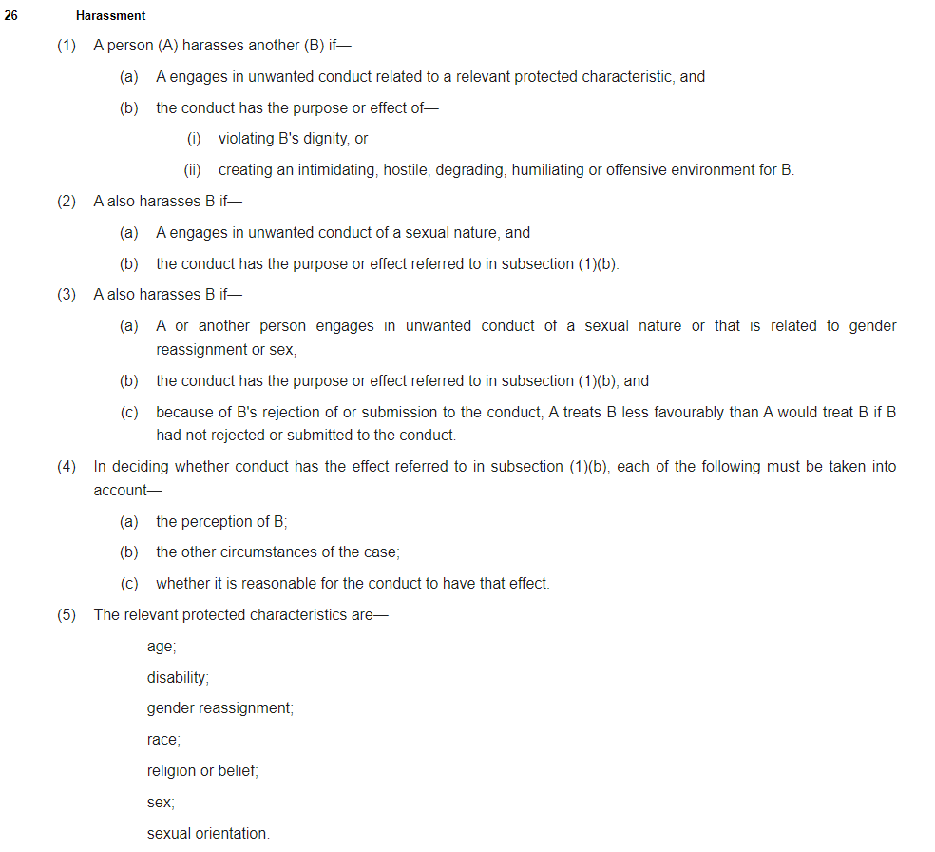
Legal definition of harassment
s. 26 of Equality Act 2010
Unwanted conduct
Related to a relevant protected characteristic
Purpose or effect of violating dignity or creating intimidating, hostile, degrading, humiliating or offensive environment
Southwark Schools’ HR Workshop • Duty to Prevent Sexual Harassment • Page 5

Slide 9
Relevant protected characteristics
What protected characteristics are missing?
Age
Disability
Gender reassignment
Race
Religion or belief
Sexual orientation
Sex
Not included in legal definition of harassment:
Marriage and civil partnership
Pregnancy and maternity
Southwark Schools’ HR Workshop • Duty to Prevent Sexual Harassment • Page 6

Slide 10
Who is protected?
Applicants
Employees
Workers
Ex-employees
Southwark Schools’ HR Workshop • Duty to Prevent Sexual Harassment • Page 7

Slide 11
Unwanted conduct
Unwelcome or uninvited
It can include a serious one-off incident or repeated behaviour
Do not need to object to the conduct for it to be viewed as unwanted
One person may tolerate as acceptable behaviour, another person may find it offensive or degrading
Conduct could be accepted at earlier stages but oversteps the mark and becomes unwanted
Examples of unwanted conduct:
spoken words
written words
banter
posts or contact on social media
imagery
graffiti
acts affecting a person’s surroundings
aggression
physical behaviour towards a person or their property
physical gestures
facial expressions
mimicry
jokes or pranks
Southwark Schools’ HR Workshop • Duty to Prevent Sexual Harassment • Page 8

Slide 12
Bullying and harassment
Bullying is unwanted behaviour from a person or group that is either:
offensive, intimidating, malicious or insulting
an abuse or misuse of power that undermines, humiliates, or causes physical or emotional harm to someone
Bullying might:
be a regular pattern of behaviour or a one-off incident
happen face-to-face, on social media, in emails or calls
happen at work or in other work-related situations
not always be obvious or noticed by others
Under the Equality Act 2010, bullying behaviour may be harassment if it relates to a protected characteristic.
Southwark Schools’ HR Workshop • Duty to Prevent Sexual Harassment • Page 9

Slide 13
Unwanted conduct related to a relevant protected characteristic
Conduct related to a protected characteristic
Employee does not have to have the protected characteristic in order to claim for harassment
Southwark Schools’ HR Workshop • Duty to Prevent Sexual Harassment • Page 11

Slide 14
Purpose or effect of violating dignity / creating and intimidating, hostile, degrading, humiliating or offensive environment
(1) Purpose
Very difficult to prove that someone intended to harrass
(2) Effect
Focus on impact on victim, rather than harasser’s motive
Take into account:
Victim’s perception
Other circumstances of the case – health, mental capacity, cultural norms, environment, previous experiences
Whether it is reasonable for the conduct to have that effect – tolerance/hypersensitivity
Southwark Schools’ HR Workshop • Duty to Prevent Sexual Harassment • Page 12

Slide 15
Examples
Someone frequently makes jokes about a female employee being “too emotional” whenever there is a deadline to meet.
Someone regularly teases another employee about their accent, making them feel self-conscious and uncomfortable.
A group of colleagues joke that their new colleague is good with numbers because of their ethnic background.
A colleague repeatedly comments on another colleague’s social media posts with derogatory or unwelcome remarks.
Employees sit together at lunch every day and consistently exclude another employee.
Colleagues have a whatsapp group chat and share inappropriate jokes, memes or images.
Someone repeatedly stands too close to a colleague, ignoring their visible discomfort or request for space.
An individual blocks a colleague’s exit during a disagreement to keep them from leaving until they “listen to them”.
Southwark Schools’ HR Workshop • Duty to Prevent Sexual Harassment • Page 8

Slide 16
Impact of unwanted behaviour
The person being harassed might feel:
Disrespected
Frightened
Humiliated
Insulted
Intimated
Threatened
It can still be against the law even if the person being harassed does not ask for it to stop.
Can you think of how else a person might feel?
Southwark Schools’ HR Workshop • Duty to Prevent Sexual Harassment • Page 8

Slide 17
Sexual harassment and the new law
Add school logo
Notes:
To change the image, right click on the picture and select Change Picture > from file. Choose your new image and once inserted, use Picture format > Crop to adjust

Slide 18
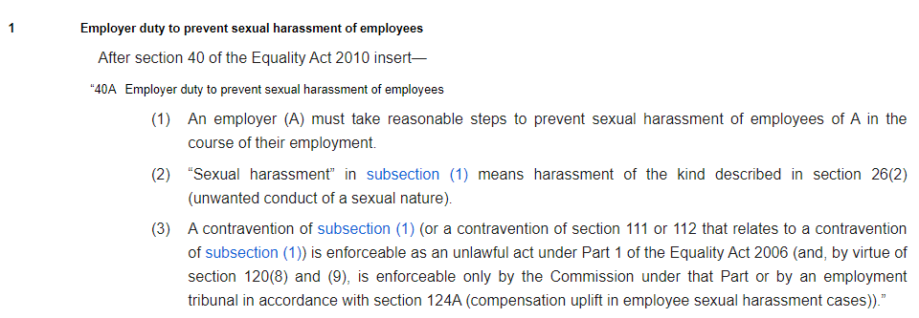
Sexual harassment and the new law
Worker Protection (Amendment of Equality Act 2010) Act 2023, s. 40A
New duties for employers effective from 26 October 2024
Take reasonable steps to prevent sexual harassment of employees
Objective test and will vary between different employers, depending on the facts and circumstances of each situation
Takes into account the:
Nature of the working environment
Time, cost and potential disruption of taking a particular step, weighted against the benefit it could achieve
[School Name] • Duty to Prevent Sexual Harassment • Page 7

Slide 19
Legal definition of sexual harassment
s. 26(3)(a) of Equality Act 2010
Unwanted conduct of a sexual nature
Purpose or effect of violating dignity or creating intimidating, hostile, degrading, humiliating or offensive environment
Prohibits less favourable treatment if victim rejects the conduct
[School Name] • Duty to Prevent Sexual Harassment • Page 8

Slide 20
Examples of sexual harassment
Conduct can be by someone of the same or different sex
Sexual conduct that has been welcomed in the past can become unwanted
Conduct does not have to be directed at the victim for it to be harassment
Examples of unwanted conduct of a sexual nature:
sexual comments or jokes
displaying sexually graphic pictures, posters or photographs
suggestive looks, staring or leering
propositions and sexual advances
unwelcome touching, hugging, massaging or kissing
making promises in return for sexual favours
sexual gestures
intrusive questions about a person’s private or sex life or a person discussing their own sex life
sexual posts or contact on social media
spreading sexual rumours about a person
sending sexually explicit emails or text messages
[School Name] • Duty to Prevent Sexual Harassment • Page 9

Slide 21
School actions
Add school logo
Notes:
To change the image, right click on the picture and select Change Picture > from file. Choose your new image and once inserted, use Picture format > Crop to adjust

Slide 22
Legal responsibilities
Third-parties:
Volunteers
Students
Parents
Contractors
Visitors
Employer’s duty to take reasonable steps to prevent harassment
The steps to prevent harassment must have taken place before the harassment occurred
Employment Tribunal will consider many factors, including whether there was a policy in place, whether the employer had previously taken disciplinary action against harassment, how effective the employer’s steps were etc
Vicarious liability and third-party harassment
An employer can be liable for harassment if an employee has carried out harassment within the course of their employment
Irrespective of whether the harassment takes place with or without the employer’s knowledge or approval
The employer can also be liable for actions whilst someone is outside the workplace e.g. work events, such as Christmas parties organised by employers – this is seen as an extension of the workplace, even if held offsite
[School Name] • Duty to Prevent Sexual Harassment • Page 11

Slide 23
School actions
Having and implementing an equal opportunities or an equality, diversity and inclusion policy and an anti-harassment and bullying policy
Regularly reviewing policies
Making all employees aware of the policies and their implications
Training to staff – what? How? When?
Part of induction procedure
Additional training for managers – in identifying and handling equal opportunities and harassment issues
Considering and acting on initiatives put forward by employees and keeping evidence of this
Clear complaints policy
[School Name] • Duty to Prevent Sexual Harassment • Page 12
Notes:
SCHOOL ACTION – school to amend / adapt this slide depending on what actions it is proposing to take / has taken

Slide 24
Employees’ rights and responsibilities
Add school logo
Notes:
To change the image, right click on the picture and select Change Picture > from file. Choose your new image and once inserted, use Picture format > Crop to adjust

Slide 25
Legal responsibilities
Employees’ rights under the Equality Act 2010
Equality Act 2010 protects employees from harassment in the workplace
Employees cannot be treated in a way that violates their dignity, or creates a hostile, degrading, humiliating or offensive environment
Employees cannot be treated unfairly if they are making a complaint of harassment or if they are supporting someone else who is doing so
[School Name] • Duty to Prevent Sexual Harassment • Page 14

Slide 26
What is expected from employees?
Code of conduct
Be aware that the school does not tolerate sexual harassment and that sexual harassment is against the law
Follow the code of conduct for appropriate behaviours on and off-site when in a working capacity
Challenge others appropriately whose behaviours may not be in line with the school’s policies and procedures
Training and policies
Engage and stay up to date on training
Read the relevant policies so that you are aware of procedures
Reporting incidents
Know where to report any incidents of sexual harassment
Know where to report any situations where you felt at risk, even if nothing happened
Report any instances of inappropriate behaviour, even if it is not directed to you personally
[School Name] • Duty to Prevent Sexual Harassment • Page 15

Slide 27
Workplace banter
Banter is often light-hearted, but it can easily cross lines, especially when jokes become personal, sexual in nature or are targeted at someone’s identity
What may seem harmless to one person may feel inappropriate or offensive to another
Important to consider the impact the behaviour is having on the recipient.
Do not need to be the recipient of the behaviour to find it offensive.
Banter may be perceived as targeted, particularly where one individual or a number of individuals with the same/similar characteristic, are often the butt of the jokes.
Just because employee has previously put up with or joined in with banter, it doesn’t mean that the conduct isn’t unwanted.
Colleagues will have differing views and feelings and differing levels of sensitivity
Inclusive and respectful workplace - being aware of your own behaviours and the possible impact
If in doubt, best to refrain from making any comments that could be interpreted as causing offence
[School Name] • Duty to Prevent Sexual Harassment • Page 16

Slide 28
Work social events
Acceptable Behaviour | Unacceptable Behaviour
Although social events may be informal, professional behaviour is still expected | Inappropriate comments, jokes or gestures
Alcohol may be available at some social events – everyone is expected to consume responsibly. | Excessive drinking is not an excuse for unprofessional or offensive behaviour.
Physical contact should be consensual, respectful and appropriate. | Unwelcome sexual advances, requests for sexual favours or other conduct of a sexual nature are strictly prohibited
 | Unwelcome touching or hugging could be interpreted as harassment
 | Sexual or derogatory comments, jokes and language are unacceptable
 | Non-consensual photography/recording (taking photos of others without their consent, especially in compromising or embarrassing situations) is not allowed
[School Name] • Duty to Prevent Sexual Harassment • Page 17

Slide 29
Reporting sexual harassment
Add school logo
Notes:
To change the image, right click on the picture and select Change Picture > from file. Choose your new image and once inserted, use Picture format > Crop to adjust

Slide 30
Reporting Sexual Harassment
Encouragement to report
Reports welcomed without fear of retaliation
Reporting channels
Directly to your line manager
To the Headteacher
To the Chair of Governors
Through a trade union representative
Through Southwark Schools HR online reporting tool
[School Name] • Duty to Prevent Sexual Harassment • Page 19

Slide 31
Reporting Sexual Harassment
Resolution options
Informal resolution: explanation of inappropriate behaviour; mediation; immediate corrective actions
Formal resolution: filing a formal complaint; investigation and actions as per disciplinary policy
Disciplinary action for confirmed harassment
Written warnings
Suspension
Dismissal in severe cases
[School Name] • Duty to Prevent Sexual Harassment • Page 20

Slide 32
Resources and support
Add school logo
Notes:
To change the image, right click on the picture and select Change Picture > from file. Choose your new image and once inserted, use Picture format > Crop to adjust

Slide 33
Resources and Support
Employee Assistance Programme (EAP) [school to provide details]
Occupational health referral [school to provide details]
Acas helpline (https://www.acas.org.uk/contact)
Trade Unions
GMB (https://www.gmb.org.uk/gmb-regions)
Unite (https://www.unitetheunion.org/contact-us)
Unison (https://www.unison.org.uk/about/contact/)
NEU (https://neu.org.uk/about/contact-us)
NASUWT (https://www.nasuwt.org.uk/contact-us.html)
NAHT (https://www.naht.org.uk/About-Us/Contact-us)
Community (https://community-tu.org/homepage/get-help-now/)
Rights of Women (https://www.rightsofwomen.org.uk/)
[School Name] • Duty to Prevent Sexual Harassment • Page 22

Slide 34
Resources and Support
After an Incident
Samaritans (https://www.samaritans.org/how-we-can-help/contact-samaritan/talk-us-phone/)
LGBT Foundation (https://lgbt.foundation/contact-support/)
Rape Crisis (https://rapecrisis.org.uk/get-help/want-to-talk/)
Victim Support (https://www.victimsupport.org.uk/more-us/contact-us/)
The Survivors Trust (https://thesurvivorstrust.eu.rit.org.uk/)
SurvivorsUK (https://www.survivorsuk.org/)
Galop (http://www.galop.org.uk/)
Reporting a Crime
Emergency: Call 999
Non-Emergency: Call 101 or report online (https://www.police.uk/pu/contact-us/what-and-how-to-report/how-to-report/)
[School Name] • Duty to Prevent Sexual Harassment • Page 22

Slide 35
Your school context and culture:
What is ok and what is not ok?
Add school logo
Notes:
To change the image, right click on the picture and select Change Picture > from file. Choose your new image and once inserted, use Picture format > Crop to adjust

Slide 36
Talking Point
How would you describe the culture now?
Is teasing and making fun of one another common?
Do you consider the behaviours to be wanted / unwanted? How would you know?
Are the behaviours appropriate / inappropriate?
What type of culture do we want to have in the school?
Does this fit in with the school’s policies and procedures?
[School Name] • Duty to Prevent Sexual Harassment • Page 24

Slide 37
Are these acceptable behaviours?
Sharing information / asking someone about their sex lives.
Sharing sexual images with others in a personal whatsapp group.
Someone frequently makes jokes about a female employee being “too emotional” whenever there is a deadline to meet.
Someone regularly teases another employee about their accent, making them feel self-conscious and uncomfortable.
A group of colleagues joke that their new colleague is good with numbers because of their ethnic background.
A colleague repeatedly comments on another colleague’s social media posts with derogatory or unwelcome remarks.
Employees sit together at lunch every day and consistently exclude another employee.
Colleagues have a whatsapp group chat and share inappropriate jokes, memes or images.
Someone repeatedly stands too close to a colleague, ignoring their visible discomfort or request for space.
An individual blocks a colleague’s exist during a disagreement to keep them from leaving until they “listen to them”.
An individual is being called homophobic names, but is not gay.
[School Name] • Duty to Prevent Sexual Harassment • Page 25
Notes:
TRAINER ACTION:
- ask the group if these behaviours are acceptable in any context.
- are they acceptable in a work context?
- what happens if the conduct occurs outside of school? Refer back to work social events.
- if the conduct happens in a personal setting, still need to be considerate of the fact that the individual is your colleague and so whilst you may socialise with someone, it does not mean that you can cross the line.
Context is important –
It is not about the intentions of the person who is carrying out the conduct. What matters is the perception of the individual and whether they believe the comments had the effect of creating an offensive environment.
An employer cannot rely on the defence that the person’s actions were not malicious or intentional.
In some cases, it will be obvious that conduct is unwanted because it would plainly violate a person’s dignity.
At the opposite end of the spectrum are cases in which many people would not like the behaviour, but the actions of the particular worker concerned make it clear that in their case, the conduct was not unwanted.
There may be circumstances in which a course of conduct is not unwanted in the earlier stages, but at some point 'oversteps the mark' and becomes unwanted.
Sharing information / asking someone about their sex lives.
This could be deemed to be sexual harassment.
2. Sharing sexual images with others in a personal whatsapp group.
This could be deemed to be sexual harassment.
3. Someone frequently makes jokes about a female employee being “too emotional” whenever there is a deadline to meet.
This could be deemed to be harassment on grounds of sex.
4. Someone regularly teases another employee about their accent, making them feel self-conscious and uncomfortable.
This could be deemed to be racial harassment.
5. A group of colleagues joke that their new colleague is good with numbers because of their ethnic background.
This could be deemed to be racial harassment.
6. A colleague repeatedly comments on another colleague’s social media posts with derogatory or unwelcome remarks.
This could be deemed to be harassment – but it may not be related to a protected characteristic. It may still be a breach of the school’s code of conduct and policies and procedures and still a disciplinary matter.
7. Employees sit together at lunch every day and consistently exclude another employee.
This could be deemed to be harassment – but it may not be related to a protected characteristic. It may still be a breach of the school’s code of conduct and policies and procedures and still a disciplinary matter.
8. Colleagues have a whatsapp group chat and share inappropriate jokes, memes or images.
This could be deemed to be harassment – but it may not be related to a protected characteristic. It may still be a breach of the school’s code of conduct and policies and procedures and still a disciplinary matter.
9. Someone repeatedly stands too close to a colleague, ignoring their visible discomfort or request for space.
This could be deemed to be harassment – it could be sexual. If it is not related to a protected characteristic, it may still be a breach of the school’s code of conduct and policies and procedures and still a disciplinary matter.
10. An individual blocks a colleague’s exist during a disagreement to keep them from leaving until they “listen them”.
This could be deemed to be harassment – but it may not be related to a protected characteristic. It may still be a breach of the school’s code of conduct and policies and procedures and still a disciplinary matter.
11. An individual is being called homophobic names, but is not gay.
This could be deemed to be harassment on grounds of sexual orientation. The individual doesn’t have to have the protected characteristic and whilst this is not a case of perceived discrimination, because what is being said relates to a protected characteristic then there could potentially be a successful claim.
QUESTION: Can someone bring a claim in relation to something they perceive has happened to someone else?
The individual does not have to have the protected characteristic themselves in order to bring a claim of harassment or be successful. The conduct needs to be related to a protected characteristic, and not to the claimant’s protected characteristic.

Slide 38
Talking Point
Can an individual who has used similar words/language and behaved the same way say they have been offended and harassed?
What is the perception of the individual who is receiving the comments?
Are there any instances where an individual who has taken part in this behaviour still would be able to feel harassed?
[School Name] • Duty to Prevent Sexual Harassment • Page 26
Notes:
TRAINER ACTION:
- To divide the group into smaller groups and ask them to discuss the questions in their groups.
- Bring everyone back together and ask them to share their thoughts.
- Pick up on common themes.
- Ask them (if they haven’t already picked up on this) to relate back top the school policies and procedures and the importance of adhering to them.
- If in doubt, best to not say / do anything that may offend.

Slide 39
School Commitments
The School commitment…. SCHOOL TO INSERT
To take all allegations seriously and treat all individuals with respect, in line with the school’s policies and procedures.
[School Name] • Duty to Prevent Sexual Harassment • Page 26
Notes:
NOTE: SCHOOL TO COMPLETE THIS SLIDE AND DELETE SECTIONS AS APPROPRIATE.
Refer to Governing Board’s commitments as an employer.

Slide 40

Any questions?
Add school logo
Notes:
To change the image, right click on the picture and select Change Picture > from file. Choose your new image and once inserted, use Picture format > Crop to adjust

