Slide 1
Physical activity and mental health
March 2018

Slide 2
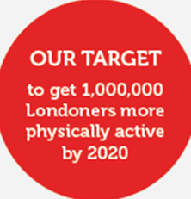
.
Who are London Sport?
London Sport are the County Sport Partnership for London

Slide 3
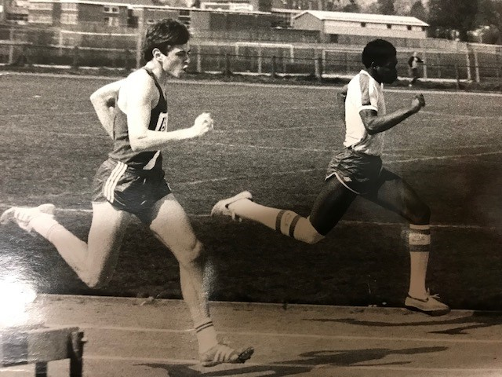
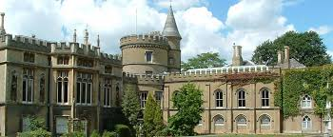
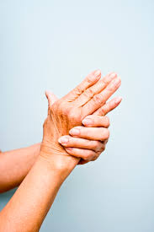
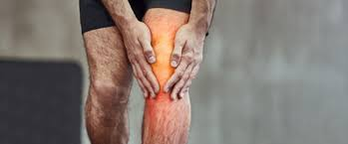

Slide 4
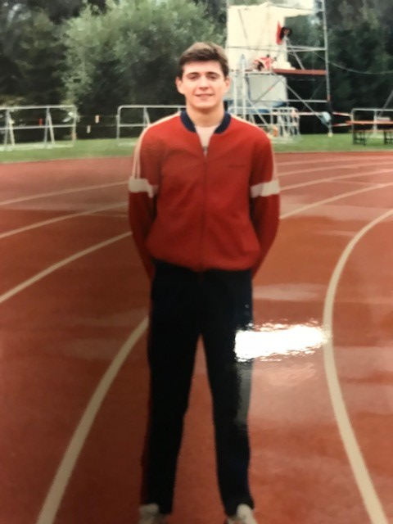

Slide 5
Question…..How do you feel today?
Notes:
With the person next to you – any ideas? 60 secs to discuss
Ask for 1-3 ideas?

Slide 6
Overall, how happy did you feel yesterday?
Is this how you usually feel?
Yes
No

Slide 7
This survey that measures young people’s
involvement in sport and physical activity
across the whole country
Detailed picture of the physical activity
habits of children and young people in England
Understand children's attitudes and behaviours
around sport and physical activity
Active Lives CYP
Notes:
There are three different surveys for young people, each designed using language and images that the age group will understand.
Years 1 and 2, Years 3-6, Years 7-11
Each term, a number of schools will be randomly selected to take part in the survey, with the aim of getting 100,000 children and young people in Years 1 to 11 to complete it each academic year.

Slide 8
What is mental health?
‘Mental health is a state of wellbeing in which every individual realises his or her own potential, can cope with the normal stresses of life, can work productively and fruitfully, and is able to make a contribution to her or his community’
Source: World Health Organization
Mental wellbeing describes the wider set of thoughts and feelings that influence our emotions and day-to-day behaviour.
Source: Mind
Notes:
Just as we can look after our physical health, we can do to take care of our mental wellbeing too.
Looking after our mental wellbeing can play an important role in developing our ability to cope with the ups and downs of life.

Slide 9
Physical activity and mental wellbeing
Prevention
Treatment
Notes:
With the person next to you – any ideas? 60 secs to discuss
Ask for 1-3 ideas?

Slide 10
Physical activity and mental wellbeing
Prevention
Treatment
Notes:
With the person next to you – any ideas? 60 secs to discuss
Ask for 1-3 ideas?

Slide 11
Prevention is so important….
Young people aged 10-19 years account for more than half of hospital admissions for eating disorders, with the largest number among young women aged 15
13% of boys and 10% of girls aged 11-15 have mental health problems
32% of 15 year old girls and 11% of 15 year old boys report self-harming
Half of all lifetime cases of psychiatric disorders start by age 14 and three quarters by age 24
Some estimates suggest the majority start before age 18
(Source: Association of Young People’s Health, 2016)
Notes:
With the person next to you – any ideas? 60 secs to discuss
Ask for 1-3 ideas?

Slide 12
How do you feel after exercise?
Happy Relaxed Tired
Exhausted Hot Sweaty
Proud On a high
Clear in mind Energised
More productive Calm Confident Self-assured
Notes:
Are these good things? Would you like your young people to feel like this?

Slide 13
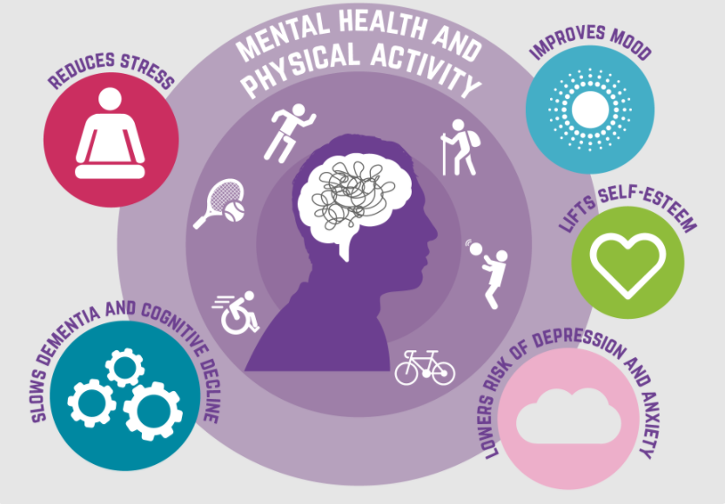
Positive impact on physical activity can have on mental health
Notes:
With the person next to you – any ideas? 60 secs to discuss
Ask for 1-3 ideas?

Slide 14
More than half of women (57%) do not participate in sport because they were not good at PE at school while nearly half (43%) feel it is too competitive.
85% of women with mental health problems did not participate in sport because they don’t feel confident in their sporting ability.
More than half (56%) told the charity they are not ‘gym body ready’, saying they are not members of sports clubs, gyms or leisure centres, because they are embarrassed about their body shape or size.
Notes:
With the person next to you – any ideas? 60 secs to discuss
Ask for 1-3 ideas?

Slide 15
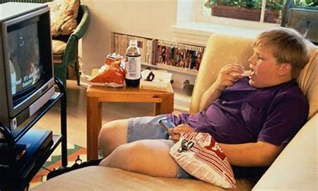
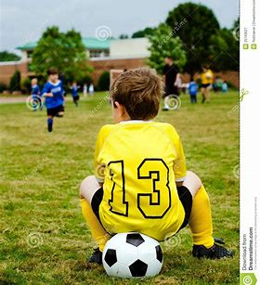
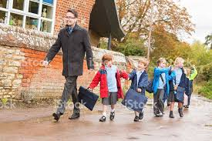
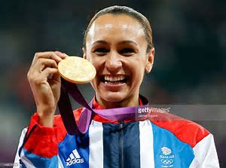
Notes:
Its not about Olympic medals or school trophies, its about eating less and less scree time, its about active travel and moving more
Its about feeling included rather than excluded, its about being happy and achieveing more because of that social, emotional and mental wellbeing

Slide 16
Question…..
What should we be doing?
Answer…
Encouraging children to move more, play more and be more active
Notes:
For some people this is sport, for many it is playing – don’t assume that every child needs sport, they all need physical activity

Slide 17
Encourages children to run, walk or jog for 15 minutes every day in their school. It is a physical activity which promotes social, emotional and mental health and wellbeing, as well as fitness. It takes place outside in the fresh air during the school day at a time of the teacher’s choosing

Slide 18
Fitt-in provides an online solution to help reduce pupil sedentary time, without the need to leave the classroom. On screen graphics, music and choreographed routines, immediately engage pupils.
With videos regularly added to the play list, this is a tool that schools can use for years. Weekly reports highlight levels of activity and evidence impact

Slide 19
The Outdoor Play and Learning (OPAL) Primary Programme supports schools in developing a cultural shift in thinking about and supporting children’s play. The programme embeds play into school’s policies and practices and establishes clear guiding principles and strategies for initiating changes at playtimes

Slide 20
A simple, manageable and sustainable fitness framework for all 7-11 year olds, helping kids to be the best they can be
Children complete five core fitness challenges. Each child’s overall score matches one of eight fitness badges from red to pink.
The scheme tracks fitness progression and provides exercise motivation for all children, while developing a school culture for health and fitness.

Slide 21
Marathon Kids gives children the opportunity to run or walk up to four marathons throughout the school year.
The programme encourages children of any fitness ability to set and reach personal goals. It's a fully sustainable school running programme supported with evidence based tools and a digital tracking system.

Slide 22
Where do I find more?
www.schoolsportsupplier.co.uk

Slide 23
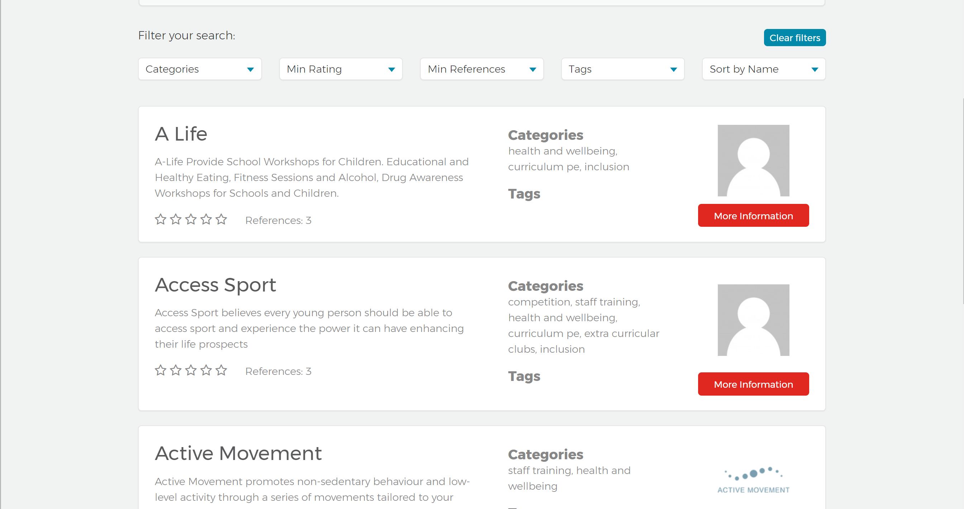
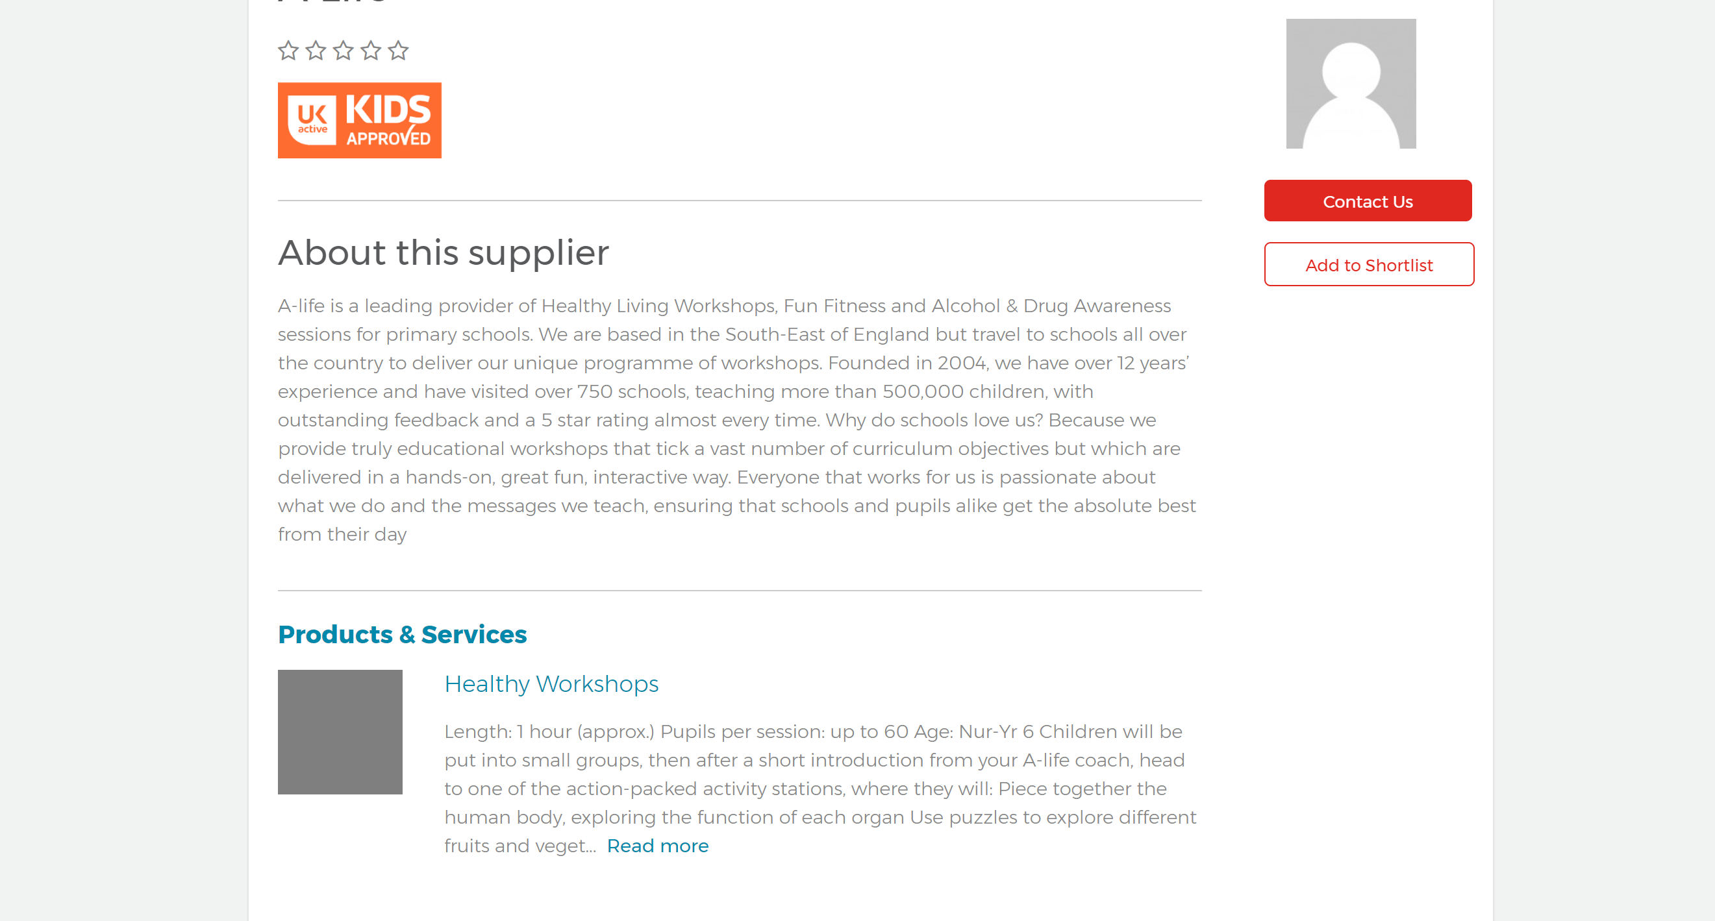
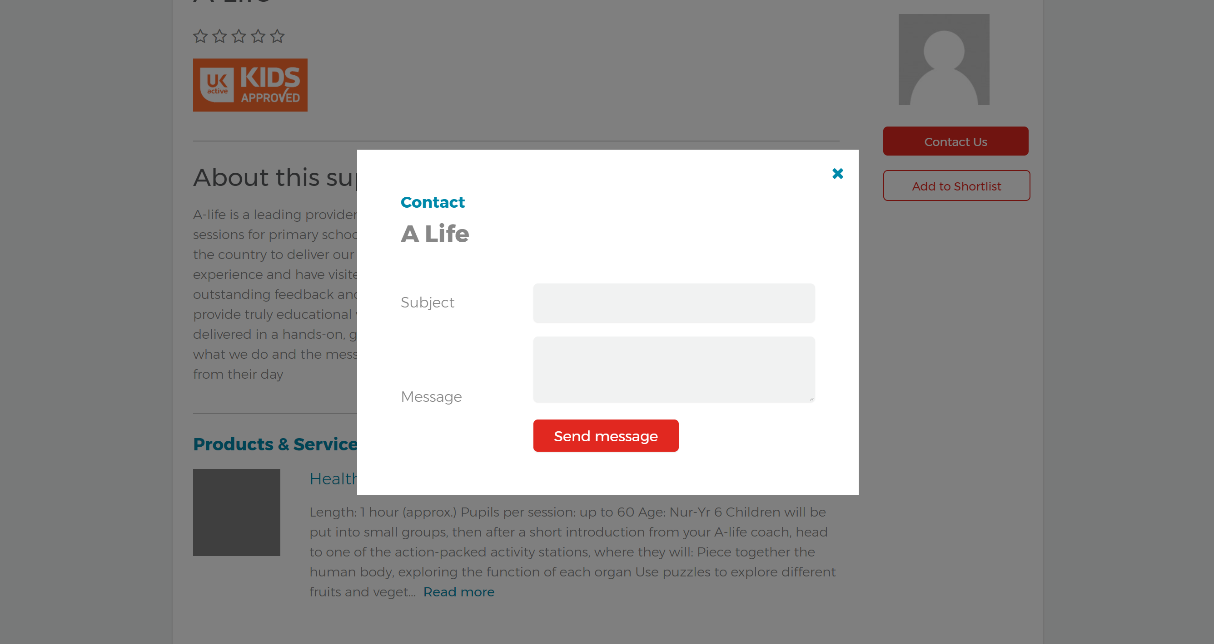
USER JOURNEY
1
2
3
4
SEARCH
RESULTS
FIND
MESSAGE
Notes:
Created at the request of teachers who asked us to
make it easier for schools to find providers who can
meet their needs. They asked for:
An online directory (‘a school sport google’)
Search functions
Filters
Customer ratings
Simple
All providers should meet a basic minimum standard

Slide 24
Do what you can and do it well
Work in partnership to maximise your resources
Have a vision of sustainability
Gary Palmer
gary.palmer@londonsport.org
@garyapalmer66

