Slide 1
Emotional well being and Family Early Help support – what’s on offer
Jenny Brennan - Assistant Director Family Early Help and Youth Justice
Carol-Ann Murray - Joint Commissioning Manager

Slide 2
Emotional Well Being
Crucial to address emotional well being at schools to avoid poor outcomes (exclusion and attainment)
At any one time ~1 in 4 people has a common mental health problem over half of problems start by the age of 14 and 75 per cent by 18

Slide 3
Family Early Help resource
Whole family work to improve outcomes re attendance, anti-social behaviour, worklessness, and impact of domestic abuse and parental mental health issues
Parenting Programmes
Parental Mental Health Team
Early Help CAMHS practitioners

Slide 4
Update on service provision
Staff –
Manager (vacant)
Maria-Luz Herrero-Verona (Peckham, Nunhead and Peckham Rye)
Alexandra Holt (Borough, Bankside and Walworth)
Alex Barton/Katie Durka (Camberwell and Dulwich)
Jo Skeldon (Bermondsey and Rotherhithe)
Structure
Relationships with other CAMHS services
Relationships with Family, Early Help and Youth Justice
Notes:
We are locality based. This allows good working relationships within a geographical location - schools and gps
We work with FSOS and EWOs in our localities.
WE are a tier two service, who has good working relationships with the child and family adolescent, and the neurodevelopmental teams
Sitting within the family early help and youth justice directorate.

Slide 5
What is our offer?
Consultation and liaison
Assessment, formulation, intervention
Types of referrals we receive and support we offer
What are our timeframes
Notes:
We plan interventions based on assessments and a formulation framework – early intervention – short term work
Common referrals we receive are around difficulties with feelings, behaviours and relationships. The child does not have to have diagnosed mental health difficulty.
e.g. worry, sadness, or anger that is getting in the way of life.
Challenges in relationships with staff or peers
Challenges in managing expected behaviour in class.
We formulate using broad range of information about family and wider context, and provide interventions that are tailored –
Range of locations, range of ‘people in the room’, range of therapeutic techniques (e.g CBT for anxiety or depression, narrative therapy ‘getting in charge of anger’).
This may required coworking or onward referral to colleagues – eg. EP, parenting programmes
We receive cafs through duty and allocation meetings are weekly on thursdays. We in most cases we will speak to referrer and or family within the week.
We are doing our best to avoid a waiting list – but will be unlikely to for much longer.

Slide 6
Making a good referral
Speaking to the families first! Consent.
What we need to know
What help do they need and want?
Presenting problem and contexts
Including any safeguarding issues
What you may have tried first
Assessments and the role of TAC/Fs
Feedback you can expect from assessment process
Notes:
Well begun half done by speaking to families to ensure good engagement. Manage expectations. Normalising early intervention. Helping us when parents arent picking up the phone.
Well completed cafs including whole family knowledges.
Working systemically - particularly if difficulties are apparent at school.
W

Slide 7
Going forward
Review of CAMHS and emotional well being support
Remodelling of Family Early Help
Collaborative working and external funding:
Family Group Conferences for Early Help and Domestic Abuse situations
Kidstime for parents with mental health difficulties and their children
In your corner – boxing and mental health

Slide 8
Current pathways to CAMHS support

Slide 9
SLAM
Early Help Locality Team
Specialist
Adolescent Team
Child and
Family Service
Child and Adolescent Mental Health Neuro-Developmental Service
Carelink
(Looked After Children Service)
Functional Family Therapy (Families First Team)
Early Help
CAMHS Team
Service available to
Children & young people (CYP) 12 to <=18 yrs
CYP <= 12 yrs
Trauma abuse: CYP <= 18 yrs
CYP <= 18 yrs
Looked after CYP 0 to <= 18 yrs
CYP 10 to <= 17 yrs and their family
CYP <= 18 yrs and their families
CYP experiencing severe and complex mental health problems: depression, anxiety, self-harm and psychosis
All ADHD over 12
Youth offenders with severe and complex mental health problems
Child and family relationship difficulties
Emotional problems
Behavioural problems
Attention and concentration difficulties
Anxieties and depression
Trauma and loss
Abuse including sexual abuse
Self-harm
ADHD with co-morbid conduct difficulties <= 12 yrs
CYP with complex developmental disabilities (mainly intellectual disability, autism spectrum disorders) associated with known or suspected mental health challenges and/or challenging behaviours
ADHD with co-morbid neuropsychiatry under 12
Emotional difficulties e.g. anxiety, depression, anger, mood swings, low self-esteem
Behavioural difficulties e.g. violence, destructiveness, self-harm, over activity, sexualised behaviours, obsessive compulsive behaviours
Relationship difficulties e.g. problems in the family, with peers, in school or community
Developmental difficulties e.g. wetting, soiling, problems with eating or sleeping, problems with communication
Family relational difficulties / violence
Behavioural and emotional difficulties at school, home and in the community
Antisocial behaviour, conduct disorder
Where substance abuse co-exists with behavioural and relationship problems
Breakdown in the home/relationship
Going missing/staying out late
Early Intervention for mild, to moderate, mental health issues
Assessment and short-term therapeutic intervention for CYP, up to the age of 18, who have mental health problems e.g. poor school attendance because of home and/or school-based problems
Mental Health Issues
Experienced
Who can refer
General practitioner
Schools
Social Services
General practitioner
Parent or Carer
Teacher
Social Services
General practitioner
Other health professional
Teacher
Social Services
Referrals preferred from the child’s allocated Social Worker but other professionals and their carers can refer
General practitioner
Other health professional
Teacher
Family member
General practitioner
Parent or Carer
School / community
Social Services
Major mental illness with significant disturbance of functioning, in high risk
Child <=12 yrs of age presenting with mental health issues as described above
Child <=18 yrs of age who has experienced trauma (including sexual abuse)
Up to 18 years old, with known or suspected mental health challenges as above, registered to General Practitioner in London Borough of Southwark
Up to age 18 years
In care
Some adopted CYP (through CSC Post-Adoption Support referral route)
Families with a 10-17 year old displaying challenging behaviours (aggression, conflict, risky relationships, running away) in two or more settings: school, home and community
Child <=18 yrs of age presenting with mild to moderate mental health issues as described above
Referral criteria
Assessment and treatment of major mental illnesses using the following modalities
Cognitive Behavioural Therapy (CBT)
Mindfulness
Family Therapy
Medication management
Assessment
Parent and child work
Individual sessions for the child
Family therapy
Parenting interventions
CBT
Consultation
Medication prescription
Trauma-focused therapy
HOPE Project
Specialist Multidisciplinary assessments
Parenting advice, support and parent groups,
Family work,
Behaviour modification programmes incl.CBT
Individual counselling,
Medication,
Mental health promotion & education,
Liaison & consultation
Mental health and therapeutic services for LAC, their carers and their professional network
Assessment
Treatment
Consultation
Intensive family therapy for CYP and their families in the home
Shifts focus away from negative and blaming interactions on individuals, to a helpful and supportive way of building and strengthening relationships in families
Assessment of the problem
Parent/child or family work
Individual sessions for the child
CBT
Parenting interventions
Consultation
Services provided
1st Floor Mapother House
De Crespigny Park
London SE5 8AZ
Tel: 020 3228 7777
Reception: 020 3228 7777
Lead Clinician: Dr Partha Banerjea: 020 3228 7750
Email: CAMHS.SouthwarkReferrals@slam.nhs.uk
Child and Family Service
Address as per Specialist Adolescent Team
Tel: 020 3228 7777
Lead clinician: Dr Tara Weeramanthri 0203 228 7754
Henry Ker: 020 3228 7774
Email: CAMHS.SouthwarkReferrals@slam.nhs.uk
Child and Adolescent NDS
4th Floor Sunshine House
27 Peckham Road
London SE5 8UH
Tel: 020 3049 8269
Duty clinician: 020 3049 8269
Team Manager: 020 3049 8269
NDSAdmin.Southwark@slam.nhs.uk
Carelink - CAMHS for Children in Care
Lister Primary Care Centre (1st Floor)
101 Peckham Road,
Peckham
London SE15 5LJ
Tel: 0203 049 8470
Duty clinician: 0203 049 8470
Lead Clinician: Elizabeth Murphy: 07976782025
Email: Southwark.Carelink@slam.nhs.uk
Functional Family Therapy Service
1st Floor Ann Bernadt School
29 Chandler Way
London SE15 6DT
Tel: 020 7525 2432
Karen Burgess: 07710921753
Duty Clinician: 0207 525 2432
Email: FFTsouthwark@southwark.gov.uk
Early Help Service
Duty Manager
Team Lead: Dr Donna Oxley
Tel: 0207 525 3893
Email: earlyhelp@southwark.gov.uk
Contact details

Slide 10
Other sources of support

Slide 11
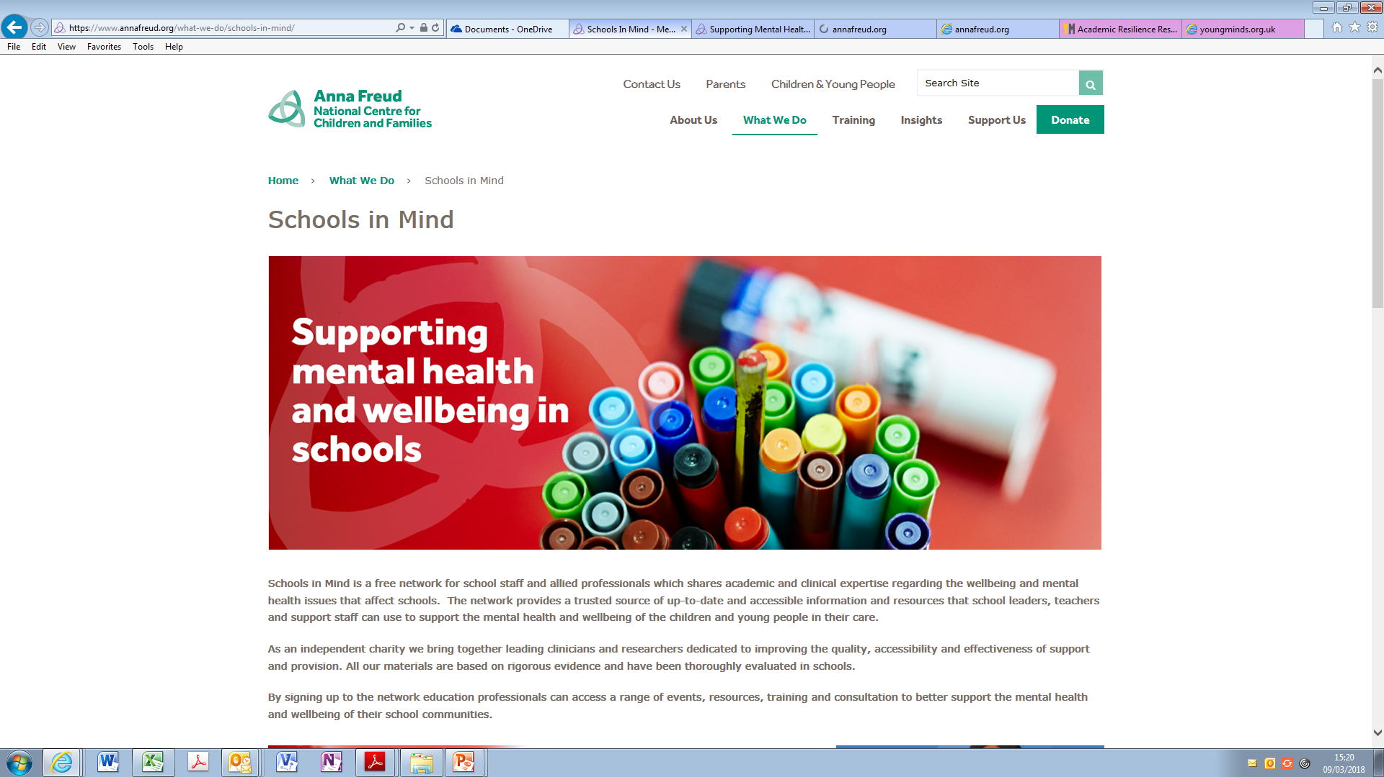
Anna Freud Centre – Schools in Mind

Slide 12
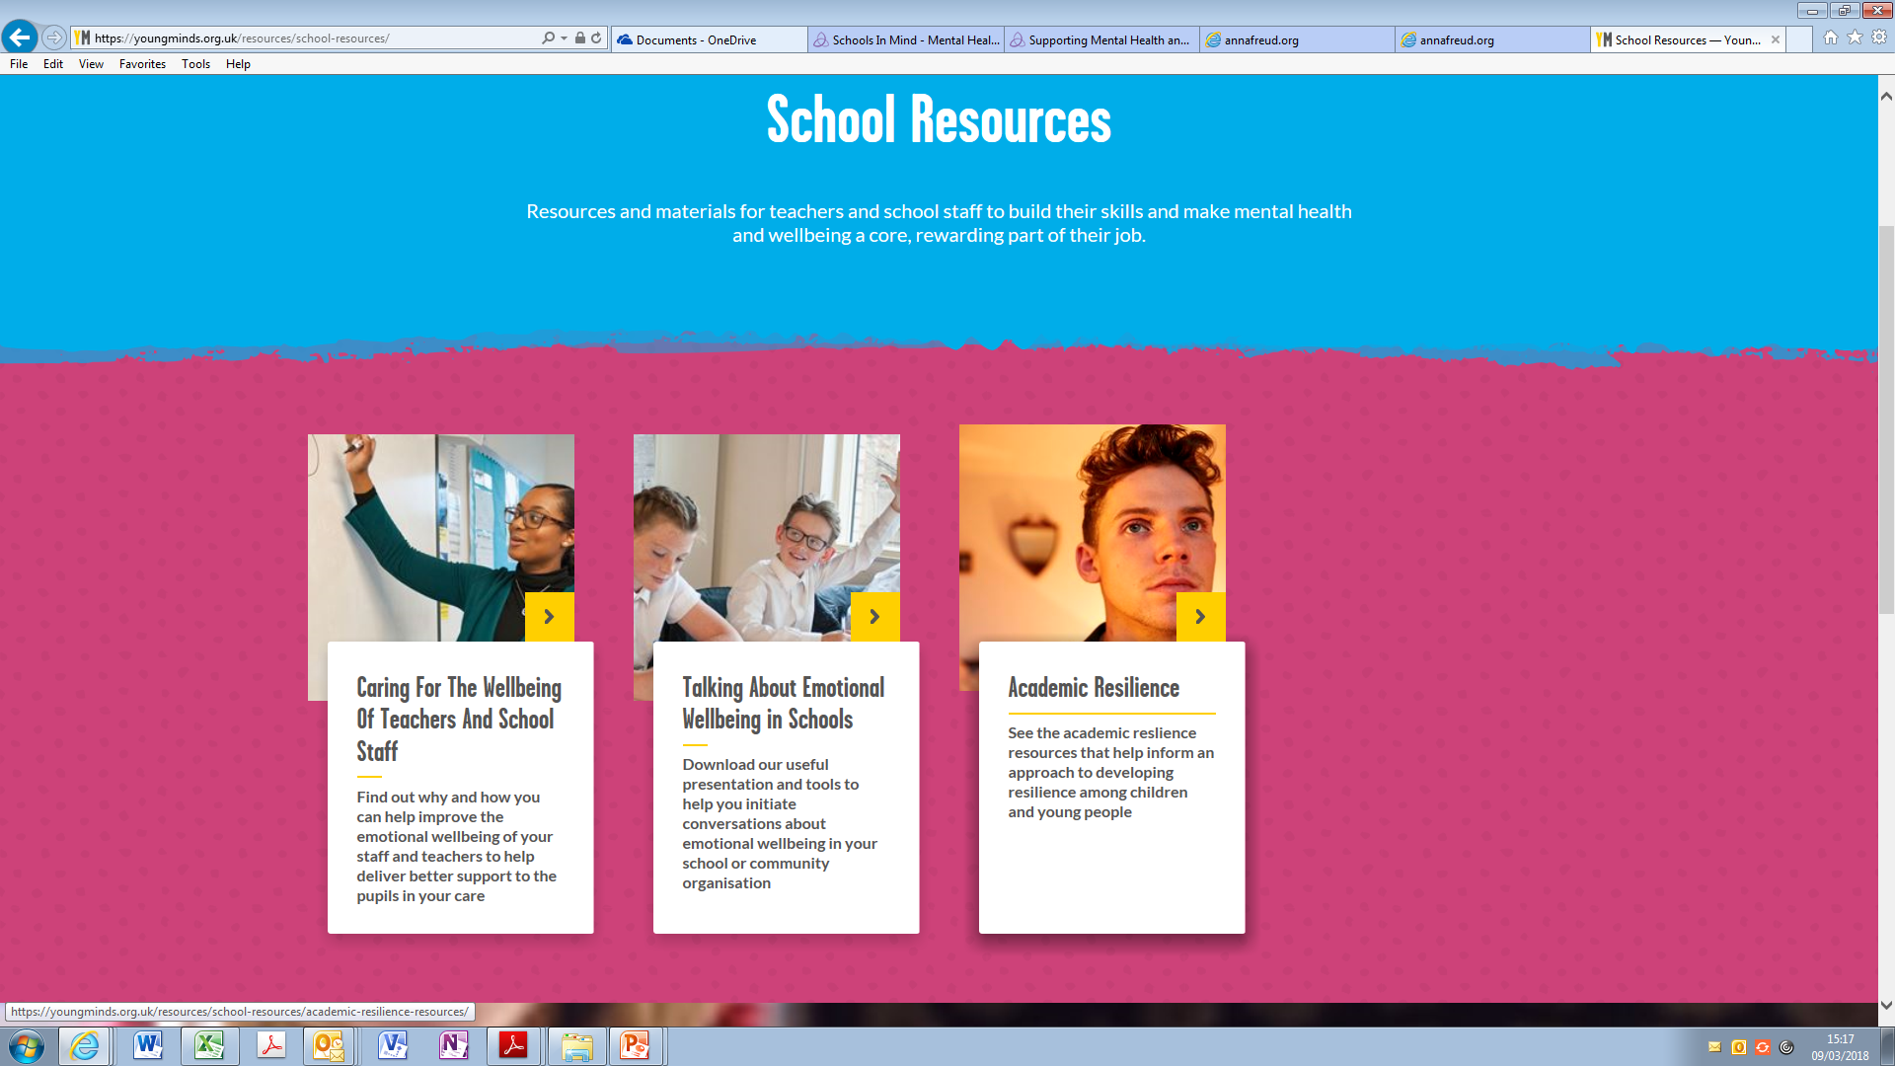
Young Minds

Slide 13
Discussion questions for tables
What’s working well in your school to address emotional well being…what difference is it making? What impact is it having on whole school, pupils, families?
What are you still worried about?
Ideas for action – Even better if….
Feedback (each locality)

