Slide 1
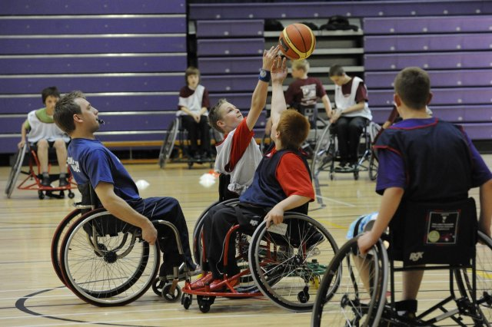
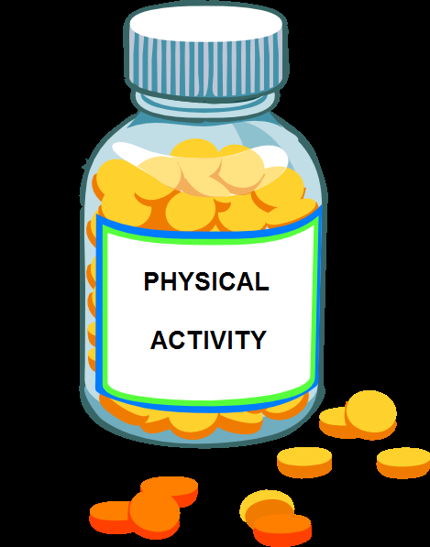
The wider health benefits of physical activity- what works best?
Notes:
Game – Answers on walls, get people to move to locations when asked Q’s:
Q – How many minutes of moderate activity should adults be doing a week? (150mins)
Q – How many minutes of vigorous activity should adults do a week? (75mins)
Q – How many minutes of moderate activity should children 5-18 years be doing a day? (60mins)
Q – How many minutes of activity should children 0-5 years be doing a day? (180mins)
Q – As a percentage what reduction to onset of Type 2 diabetes can be achieved if meeting PA guidance? (-40%)
Q – As a percentage what reduction to colon and breast cancer can be achieved if meeting PA guidance? (-20%)
Q – As a percentage what reduction to Falls, Depression and Dementia can be achieved if meeting PA guidance? (-30%)
Q – As a percentage what reduction to onset of Cardiovascular Disease can be achieved if meeting PA guidance? (-35%)

Slide 2
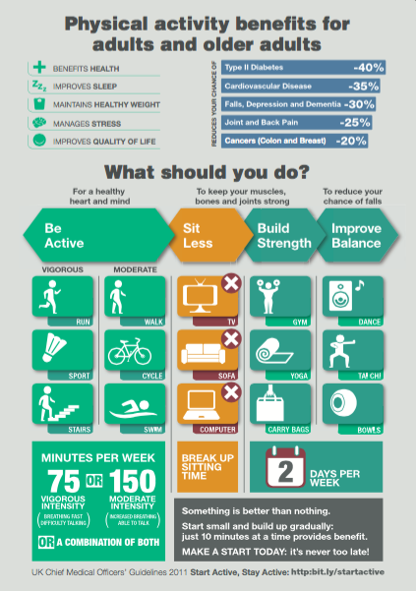
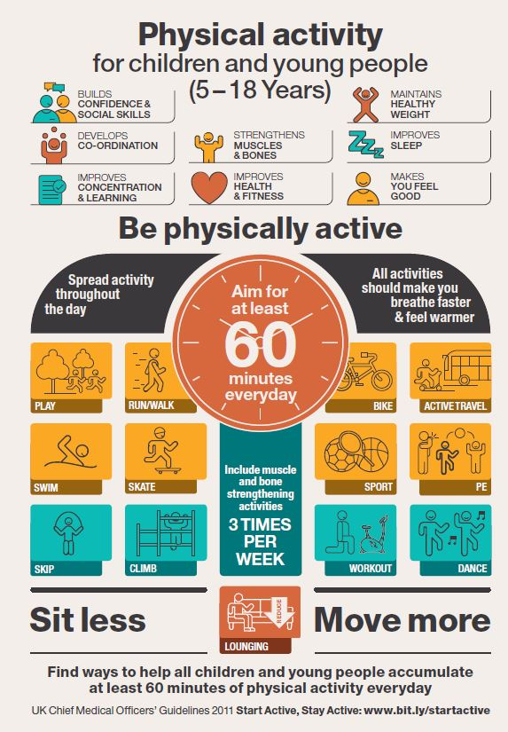
Why do we do physical activity?
Notes:
Research suggests:
Rate of academic learning per unit of class time is enhanced in physically active students
PA leads to faster cognitive processing speed
PA leads to improved concentration and memory
PA provides cognitive benefits for children with disabilities by turning on the attention system including sequencing, working memory, ability to prioritise, increased attention span
Active children are more likely to be active adults
Physically active students reflect:
Reduced absenteeism in school
Enhanced mental wellbeing including positive self esteem, confidence, and lower levels of anxiety and stress
Around 2/10 children meet the PA guidelines; 21% Boys & 16% Girls
Key indicator for PE Premium money
http://www.psychiatrictimes.com/child-adolescent-psychiatry/mental-health-benefits-exercise-children
Key Indicator 1 – Engagement in poupils with 30mins of activity

Slide 3
Notes:
The evidence shows that doing at least 60 minutes of moderate to vigorous physical activity a day can prevent the majority of these health conditions

Slide 5
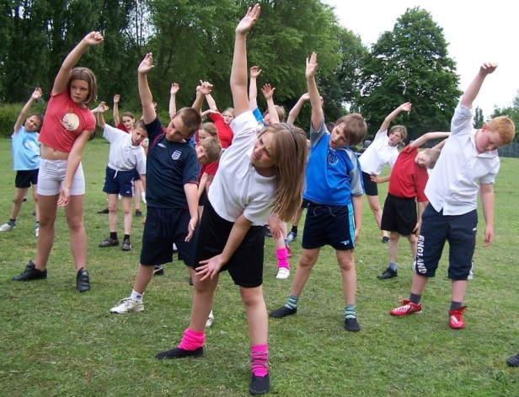
What works best to increase physical activity in schools?
Notes:
What Works in Schools and Colleges to Increase Physical Activity?
A briefing paper was prepared by Public Health England, the Youth Sport Trust and the Association of College Sport and supported by the Department of Health; the Department for Transport; the Department for Culture, Media & Sport; and the Department for Education.
Its purpose was to inform Head teachers, principals, staff working in education settings, directors of public health and other partners (October 2015)
Eight principles were drawn from an appraisal of evidence about what works in schools and colleges to increase levels of physical activity among children and young people.
We are going to take you through the 8 principles and give you an associated case study from the report.
Depending on time we will discuss in groups what principles you may already have embedded in your school.

Slide 6
Principle 1 – Whole Community Approach
Adopting a whole community approach appears to be most effective
- PA across curriculum (in PSHE / classrooms / playtime / after school)
- Culture, ethos and environment supports PA
- Engagement of the wider community (People / place / networks)
NICE recommends multi-component physical activity programmes that include education about the benefits of physical activity, creating a more supportive school environment, and engagement of the family and local community.
Notes:
Engaging families and the community in education and delivery of physical activity.
[ National Institute for Health and Care Excellence – promote health improvement through evidence based guidance ]

Slide 7
Principle 1 – Featherstone Primary
Used the Change4Life Sports Club programme to develop “Activ8” targeting the least active children and their parents.
The club helped create a positive partnership with families, helping them to understand the wider benefits of physical activity and the links with learning. This has led to opportunities for parents and young people to be leaders in the club.
Positive reported outcomes include improvements in pupil attendance and behaviour, as well as greater levels of parental engagement and support for their children’s learning. The children are increasing their levels of physical activity and self-esteem/resilience, they are making more progress in writing and reading, and are engaging more proactively with PE and clubs.
Notes:
-By developing a unique and inspiring club environment it has been able to provide engaging and fun activities that build the confidence and competence of children to be more physically active.
-Children use a personal logbook to track their progress against levels of physical activity, health behaviours and club values.
-The club is seen as an integral part of the wider curriculum offer for pupils, alongside the school food and PE curriculum and the school is now evaluating the impact on pupil achievement and attainment.
-Some children are also putting themselves forward for school council roles. The school is now developing the concept of its club to include celebration events and award ceremonies and is planning to expand the reach of the club to more year groups.

Slide 8
Principle 2 – A skilled workforce
Evidence supports the need for an appropriately trained, skilled and knowledgeable workforce.
Ensuring staff have confidence and competence to offer quality experiences of both physical education and physical activity across the school/college day can contribute towards higher levels of physical activity.
NICE recommends that all staff and volunteers should have the necessary experience and skills to design, plan and deliver physical activity sessions that meet children and young people’s needs and abilities.

Slide 9
Principle 2 – Easington CofE Primary
The subject co-ordinator for PE was involved in Start to Move, a Youth Sport Trust programme, that supports teachers to deliver quality physical literacy and sport.
The subject co-ordinator has used his training, skills and the resources as part of his team-teaching with other staff.
The resources have helped teachers to support the development of pupils’ social skills in and through PE at Key Stage 1. The school has been praised by Ofsted, with a recommendation that the school records pupil impact.
Notes:
-Unlock the potential of pupils as a means for increasing physical activity.
-Teachers have reported that pupils are now keener to participate in physical activity and are doing so through extra-curricular provision.
-The school has since initiated a survey to track pupil’s participation in PE through school sport and into community participation to ensure that pupils are being supported to lead a healthy lifestyle beyond school.

Slide 10
Principle 3 – Giving a voice
Giving students a voice and enhancing their ownership of physical activity delivery to ensure that they are appropriately tailored to their needs can support participation.
In addition, encouraging young people to act as role models can have an aspirational impact and encourage younger age groups to follow their elders.
NICE recommends that children and young people
should be actively involved in planning physical activities.

Slide 11
Principle 3 – Trinity School & Sport College
Pupil voice and pupil needs are central to the planning in this school. The school recently undertook a survey with pupils who attend after school clubs to review their current provision.
In response, the school worked in partnership with a local club, gained external funding and completed a ten week block of work where pupils achieved a karate belt and could join with a local club if they wished.
The club promoted the pupils’ independence and resilience to their learning and a target setting approach to their success as a learner.
Notes:
-From this consultation they found that pupils would like the school to run a karate club.
-Pupils kept their karate suit and this allowed them to have a seamless transition and continue with their karate.

Slide 12
Principle 4 – Create active environments
Access to, and integration in the school / college day of, open space, forests, parks and playgrounds are positively associated with physical activity levels.
NICE recommends that safe opportunities, facilities and equipment should be made available to encourage all children and young people to take part in physical activity
Notes:
Access to loose and fixed equipment, along with non-traditional play materials (for example, car tyres or milk crates) also support physical activity among children and young people.
Schools and colleges are also encouraged to make their facilities available at different times (including early morning, late afternoon, evenings, and in the holidays)

Slide 13
Principle 4 – Woodhill Primary School
Woodhill took a radical approach to changing the look and feel of its outdoor space and playground by applying and accessing the Primary Spaces Fund.
This approach has led to the redesigning of the playground, new logos and PE kit for the school, a change to the activity offer for the community, funding being made available for the training of young leaders and adult deliverers and the implementation of a ‘play before lessons’ culture.
Notes:
This involved the design and development of an inspiring and engaging space for children at the school and within the local community to be more physically active and improve the quality of their PE provision.
This has led to a 20% increase in community activity on site, 36% increase in physical activity levels across the school and the engagement of early years and community (such as brownies and scout groups) providers to use the space.

Slide 14
GROUP DISCUSSION
What are you doing related to the themes mentioned?
What has been successful?
What are the challenges?
What would help you?

Slide 15
Principle 5 – Offer choice and variety
Offering a variety of physical activity opportunities for young people to take part in, including free play can increase participation in physical activity.
In addition, a focus on games and the fun elements of participation, as well as the more traditional sports or competitive activities, can help to encourage participation, particularly among inactive children and young people.
NICE recommends that children and young people should have the opportunity to explore a range of physical activities to help them identify those they enjoy and maintain children and young people’s interest and motivation.

Slide 16
Principle 5 – Bolsover Junior School
With the help of pupil premium money and other investment, the school recruited a specialist lunch time assistant and established an inclusive activity zone at break times. The school also had the help of young playground leaders to offer a variety of physical activities and sports to engage every child in active play between lessons.
As a result of the five times a week programme more young people are physically active on a regular basis. There is improved behaviour at lunchtimes with fewer incidents for staff to deal with, and better concentration and behaviour in the afternoon.
Notes:
Activities range from creative dance, throwing and catching games, self led orienteering, circus skills and tag and chase games as well as a traditional mix of school sports.
The school decided to deliver literacy in the afternoon rather than during the morning because the children were more focused in the afternoon, after they had been active at lunchtime.

Slide 17
Principle 6 – Embed PA in teaching
Increasing the amount of time spent being physically active during
PE and other lessons can improve both physical development, educational outcomes and emotional development.
It should provide opportunities for pupils to become physically confident in a way which supports their health and fitness. Opportunities to compete in sport and other activities build character and help to embed values such as fairness and respect.
The national curriculum for physical education aims to ensure that all pupils develop competence to excel in a broad range of physical activities, are physically active for sustained periods of time, engage in competitive sports and activities and lead healthy, active lives.

Slide 18
Principle 6 – North Wingfield Primary
The school wanted to introduce the Forest School concept to impact on the curiosity, communication and co-operation skills, teamwork, and motor skill development of year 5 and 6 pupils and ultimately increase physical activity with their parents.
The 14-week programme was a mixture of delivery in school and a local forest. The school used pupil premium funding to pay for transport costs and support the professional development of the school workforce.
This encouraged young people to be active while learning. Teachers have also remarked on improvements in the classroom relating to increased compliance and improved behaviour, greater concentration in written tasks and a greater motivation across other curriculum subjects.

Slide 19
Principle 7 – Promote active travel
Interventions to encourage active travel can play a key role in contributing to children and young people’s physical activity levels. Travel plans, which include a range of active travel options, have all been found to increase physical activity levels among children.
NICE recommends that schools should encourage a culture of physically active travel; developing a school travel plan and aligning it with other local authority plans is encouraged.

Slide 20
Principle 7 – Cale Green Primary
Cale Green has worked with Sustrans since 2011. When first starting working with the school, 26% of the children were driven to school. This has now reduced to 6%.
By working in partnership with Sustrans, two thirds of pupils now regularly cycle, walk or scoot to school. On activity days this can leap to more than 90%. This was achieved in the following ways:
Learn to ride sessions. - all pupils left the school in Year 6 being able to ride
Dr Bike sessions - Regular visit to the school to fix pupil’s bicycles
Bike Breakfasts - pupils that travel actively are given a free breakfast
Route Planning.
Ditch the Stabilisers sessions.
Notes:
The Modeshift STARS programme awards schools bronze, silver or gold stars according to how effective they are at persuading pupils to choose greener and healthier ways of getting to and from school.

Slide 21
Principle 8 – Embed M & E
Effective evaluation of physical activity interventions is considered to be a cross cutting principle that requires
the identification of appropriate baseline information, interim outputs/milestones and appropriate outcomes linked to the physical activity interventions.
NICE recommends that physical activity initiatives aimed at children and young people are regularly evaluated. Evaluations should measure uptake among different groups (for example, among those with disabilities or different ethnic backgrounds). Any changes in physical activity, physical skills and health outcomes should also be recorded.

Slide 22
Principle 8 – St Godric’s RC Primary
Living Streets aims to make streets safe, attractive and enjoyable spaces. The school has taken part in Living Streets’ Walk once a Week scheme. This has included using Living Streets’ Travel Tracker, which is a digital alternative to wall charts.
As part of Walk Once a Week, the school has also established two Park and Stride sites with local businesses who offer their car parks for parents to use during the school term. This has reduced congestion at the school gates, which has made it a safer place for pupils.
In an eight week period, the school saw an increase in its walk to school rate from 34% to 62%. A year later, this had increased to 70%.
Notes:
The Travel Tracker makes it easier for the school, and fun for the students, to record pupils’ daily journeys. They also have Walk Once a Week badges that effectively drip feed messages around walking to school all through the school year, plus a ‘class of the month’ trophy.

Slide 23
GROUP DISCUSSION
What are you doing related to the themes mentioned?
What has been successful?
What are the challenges?
What would help you?
Notes:
What Works in Schools and Colleges to Increase Physical Activity?
A briefing paper was prepared by Public Health England, the Youth Sport Trust and the Association of College Sport and supported by the Department of Health; the Department for Transport; the Department for Culture, Media & Sport; and the Department for Education.
Its purpose was to inform Head teachers, principals, staff working in education settings, directors of public health and wider partners (October 2015)
Eight principles were drawn from an appraisal of evidence about what works in schools and colleges to increase levels of physical activity among children and young people.

Slide 24
PE and School Sport Premium:
5 Key Indicators
Where do you want to be?
Key indicator 1: The engagement of all pupils in regular physical activity – Chief Medical Officer guidelines recommend that primary school children undertake at least 30 minutes of physical activity a day in school
Key indicator 2: The profile of PE and sport being raised across the school as a tool for whole school improvement
Key indicator 3: Increased confidence, knowledge and skills of all staff in teaching PE and sport
Key indicator 4: Broader experience of a range of sports and activities offered to all pupils
Key indicator 5: Increased participation in competitive sport
Notes:
All of the Principles support the delivery of the 5 Key Indicators for PE School Sport Premium –

Slide 25
Local physical activity opportunities
SCHOOL (30mins) | COMMUNITY (30mins)
School Games Active Travel STOP* PE premium funded activity Swimming Millwall Primary Stars Education Portal | Free Swim Gym Sport & leisure facilities Parks Sports clubs Alive n Kicking* Youth Clubs Burgess Sports

Slide 26
Let’s Get Moving
Project with Street Games:
Summer play programme
September Schools
Autumn Community Clubs
Training for the community
Notes:
SG – Trained coaches before sending them to schools / consulted young people on activities to identify barriers & activities
69% increased their step count over the 6 week school programme (pedometers).
73% of participants increased or maintained their PA levels after 6 months.
Consults young people about the programme
Whole community approach
A skilled workforce
Giving a voice
Create active environments
Offer choice and variety
Embed PA in teaching & learning
Promote active travel
Embed M&E

Slide 27
They think it’s all over
It is now…
Jardine Finn – Southwark Council jardine.finn@southwark.gov.uk
Gabby Shirley – Youth Sport Trust gabby.shirley@youthsporttrust.org
Notes:
Videos :
Dr William Bird
https://www.youtube.com/watch?v=kYPRV-Ynilk

