Slide 1

CELEBRATING DIFFERENCE AND CHALLENGING GENDER STEREOTYPING THROUGH EFFECTIVE INCLUSION PRACTICE IN SOUTHWARK PRIMARY SCHOOOLS
Sarah Rose
Senior Account Manager

Slide 2
Why this work is important
Government estimates that 6% of the population is lesbian, gay or bisexual and 1% is trans. Some pupils will realise they are LGBT when they are older
Children grow up in many different families. Some pupils will have gay family members, and over 19,000 children are currently being brought up by same-sex parents (ONS, 2013)
Pupils should be able to be themselves
All children need to be prepared for life in Modern Britain

Slide 3
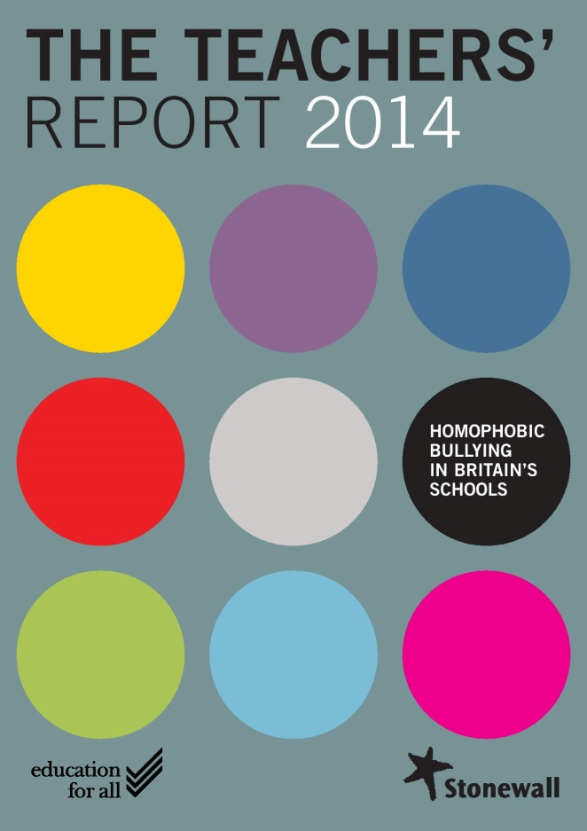
Homophobic, biphobic and transphobic bullying in primary schools
45 per cent of primary school teachers say children in their schools experience homophobic bullying
70 per cent of primary school teachers hear homophobic language in school
86 per cent of primary school teachers have had no specific training to prevent and tackle homophobic bullying

Slide 4
Who experiences homophobic bullying?

Slide 5
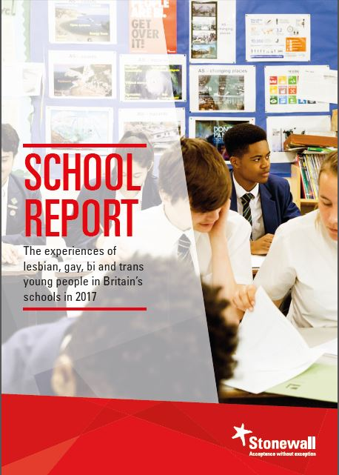
What’s the impact?
45 per cent of LGBT pupils – including 64 per cent of trans pupils – are bullied for being LGBT at school
52 per cent of bullied LGBT pupils feel that homophobic, biphobic and transphobic bullying has had a negative effect on their plans for future education
40 per cent of pupils show have been bullied for being LGBT have skipped school because of the bullying

Slide 6
What’s the impact?
61 per cent of LGB young people who aren’t trans have self-harmed
84 per cent of trans young people have self-harmed
22 per cent of LGB young people who aren’t trans have tried to take their own life, with 70 per cent of them have thought about taking their own life
35 per cent of non-binary young people have tried to take their own life, with 89 per cent of them have thought about taking their own life
45 per cent of trans young people have attempted to take their own life, with 92 per cent of them have thought about taking their own life

Slide 7


Slide 8
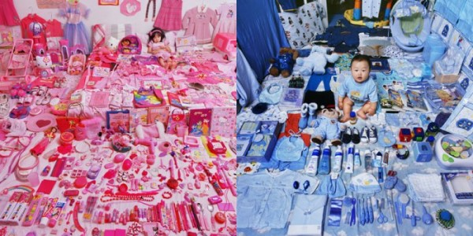
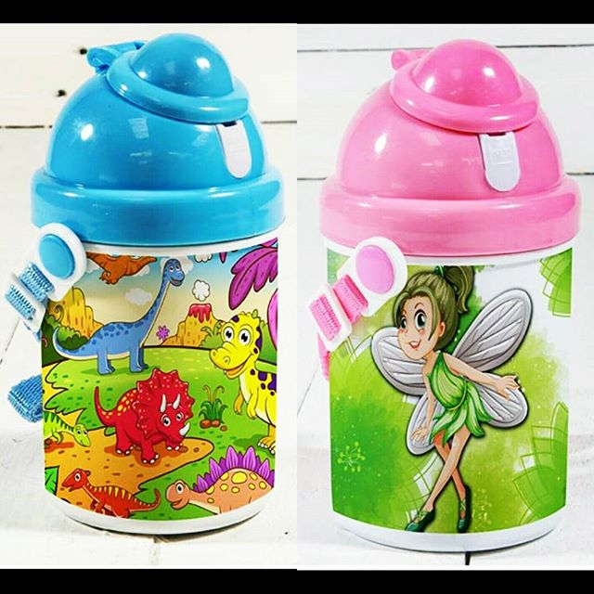
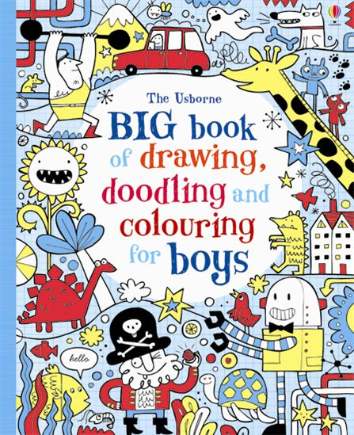


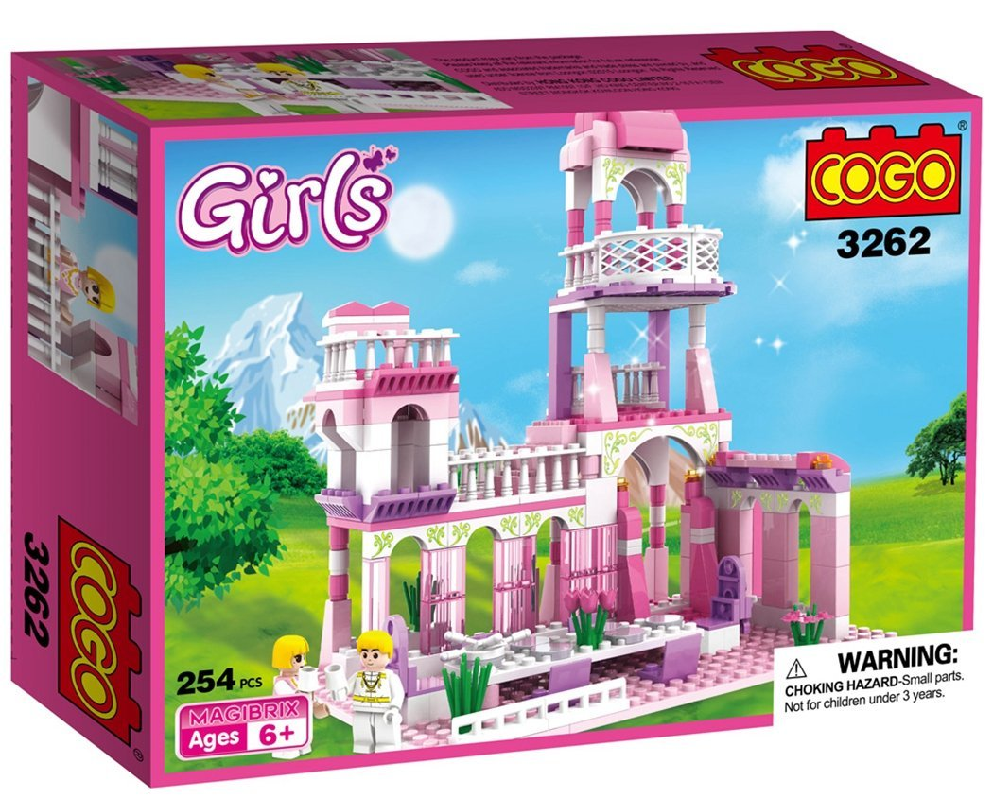
The gendered messages children receive

Slide 9
Where do the gendered messages that children receive come from?
Children learn from the world around them:
Home
Culture
Role models
Peers and siblings
Media and advertising
Commercial environment e.g. books, clothing, etc
Education settings
How is your school gendered?

Slide 10
Tackling gender stereotypes
  Don’t assume gender (of the children you work with and/or their parents/carers)
  Avoid using gendered language (e.g. ‘man up’, ‘you run like a girl’)
  Avoid reinforcing gender stereotypes (e.g. boys play football, girls do ballet)
  Avoid using gender as a way to arbitrarily divide children

Slide 11
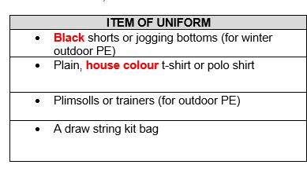
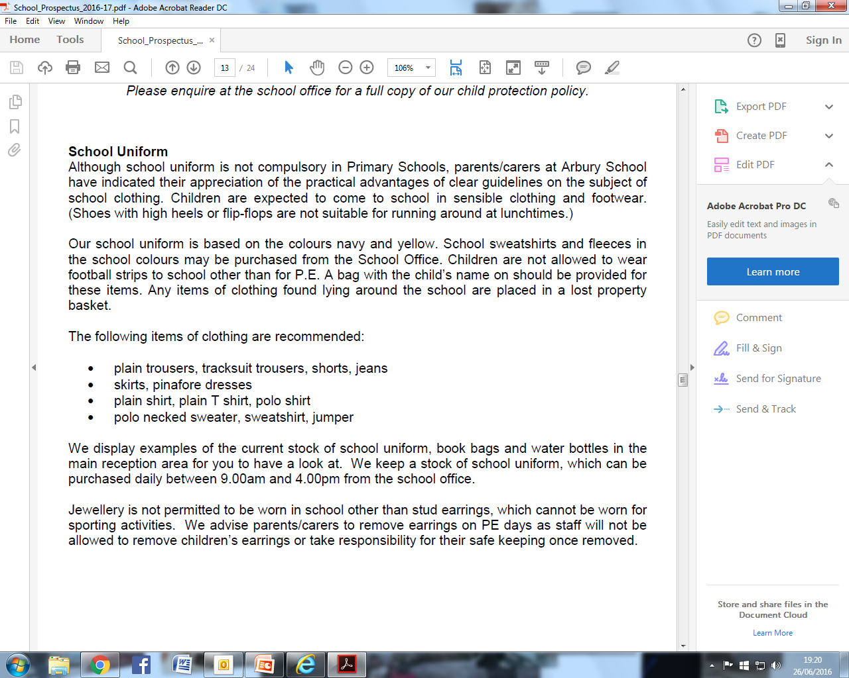
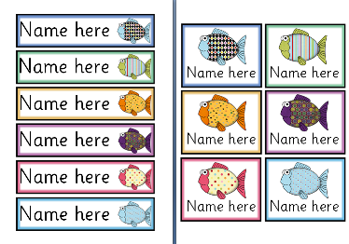
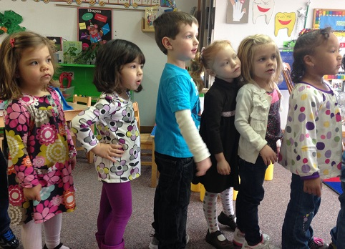
Tackling gender stereotypes
Uniform
Peg labels
Lining up

Slide 12
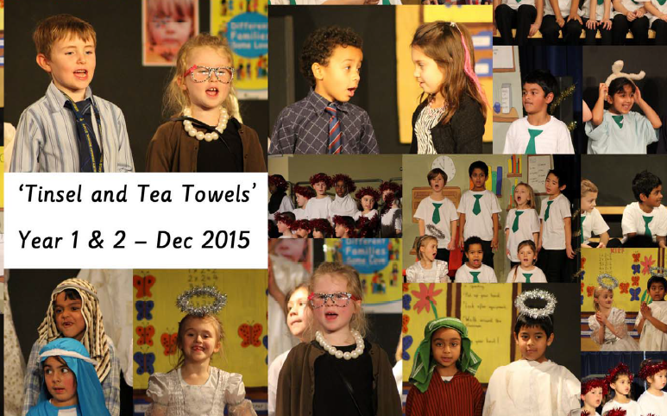
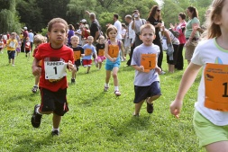
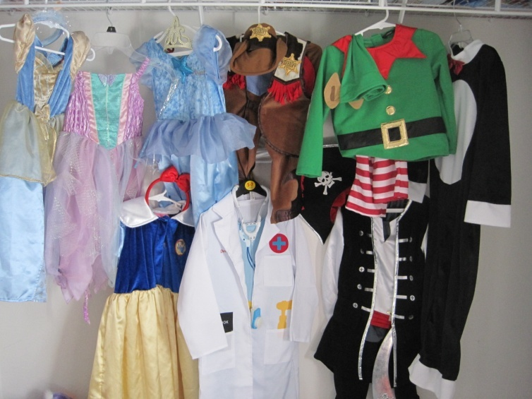
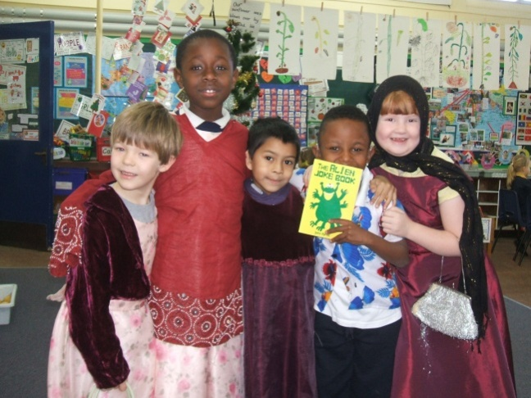
Tackling gender stereotypes
Christmas plays
Sports day
Dressing up clothes

Slide 13
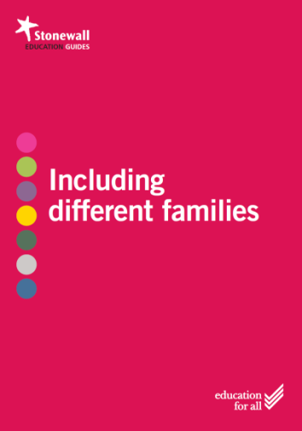
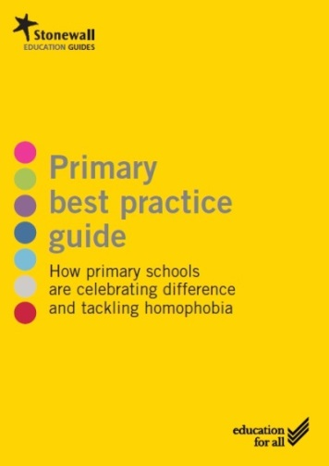



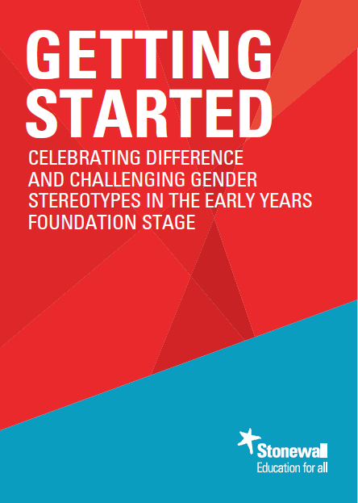
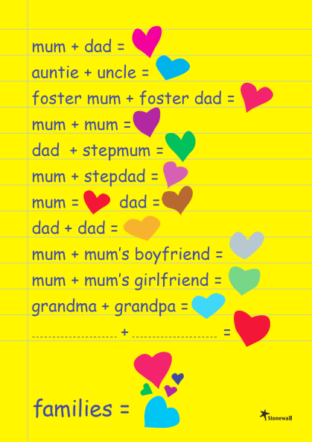


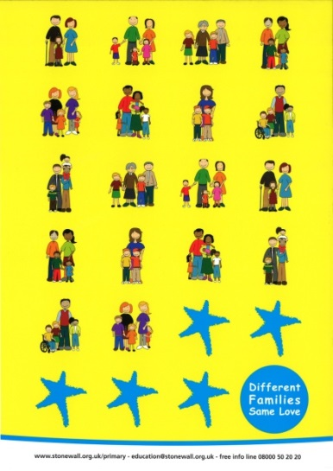

Stonewall primary resources

Slide 14

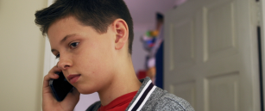







FREE – www.stonewallprimary.org.uk
Linus
Danni
Emma
Jake

Slide 15








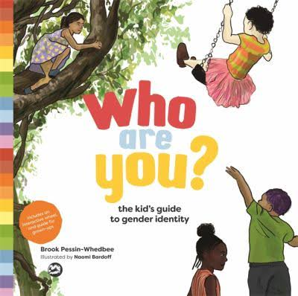
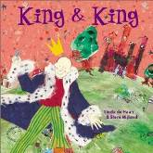

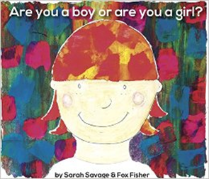
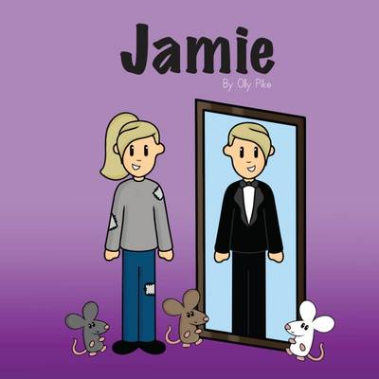
Celebrating difference in primaries

Slide 16
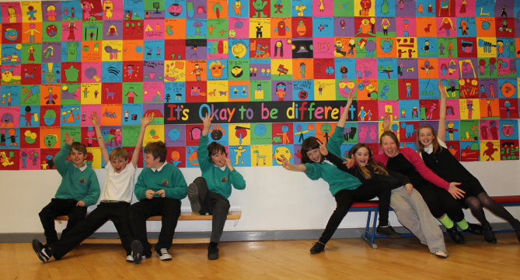
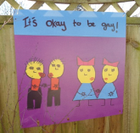
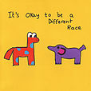
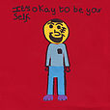
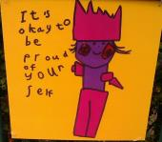
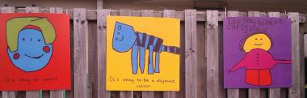
Celebrating difference in primaries
Notes:
St Keyna’s School

Slide 17
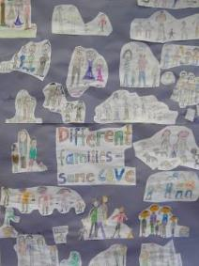
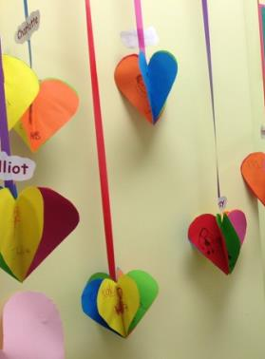
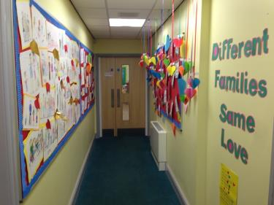
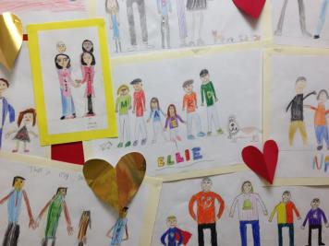
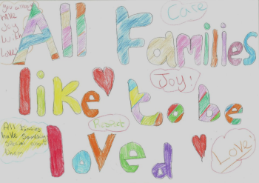
Celebrating difference in primaries
Notes:
Church of England Primary School

Slide 18
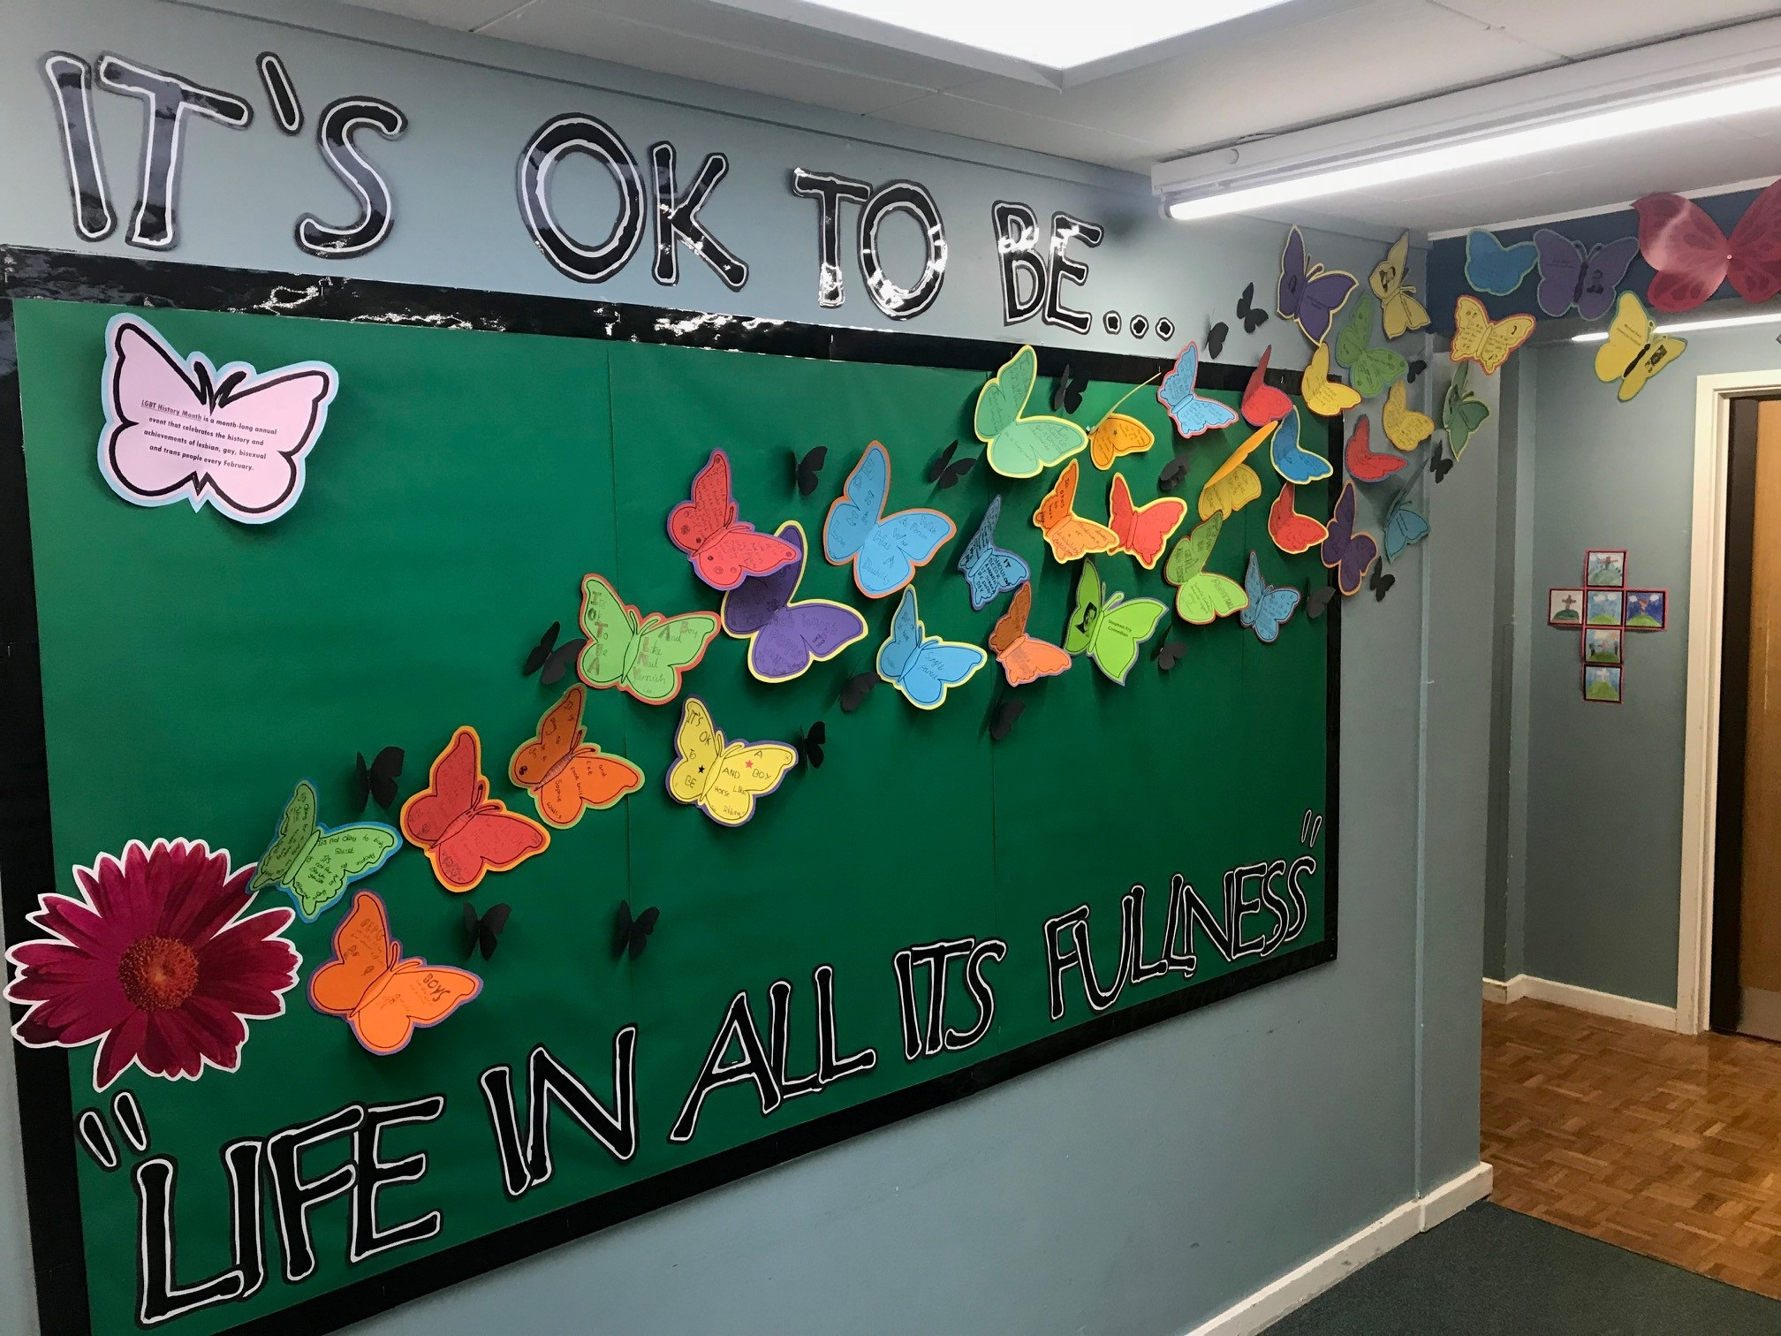
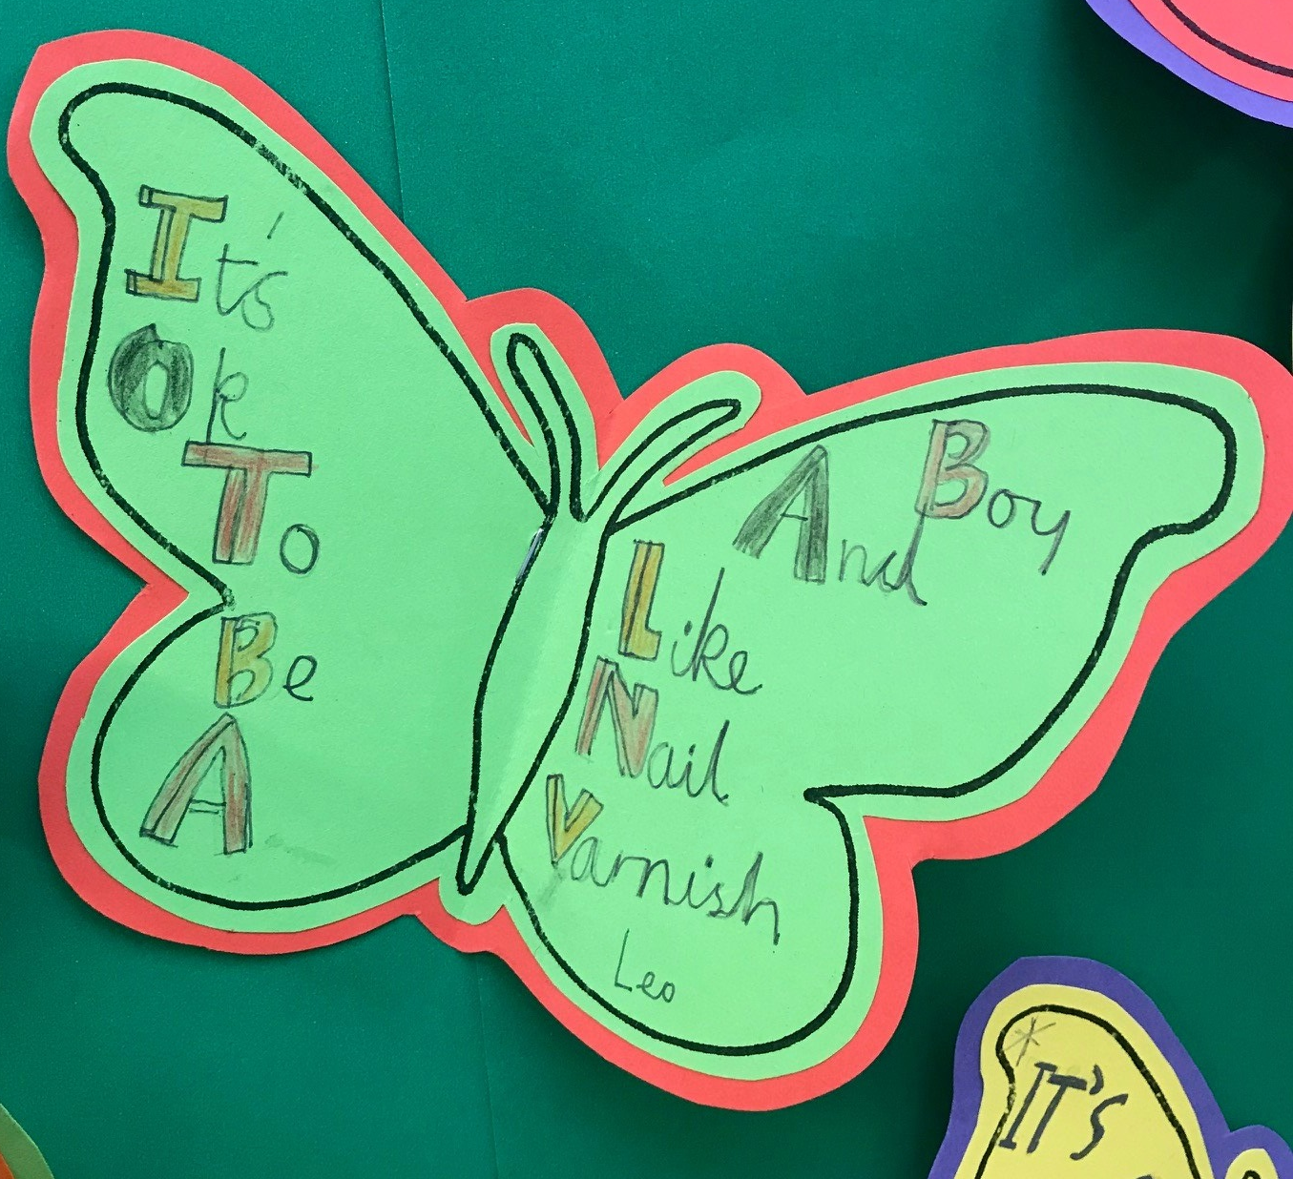
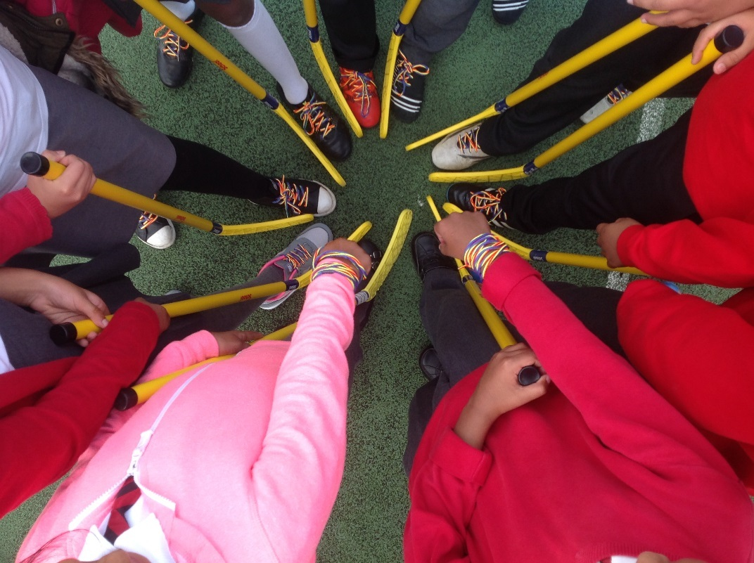
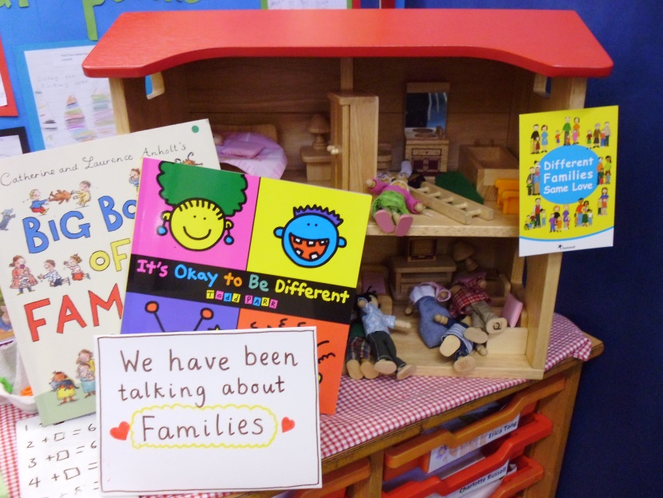
Celebrating difference in primaries

Slide 19
Dealing with concerns
I don’t like my son wearing a dress
I feel uncomfortable about the ‘Different Families’ poster you have put up. Don’t you think children are too young to learn about being LGBT?
My child doesn’t conform to gender stereotypes. How should I support them? I’ve heard about trans children, does this mean they could be trans?

Slide 20
What can schools do
Review and update policies
Make sure all staff have training
Talk about different families and LGBT people in the curriculum
Display positive materials
Involve the whole school community
Stock and use books that celebrate difference
Speak to other schools and share good practice

Slide 21

QUESTIONS?
Contact details:
sarah.rose@stonewall.org.uk
Website:
www.stonewall.org.uk

