Slide 1
St Joseph's Camberwell Catholic Schools' Federation
Healthy School Silver Award
Paul Higgins – St Joseph’s Junior School
Carlie Steadman – St Joseph’s Infant School

Slide 2
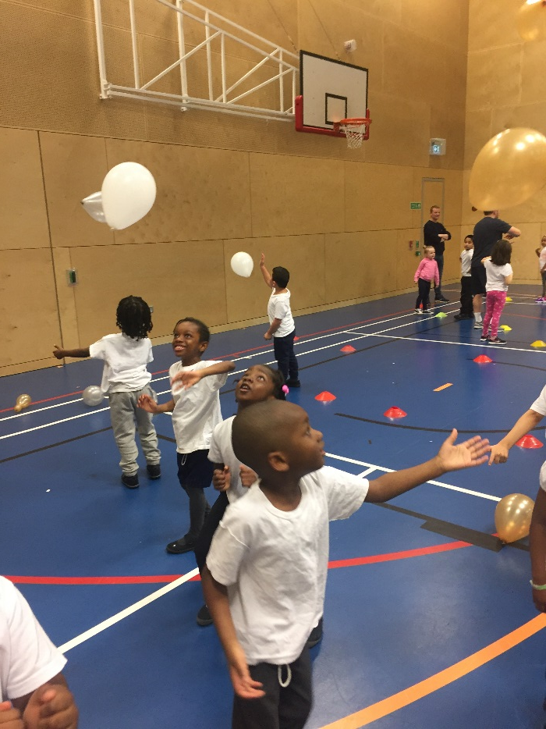
School Background
Separate Infant and Junior schools in Camberwell working in federation
73.5% of pupils EAL
Vast majority of pupils – 83.5% - fall in the highest 20% for social deprivation
Key target
Concentrate on ensuring that all children are active and that opportunities are developed to increase student participation in sports outside of curriculum time

Slide 3
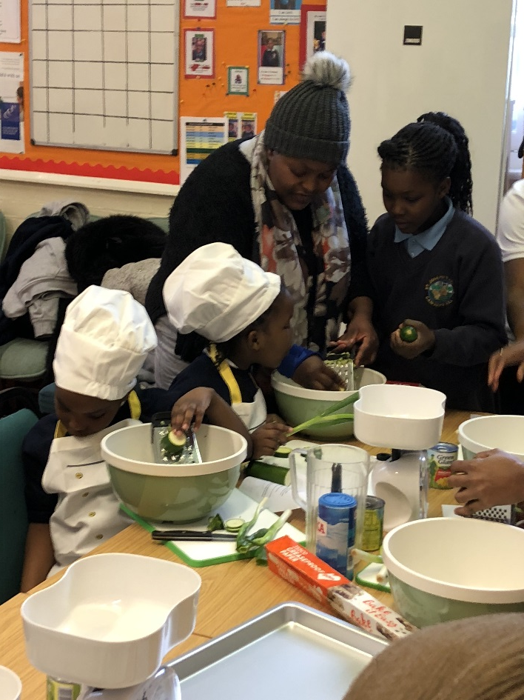
Actions
Obesity Action
We received a letter in September 2017 detailing obesity statistics in our school and due to the clear links with the demographics in our schools we decided to target this. The data looked bad for both schools so we decided to working together from EYFS to Y6 - as what is started in the infants carries forward and impacts both schools.
Identify target pupils
Target After School Provision
Send children on Nutritional Workshops and conduct in school
Shake Up Club (School nurse, specialist coach)
Parent workshops/Meetings
Incentives

Slide 4
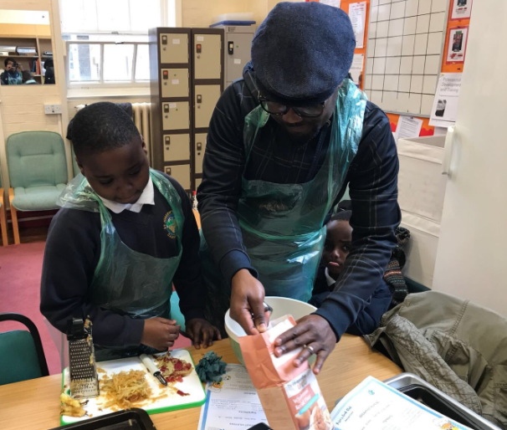
Problems faced
There have been lots of issues so far which we have had to try and overcome.
Attendance of Identified Children
Parental Attendance/Willingness to change
Self Esteem Issues
Timetabling
Workload

Slide 5
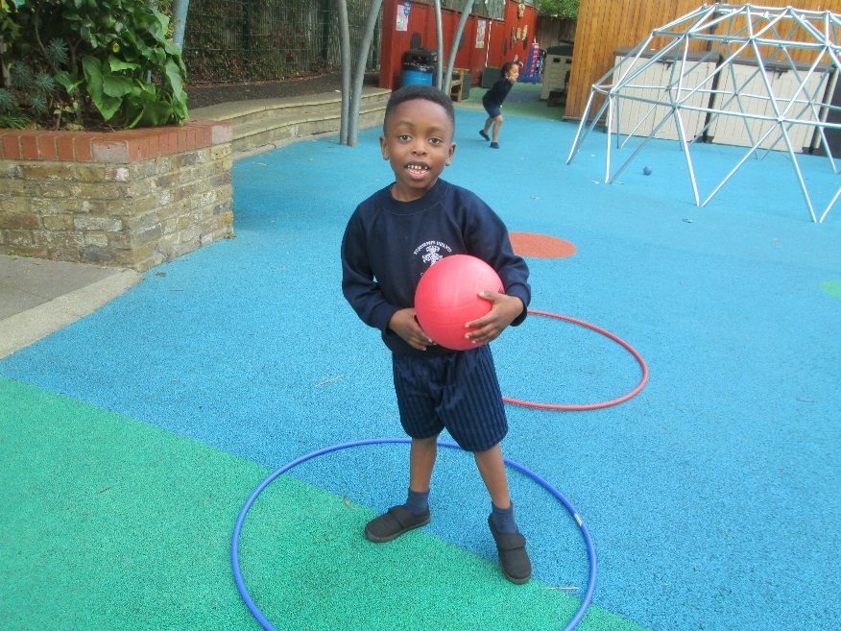
What we want
Impact
Through our whole school approach to monitoring curriculum participation we have seen an increase this year from 80% previously to 88% by Christmas in the Juniors and from 69% to 70% by Christmas In the Infants.
For our targeted SUC children we have had informal reports at this early stage from teachers of a greater focus on the SUC days.
We have seen a greater level of enthusiasm towards PE from these children.
A physical change we can see or measure
An emotional change
A change in attitudes at home
An increase of self esteem in class

Slide 6
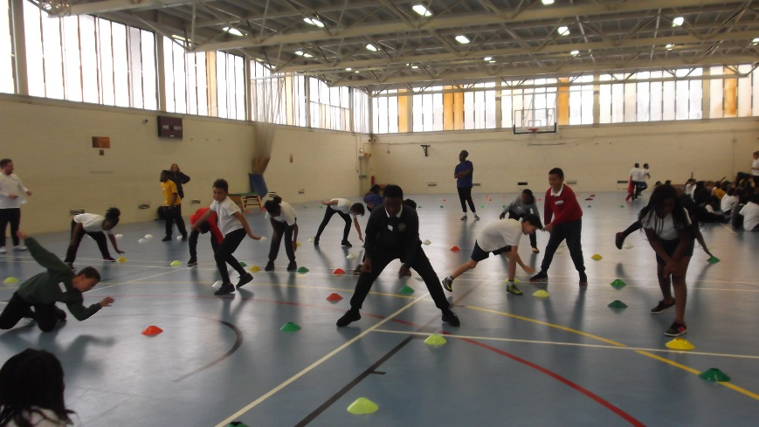
Next steps – Federation wide
As a whole school a recent pupil voice survey has shown that 71% of pupils in the Junior school and 54% of pupils in the Infant school are not aware of the correct portion of fruit and vegetables to eat in a day and that on average across play times only 56% of children consider themselves to be ‘playing hard or running’
To do this we will:
Put in place workshops in each year group regarding balanced diets
Science cross curriculum links
Improve signage and awareness of what a portion is
Increase opportunities for active play at break time
Further train staff and young leaders
We are going to focus on developing these areas before conducting another survey
and assessing the impact of measures we put in.
.

Slide 7
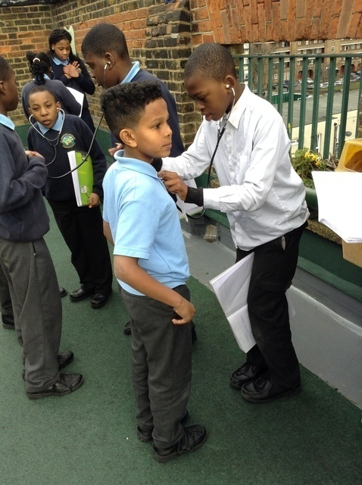
Next steps – Target group
We have only just started our work with our targeted obese children so we are going to continue to focus on them for our Silver Award. Having started meeting as a Healthy Schools Group across the federation with Science and PSHE leads we have already identified ways to push this further.
Shake Up Club
Continuation of cooking workshops with parents
Coffee Morning and follow up meetings with parents involving the school nurse
Pupil voice led afterschool club from core group
Group dealing with social needs and issues

Slide 8
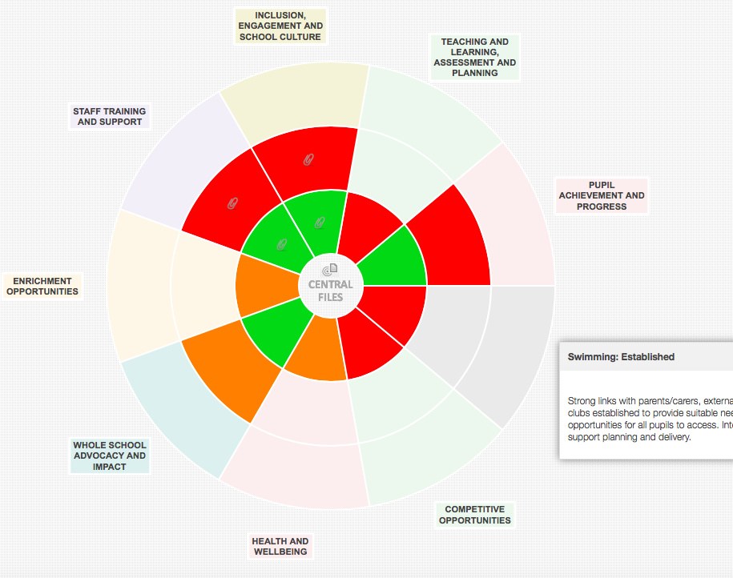
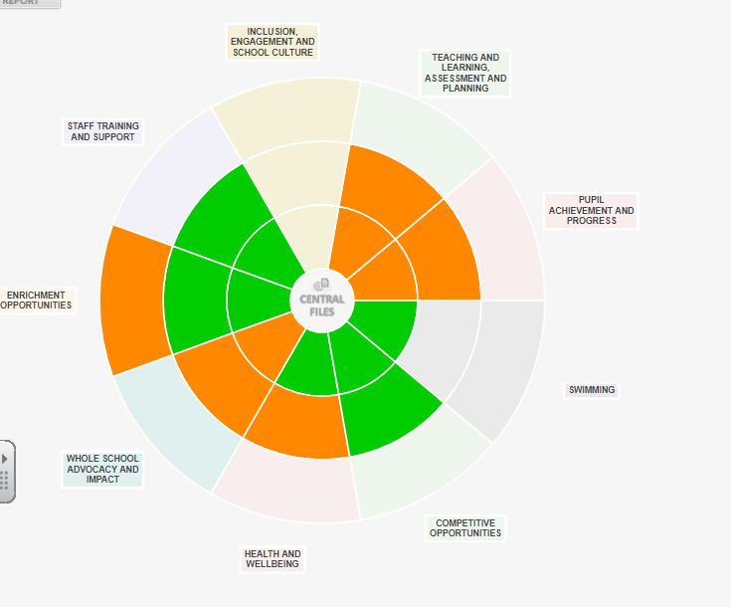
Monitoring
We have been using the CD wheel to help monitor what is being done in schools and the impact of what is happening.

