Slide 1
Staff CPD
PSHE and Wellbeing Best Practice
(what to teach, assessment, resources, monitoring impact)
Notes:
This presentation is designed to support the Subject Leader and Teaching Staff as CPD.
You will need to have read and considered options within this presentation prior to the session.
You may choose to cover all of the content in this PPT or break it into separate sessions
It is intended to support you in disseminating best practice to your staff PLUS guiding your subject leadership
STAFF CPD: Introduce the session

Slide 2
What is PSHE & Wellbeing Education?
Personal, Social, Health, Emotional and Economic Education
Emotional Wellbeing and Mental Health
PE/Sport and Physical Activity
British Values
SMSC
Aspects of RE
Health Education
Citizenship
Values Education
Safety/Safeguarding
Health Education
Anti-Bullying
Drug, Alcohol and Tobacco Education
Relationships and Sex Education
Notes:
Ask staff what PSHE and Wellbeing are/include.
Take suggestions and click through to make each aspect appear – these are the National Curriculum Target Links in the Southwark PSHE and Wellbeing Curriculum Framework – shown on the next page
Discuss where these aspects are currently taught in the school
Explain that many of these aspects can/should be part of whole school provision
However best practice is that PSHE is taught discretely – in a weekly slot, not through another subject
This is not always possible but it is something to aim towards

Slide 3
How do I know what to teach?
Notes:
Introduce the Southwark PSHE and Wellbeing Curriculum Framework Document – it would be beneficial to distribute copies to your staff or ask them to bring laptops/tablets and have it stored on your shared drive and show them where it is
It is important that they can interact with it in this session

Slide 4
What is it?
A whole school curriculum framework
Spiral – skills build year on year
Outlines Essential Skills for PSHE & Wellbeing
Includes content for each year group
Details Learning Objectives & Outcomes
Shows what children should learn
A Long term plan – overview of the year
It is NOT short term planning
Notes:
Allow staff to flick through
On page 2 - Introduction, it shows changes (March 2018) and that rising concerns such as knife crime/carrying, different types of bullying and identity have been added
Look at Essential Skills on Page 5 together. Invite them to read the opening paragraph about carefully selecting relevant content and explain that the following curriculum has been created with Southwark school partners, children and young people and with Southwark data trends in mind
Explain that the Essential skills are what we aim for our children to be proficient in. We might find that some children need more support to reach different aspects of these essential skills
This is a spiral framework – skills build year upon year

Slide 5
How should I use it?
We teach PSHE & Wellbeing discretely, which is best practice.
Locate the 3 themes per term model
Teach the outcomes across that term
Highlight what you have covered
The themes repeat each term
REMEMBER THAT THE OUTCOMES ARE NOT YOUR SHORT TERM PLANNING – YOU WILL NEED TO CONSIDER LESSON/S CONTENT TO ENSURE PUPILS REACH THE OUTCOMES
Notes:
There are 3 examples here.
If you are not using the PSHE and Wellbeing Curriculum Framework already, you may wish to present each option and choose one as a staff
If you are using one of these options then go through that slide only
If you use the PSHE and Wellbeing Framework in another way – create a slide to show how
Each model is described in the notes alongside the current slide
THREE THEMES PER TERM MODEL
All three core themes worked on in one term
Core themes are revisited each term
Teach the outcomes in planned lessons – some outcomes may require a series of lessons
Remind staff that they can revisit outcomes if their pupils need more work on them
If they need to go up or down a year group to plug gaps in knowledge and understanding or extend pupils, they can
Go through the process of choosing the outcomes and evidencing coverage with your staff. Short term planning slides come after the models slides

Slide 6
How should I use it?
We teach PSHE & Wellbeing discretely, which is best practice.
Locate the 1 theme per term model
Find the current half term
Teach the outcomes for that half term
REMEMBER THAT THE OUTCOMES ARE NOT YOUR SHORT TERM PLANNING – YOU WILL NEED TO CONSIDER LESSON/S CONTENT TO ENSURE PUPILS REACH THE OUTCOMES
Notes:
There are three examples over the next three slides here.
If you are not using the PSHE and Wellbeing Curriculum Framework already, you may wish to present each option and choose one as a staff
If you are using one of these options then go through that slide only
If you use the PSHE and Wellbeing Framework in another way – create a slide to show how
ONE THEME PER TERM MODEL
Locate the current half term
All themes covered in a year and revisit in each year group
Teach the outcomes in planned lessons – some outcomes may require a series of lessons
Remind staff that they can revisit outcomes if their pupils need more work on them
If they need to go up or down a year group to plug gaps in knowledge and understanding or extend pupils, they can
Go through the process of choosing the outcomes and evidencing coverage with your staff. Short term planning slides come after the models slides

Slide 7
How should I use it?
As we utilise a topic based curriculum we
will be linking our PSHE and Wellbeing
provision to our topics
Find your year group
Highlight what you
have taught
You should cover all outcomes across the year
REMEMBER THAT THE OUTCOMES ARE NOT YOUR SHORT TERM PLANNING – YOU WILL NEED TO CONSIDER LESSON/S CONTENT TO ENSURE PUPILS REACH THE OUTCOMES
Notes:
There are three examples over the next three slides here
If you are not using the PSHE and Wellbeing Curriculum Framework already, you may wish to present each option and choose one as a staff
If you are using one of these options then go through that slide only
If you use the PSHE and Wellbeing Framework in another way – create a slide to show how
TOPIC BASED MODEL
Choose the outcomes to match your year group’s topics and / or work in a cross curricular fashion, making relevant links
Highlight as you cover outcomes
Aim for all to have been covered across the year
Remind staff that they can revisit outcomes if their pupils need more work on them
If they need to go up or down a year group to plug gaps in knowledge and understanding or extend pupils, they can
Go through the process of choosing the outcomes and evidencing coverage with your staff. Short term planning slides come after the models slides

Slide 8
Short Term Planning
How do I turn the outcomes into lessons?
Baseline assessment
Creation of objectives
Lesson plan building
Teach –AfL
Baseline Assessment
Next steps
Notes:
The next slides provide key information for planning high quality lessons
Remind staff that the PSHE and Wellbeing Curriculum Framework IS NOT their short term planning – it is their yearly, long term plan/scheme
They will need to break down the outcomes into achievable steps and lessons for their pupils
*As a school you may have planning templates to use – you could share these with your staff and explain that PSHE and Wellbeing is to be planned on these and that you will monitor this planning

Slide 9
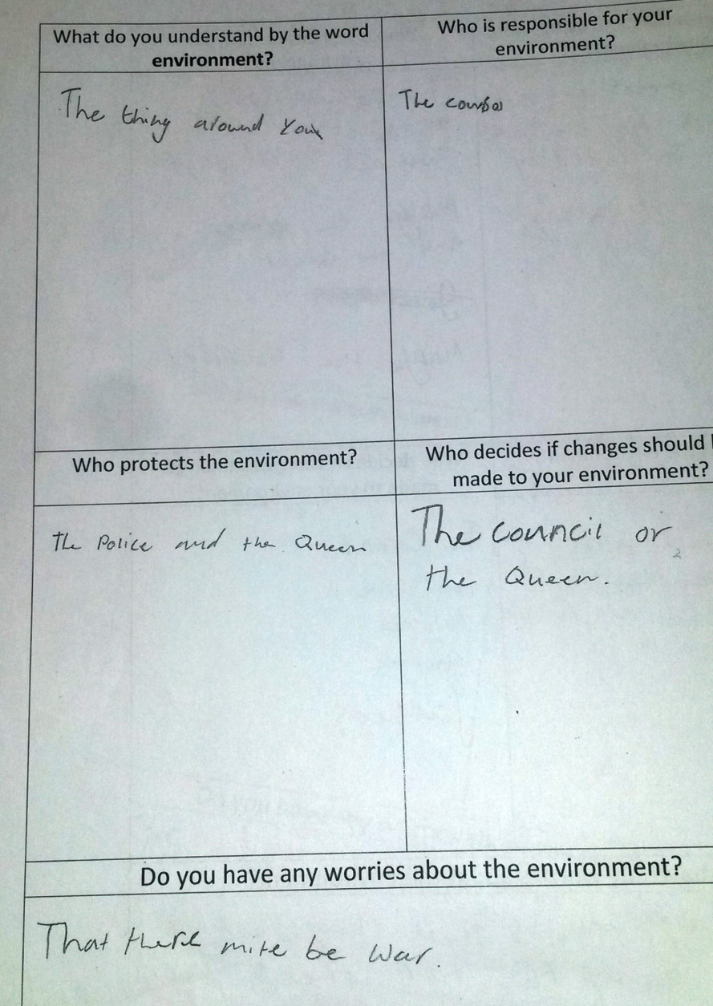
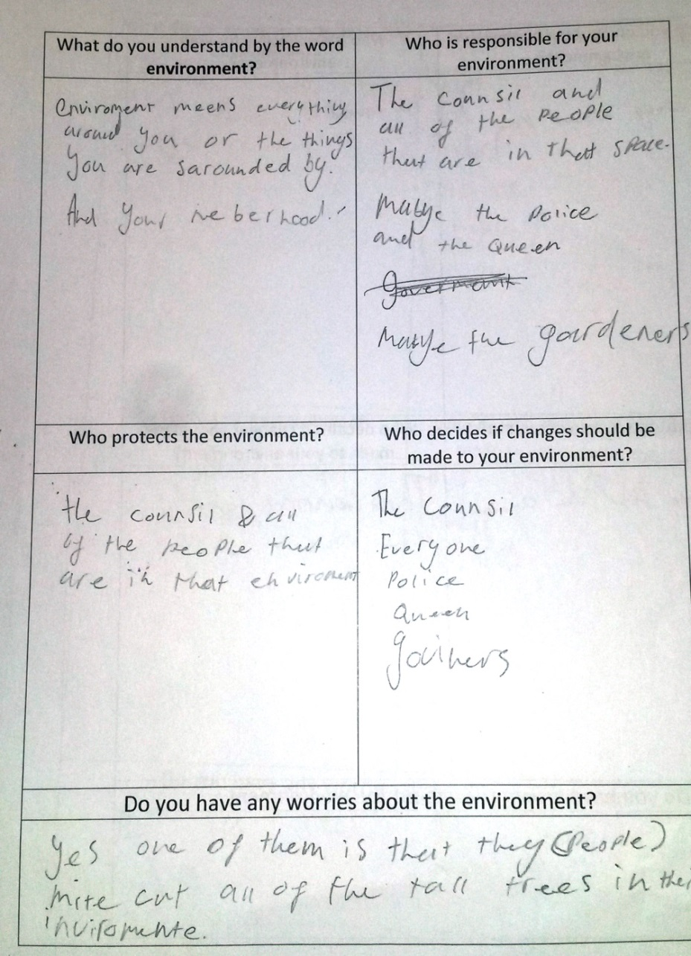
Baseline Assessment
Notes:
BASELINE ASSESSMENT
There are no levels attached to PSHE (other than the science element of RSE in STAR Science)
Best practice is to assess pupils before, during and after learning
Baseline assessment means that you find out what your pupils know before you begin teaching
Using careful questioning and discussion within lessons you can assess and move learning forward within the lesson
You repeat the same baseline assessment at the end of the unit/half term/lesson to gauge progression in knowledge and skills
In this way you ensure that your planning fits your pupils needs
Baseline assessment provides a starting point for planning and teaching, evidence of learning and the basis for the next sessions
Simple baseline assessments ask questions about the planned outcomes to gauge knowledge and understanding
They provide an opportunity to Draw and Write – so that all abilities can access
For younger years and less able pupils, staff may wish to annotate or record answers for the pupil/s
EYFS may wish to have a discussion and record evidence on a large piece of paper with pupils names under their contribution
Baselines can be completed every lesson or at the end of a unit of work/topic
There is no set format – some examples are on the following slides

Slide 10
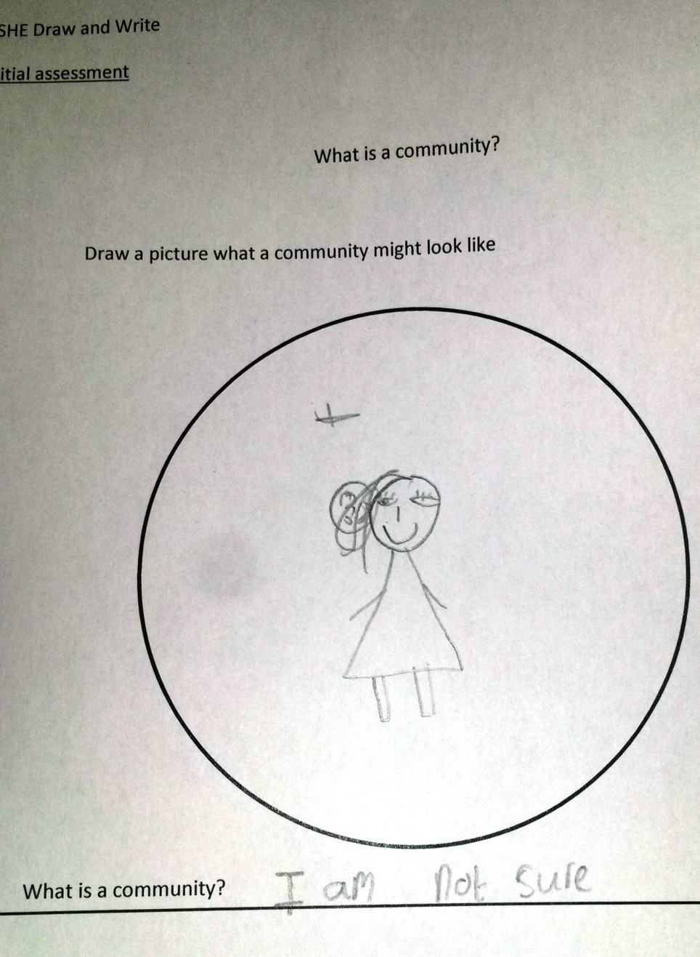
The Draw and Write can be simple or have a series of questions
Make it double sided
Label side 1 and side 2
e.g. initial and final
After the initial Draw and Write spend a few minutes looking through them
What misconceptions are there?
What knowledge do your pupils have already?
Who do you need to extend?
Who has very little knowledge?
Notes:
Ensure that staff know it is ok for pupils to write ‘I don’t know’ or put a question mark
The Draw and Write should be double sided and identify which is the first and which is the second attempt
NOTE: The example above shows us nothing about what the pupil believes community to be – we would expect that the final Draw and Write would include images of school, neighbourhoods, people around us, clubs the pupil belongs to and/or places of worship
In Year 3 in the PSHE and Wellbeing Curriculum Framework under core theme ‘Living in the Wider World’ there is a focus on community.
This Draw and Write could support the teacher in the pupils understanding of community – if the pupils are like this pupil, they wont know what ‘community’ means and much of the further learning could be lost.
Me and my community
Citizenship & British values
Children will learn:
what being part of a community means, and about the varied institutions that support communities locally and nationally
Children should:
-recognise the role of voluntary, community and pressure groups, especially in relation to health and wellbeing

Slide 11
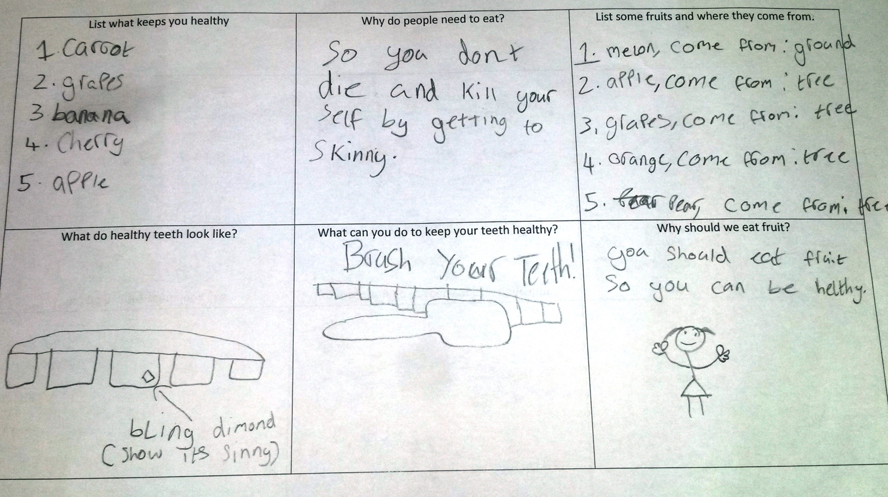
Notes:
This is an initial Draw and Write for a series of lessons on health and teeth health
Compare this to the next slide

Slide 12
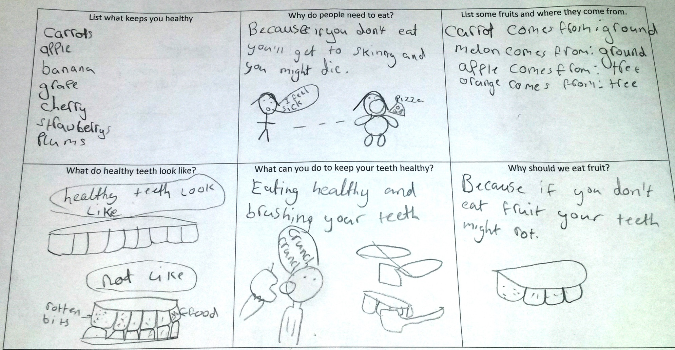
Notes:
This is the final Draw and Write for a series of lessons on health and teeth health
Compared to the previous slide we see:
The pupil’s understanding of healthy teeth has improved
The pupil understanding of how to keep teeth healthy has improved
The pupil now needs support in ‘what keeps you healthy’ as they just list fruit and more understanding of ‘why people need to eat’ – we would expect some understanding of nutrition and energy.

Slide 13
Creation of Lessons:
Take the objective from the PSHE and Wellbeing Curriculum Framework
Me and my community
Citizenship & British values
Children will learn:
What being part of a community means and about the varied institutions that support communities locally and nationally
Children should:
-recognise the role of voluntary, community and pressure groups, especially in relation to health and wellbeing
Use baselining to find out current knowledge and build lessons
Lesson 1: What does community mean and which communities do I belong to?
Lesson 2: What is a voluntary community group and what might they do?
Lesson 3: What is a pressure group and how might they influence people in a community?
Notes:
Staff should use the PSHE and Wellbeing Curriculum Framework as the starting point for lesson creation
Take a learning objective and reduce it to the basic skills and knowledge needed (This may come from the Draw and Write evidence)
Then create lesson/s so that by the end of the lesson series of lessons the pupils own the skills and knowledge of the objectives
See the above example where one lesson objective and example of what ‘children should’ – the outcome - has been split into objectives that build up pupil knowledge and understanding

Slide 14
Turning objectives into lesson plans
Lesson Objective: What does community mean and what communities do I belong to?
Rules:
Game: Pass the smile
Round: A community is…(AfL)
Main: Start in a circle. Explain that a community is a group of people who have something in common. They may live in the same place – a Peckham community or a London Community. They may be people who go to the same school – our Primary community or in the same class. Which class community do we belong to? How do we show we belong? (use large paper and write up the things we share e.g. school uniform, school badge, class name, class logo)
Ask pupils to move into the middle of the circle if they go to: brownies/ rainbows/ cubs/ scouts/ karate/ballet/football/church/mosque,/woodland folk etc (name a range of clubs and groups to show that we belong to a range of different communities.) Ask children to share with a partner how they show they belong and some of the things that they do there. Children create a fact file of a community that they belong to.
Round: A community is…
Game: Pass the smile
Notes:
This is an example of a lesson based on the first objective from the previous slide
Every lesson should start with rules as a container for this sensitive subject. There is a Rules poster for KS1 and KS2 in the file
Another Rule example is
R -respect
O- openness
C –confidentiality
K –kindness
The Game is an opportunity to begin working together, listening to each other and being mindful of each other and should take no longer than 5 minutes. A games list is in the file. It is repeated at the end to celebrate the end of the session
The Round is an Assessment for Learning tool (AfL) –finding out what the pupils know. It should take no more than 1 minute to hear the answer from every child and if it goes over 2 minutes then ask pairs to turn to each other and tell each other their answer. If you let it go on longer then attention will wane
Main – this is the teaching of skills and knowledge – teaching the objective
The Round is repeated to hear changes in opinion, additions to knowledge etc
At the end of the session (or the day after) the final Baseline Assessment can be completed – unless this is a series of lessons or a unit of work, in which case the Assessment will take place at the end of the series of lessons

Slide 15
Monitoring
Ways PSHE and Wellbeing Education will be monitored…
Notes:
Monitoring
Prior to the Staff CPD session the Subject Leader will need to make decisions and share them with staff – options for monitoring are below
Knowing what the provision is like across the school is key to being a subject leader – if you wwhat is happening you are able to make plans to improve your subject
You can monitor in many ways:
Checking PSHE and Wellbeing is included in timetables, how much time, how regularly – can you drop in and see if it is happening?
Speaking to children – use surveys to find out what they are learning in PSHE lessons, if they like them, if they think they are important, what else they would like to see. School Councils are great places to survey children but you can also chat in the playground, at lunch etc
Looking at displays – if you have an expectation that there is a PSHE display per class or year group per term you will be able to see what has been covered, the quality of work and whether it matches the PSHE and Wellbeing Curriculum Framework requirements for that year
Planning Scrutinies – Taking in planning, checking it matches with the PSHE and Wellbeing Curriculum Framework requirements for that year, does it seem maturity relevant, is it actively teaching skills, knowledge and understanding?
Taking in a high ability, middle ability and low ability Draw and Write example at the end of every half term or term – this will allow you to see if there is differentiation in the class, if the pupils have learned from the initial session to the final session, is the content maturity relevant etc. You can provide a post it note to teachers with 2 good points and 1 for development and keep a record of what you have seen and support that you have given
Lesson observations – this is key in areas that you believe are struggling. These could be informal drop ins or more formal observations as part of the observation schedule in your setting. Records should be kept. This could become a case study, where you work together to improve teaching and learning
Explain to your staff how you and when will be monitoring PSHE and Wellbeing as Subject Lead
You may need to align this with your school monitoring schedule

Slide 16
Resource Bank
Notes:
Resource Bank
Schools tend to have many PSHE and Wellbeing resources stored across their setting
An amnesty and then an audit is a good idea so that a list of resources and their location can be shared with staff
Southwark has created a Resource Bank for Subject Leader and Teacher use in their lessons
This Resource Bank has recently been updated
For each National Curriculum Target Link in the PSHE and Wellbeing Curriculum Framework, there is a heading and list of resources, providers and initiatives within the Resource Bank, plus additional sections
When planning, staff should consult the resource bank for high quality examples and quality assured resources, subject associations and support organisations
See example walkthrough on the next slide
e.g. When using the PSHE and Wellbeing Curriculum Framework and teaching Year 4

Slide 17
Chris Winter Project (CWP), RSE & DAT &Science/RSE/Drugs, alcohol & tobacco (DAT)
The Christopher Winter Project –SRE (now called RSE)
To support your delivery of Relationships and Sex Education (RSE) and Drugs, Alcohol & Tobacco Education (DAT), the following resources are supported by Southwark’s Healthy Schools Partnership. Training is available for Southwark schools. Visit the Southwark Schools Website to book.
http://cwpresources.co.uk/resources/
Notes:
You could provide a walkthrough with your staff:
If, for example, a teacher is ready to teach Year 4 (encourage staff to find Year 4 in the PSHE and Wellbeing Curriculum Framework)
They are teaching under core theme ‘Health and Wellbeing’ Drug Education (encourage staff to locate the section in the PSHE and Wellbeing Curriculum Framework)
It states pupils will learn ‘about the effects of alcohol and how to make safe decisions’
Next to Drug Education staff will see (CWP), -Healthy and safe and [working scientifically, biology)
These links can be seen in the header and directly link to the Resource Bank.
There is a section in the Resource Bank with resources that staff may peruse and choose to use if they fit their class.
THE NEXT SLIDE IS ABOUT RESOURCE CHOICE AND QUALITY ASSURANCE
It must be made clear that not all resources will be of use to the teacher and the class and discernment must be used when choosing resources

Slide 18
How do I choose resources?
The Resource Bank includes a Toolkit of PSHE Association Quality Assured Resources. These are resources that have been given a seal of approval by the PSHE Association – the National Subject Association for PSHE
All Southwark schools receive FREE membership to the PSHE Association and to the SEAL Community websites
Notes:
Resources must be chosen for their impact and suitability for the pupils they will be used with
The Resource Bank includes a Toolkit of PSHE Association Quality Assured Resources. These are resources that have been given a seal of approval by the PSHE Association – the National Subject Association for PSHE
All Southwark schools receive FREE membership to the PSHE Association and this should be disseminated to staff. All of the Quality Assured Resources can be found on their website as well as many other useful resources www.pshe-association.org.uk
The Resource Bank is not a exhaustive list. There are many resources available. Staff must always question whether a resource is useful for their class and whether it will contribute positively towards them meeting the objectives and outcomes

Slide 19
End of Year reporting
Notes:
Best practice is to report on PSHE at the end of the Year
Using Draw and Writes and the PSHE End of Key Stage Statements (Found in the PSHE and Wellbeing Curriculum Framework under ‘Assessing PSHE and Wellbeing) staff can craft entries that report on the skills, knowledge and understanding undertaken throughout the year
Having the PSHE and Wellbeing Curriculum Framework to hand when writing will help structure content

Slide 20
Signposting to best practice models & data
http://schools.southwark.gov.uk/
PSHE Association – Lesson planning tool
PSHE Association – Curriculum Framework
Education Endowment Foundation – evidence based strategies to use for impact
Local data:
Joint Strategic Needs Assessment Southwark
Child Health Profiles
Notes:
These links will support the Subject Lead and Leading teachers in their provision
Bullet point 3 takes the user to evidence based strategies for teaching that make enhanced impact on progress
Bullet points 4 and 5 take the user to local data that can be used to guide action planning, School Development Plans and Healthy Schools London Awards

