Slide 1
Early Years
The beginning of the journey

Slide 2
Overarching principles
Learning and Development

Slide 3
Maslow’s hierarchy of needs
Notes:
We are finding more that children’s basic needs are not being met

Slide 4
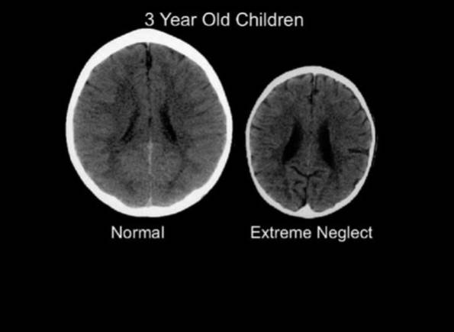
The importance of the right start in life

Slide 5
Statutory Guidance
The Learning and Development Requirements and The Safeguarding and Welfare Requirements
‘The key person must help ensure that every child’s learning and care is tailored to meet their individual needs. The key person must seek to engage and support parents and/or carers in guiding their child’s development at home. They should also help families engage with more specialist support if appropriate’.
-Statutory Guidance, page 10, section 1.10-
The key person role was developed to recognise the significance of forming secure attachments and personal attention for young children

Slide 6
When young children feel good about
themselves and are confident
‘…they are more likely to be able to engage in more complex and creative play, freely access a broad curriculum and take risks in their learning through guessing, experimenting and making mistakes’
-Grenier, Elfer, Manning-Norton, Wilson and Dearnley-
-The key person in reception and small nursery settings-
Notes:
Links here to characteristics of effective learning

Slide 7
Outcomes
Good Level of Development
PSED

Slide 8
Challenges
Notes:
Where needs are currently being met. Under threat

Slide 9
More important than ever..
Homelessness
Personal, Social and Emotional Development
Language and communication
Hunger and tiredness
Domestic violence
Physical, emotional and sexual abuse
Communication challenges
Notes:
What you will hear today is a reflection of the high quality practice that is happening around the borough

Slide 11
Equal Play
Removing barriers to children’s learning

