Slide 1
Southwark Governors’ Association
25 June 2020

Slide 2
Welcome and introductions
Martin Deutz, Chair

Slide 3
Agenda
18:05 Messages from Nina Dohel, Director of Education and Terry Segarty, Assistant Director of Learning and Achievement – Supporting schools and educational establishments during Covid-19
18:35 How schools and governors coped during lockdown and prepared for a wider re-opening. Sharing their experiences:
Bessemer and Keyworth Federation: Ms Sarah Beard, Executive Headteacher & Ms Karen Azaadi, Vice - Chair of Governors
City of London Academy: Mr Michael Baxter, Principal & Mr Antony Smyth, Chair of Governors
Cherry Garden: Ms Teresa Neary, Headteacher & Dr Margaret Morton, Chair of Governors
20:00 Close Dates of future meetings: 26 November 2020 25 March 2021 24 June 2021

Slide 4
Director’s message
Nina Dohel – Director of Education

Slide 5
Assistant Director’s message
Terry Segarty – Assistant Director of Learning and Achievement

Slide 6
Phased Return to School w/c 15th June
The phased return to schools continued last week with very nearly all secondary school settings in Southwark opening for students in years 10 and 12 (GCSE years).
As with primary and nursery settings, students are being taught in “bubbles” of up to 15 students and are working to reduced timetables to account for 2 metre social distancing, voluntary attendance and health and safety hygiene requirements identified from settings’ risk assessments.
Special schools and hospital schools have individually risk assessed their pupils and have offered on-site provision where appropriate from March 2020.
Vulnerable pupils and young people continue to be carefully monitored by schools, Family Early help and social services if they are not currently attending a setting or their attendance is sporadic.
w/c | Nursery | Primary | Special Primary | Special Secondary | Secondary
1/6/20 | 4/5 | 70/75 | 1/3 | 0 | 0
8/6/20 | 5/5 | 74/75 | 2/3 | 0 | 0
15/06/20 | 5/5 | 74/75 | 3/3 | 4/4 | 20/21

Slide 7
Phased Return to School: Data
Phased return to schools The following data is based upon schools’ attendance returns to the local authority (“Southwark Stats”). All schools are returning their attendance data even if it is a nil return due to closure. | Week 1 w/c 1st June 2020 | Week 2 w/c 8th June 2020 | Week 3 w/c 15th June 2020 | Commentary
Number of schools completing and submitting a return to the LA (2 reported zero attendance due to phased return commencing 22.6.20) | 84 | 84 | 106 | 100% of schools
Number of children who attended at least once during the week | 2,977 | 4,077 | 7,499 | +45%
Average daily number of children attending | 2,072 | 3,286 | 5,231 | +37%
Lowest daily number of children attending during the week | 1,098 | 2,824 | 4,483 | +37%
Highest daily number of children attending during the week | 2,500 | 3,504 | 5,569 | +37%

Slide 8
Questions?

Slide 9
Bessemer and Keyworth Federation
Sarah Beard, Executive Headteacher
Karen Azaadi, Vice-Chair of Governors

Slide 10
Lockdown
Both schools provided childcare / learning for Key workers/vulnerable children during lockdown-this included school holidays and bank holidays.
During this time the school also provided:
Google classroom which included PowerPoints which teacher spoke over/pre-recorded videos/response marking to children’s uploaded work.
Welfare/Safeguarding which involved calling a significant number of families weekly and even daily.
Food parcels and vouchers.
Correspondence weekly letters to parents/carers with information and links.
Contact with staff-used Southwark’s HR advice to enable self shielding to return to work. 158/162 staff have returned. This process was completed 3 weeks before the wider opening.

Slide 11
Governors support during lockdown
Regular contact with governors 2 x formal zoom meetings but many informal contacts phone calls, WhatsApp etc
Google classroom –Governors reviewed system and gave feedback
Welfare/Safeguarding
Review of amended safeguarding policy
Safeguarding lead governors to be kept abreast of active cases.
Food parcels and vouchers-supported this process
Correspondence –governors gave feedback-adaptations were made.
Contact with staff re HR- governors gave feedback-adaptations were made.

Slide 12
Wider opening
Risk assessment- created using a combination of government guidance and research. I then disseminated this to senior staff/governors ,wider staff and then to parents, carers for feedback-adaptations were made.
Modifications to the schools-arrows/signage/furniture removal/cleaning stations/staggered drop off and pick up
Information for staff- INSET-Risk assessment/user friendly guidance/maps/timetables /updated behaviour and safeguarding policies
Information for parents/carers-Risk assessment placed on website/Parent, carer user friendly guidelines
Information for children-videos welcoming child friendly explanation booklets
Both schools were open fully to Keyworkers/Nursery /Reception/Year 1 and 6 by 02/06/20-all parents/carers were personally contacted to see if they would like their children to return:
Bessemer 260 Keyworth 75-recognised we need to improve this images of children at school/quotes

Slide 13
Wider opening support from governors
Risk assessment- formally shared in detail with governors and changes were made for instance the term social distance was replaced with physical distancing.
Site visit
Regular feedback and communication
Following the success of the first 4 weeks we decided to extent our opening-risk assessment updated
Bessemer Year 2 plus extra keyworker pods
Keyworth all years
From Monday 29th Bessemer 336 Keyworth 185

Slide 14
Can’t Stop the Feeling
5 minute break
A virtual performance of ‘Can’t stop the feeling’ by Southwark students, teachers and parents with the help of Southwark Music Service & Hub.
Enjoy!

Slide 15
City of London Academy
Mike Baxter, Principal
Antony Smyth, Chair of Governors

Slide 16
Schools reopening - Chair of Governors view s on Risk Assessments
Focus on tips and tools - Most of us familiar with Risk Management concepts and some techniques
City Corporation Trust - 3 Southwark: CoLA-S a large Secondary over two sites, Two primaries – Redriff incl Nursery and Autism unit, Galleywall Y1-3 in a Victorian building; Two new Heads
Governor responsibility: Still a Critical Friend; Eyes on, Nose in, Hands off? Draft plans reviewed, queries and guidance, Video Board meeting, Email confirmations
Objectives agreed - Max number on site or on-line, Yr 6 send off, Uni prep for A level, etc……
Process appropriate - Ownership & Criteria
Design detail & tools – LA guidance, Government guidance, Senior Leadership comfort, Physical specificity, The very rare – Terror Lockdown & Fire
Judgments reasonable - pod size, cleaning plans, policy changes, Headcount, Curriculum fit eg BLM
Adequacy of design – Process > outcome, 26 pages 10k words, Teacher fatigue, Mental health, Parent support/ communication)
Effectiveness in operation - Monitoring (Inquiry, Documents, Observation), Surprise & Stress changes
Comfort to others - sign off (“all good”, “no worries”, “heard nothing”), Record keeping
Restart – 70 + topics, Parent Engagement & Coms, Mental health support, Staff risk assessment, Agency integration

Slide 17
Cherry Garden School
Teresa Neary, Headteacher
Dr Margaret Morton, Chair of Governors

Slide 18
Cherry Garden’s response to COVID 19

Slide 19
Initial stages
Extremely challenging balancing the need to ensure as many children as possible (all have EHCPs) access schooling as well as ensuring risk assessments were in place to ensure pupils and staff were safe in school.
No guidance available from health and LA would support school decisions.
School was isolated but staff team strong and building was new with plenty of space.
Mottos were ‘Do the best we can’ and ‘Keep calm and Cherry On’.

Slide 20
Risk Assessments
Children - based on behaviour, housing conditions and social concerns. Pupils meeting this criteria were all offered a fulltime place. Pupils with significant health needs would be unable to take up a place (approx. 29%).
Adults – in health vulnerable category or extreme vulnerable category. All stayed at home.
Practices in school to mitigate risks - no guidance available so I based risk assessment on assumption there was norovirus in the school.

Slide 21
Communications
Staff team –Priority was to ensure whole staff team was fully connected. Week after Easter all staff accessing Teams whole school meetings. Teacher meetings on Teams (staff in school on rota basis).
Parent - Very regular letters before Easter and weekly after Easter. School newsletters to all parents showing parents what was happening in school.
All staff who were self isolating rang into school weekly to monitor wellbeing.
Online NSPPCC safeguarding training accessed for staff.
Governors kept informed of all the above.

Slide 22
Governors
Keeping informed in a fast-changing situation
Meetings
Regular updates – direct (school led), parent letters, Southwark briefings, government guidelines, media
‘Visits’ – social media re schooling for children in Cherry Garden and at home
Training online – for a wider perspective

Slide 23
Governors
Essential business
Understanding and appreciating the impact and challenges of the pandemic
Supporters and ‘critical friends’
Looking to the future – ‘getting back on an even keel’

Slide 24
Pupil Numbers
20th March – 2nd April – 25 pupils = 33%
22nd April – 1st June – 15 pupils = 20%
1st June – 27 pupils = 36%
22nd June – 45 pupils = 60% (52% fulltime).

Slide 25
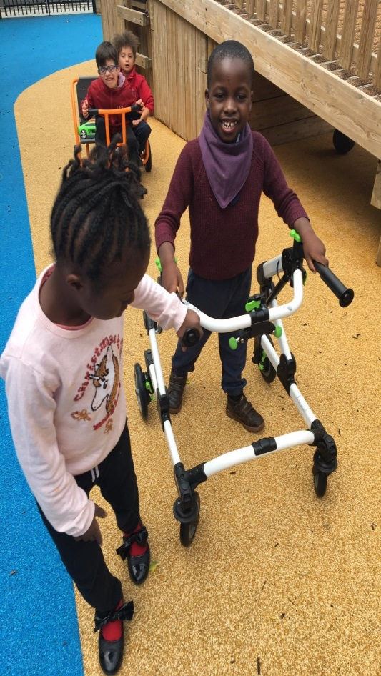
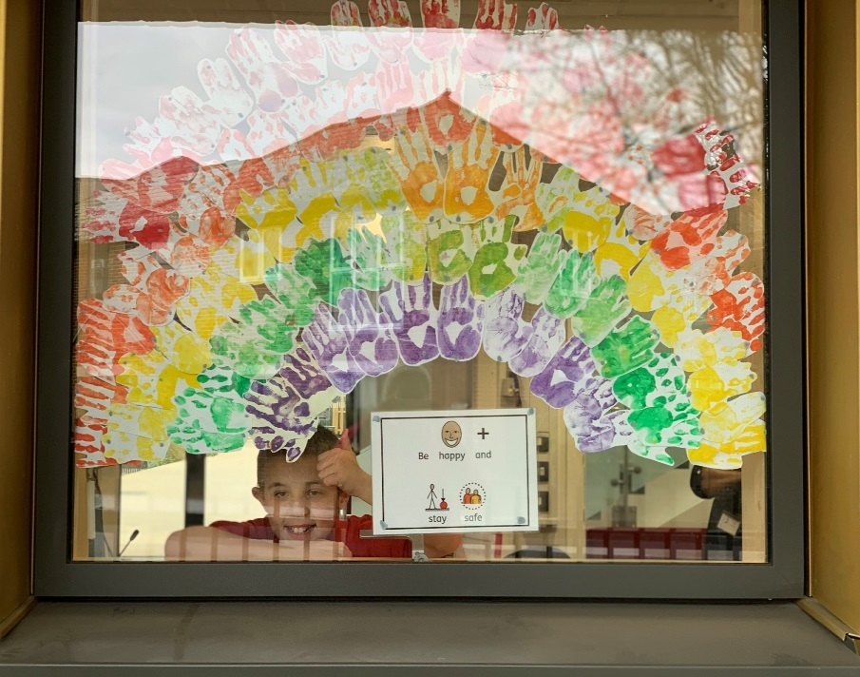
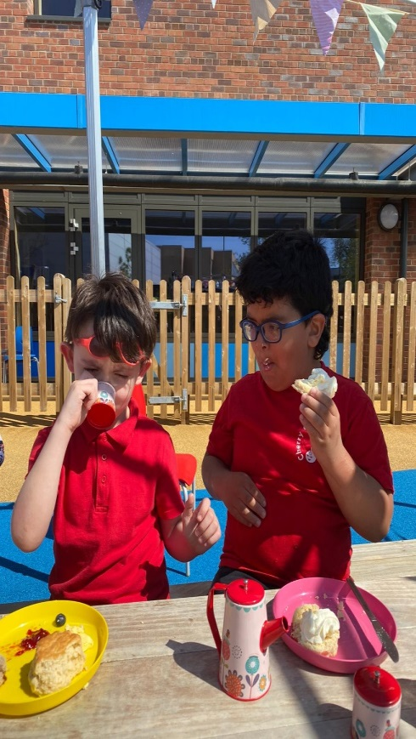
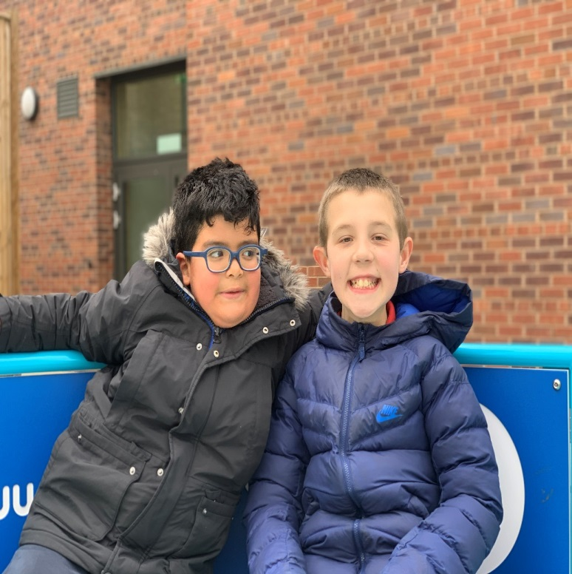
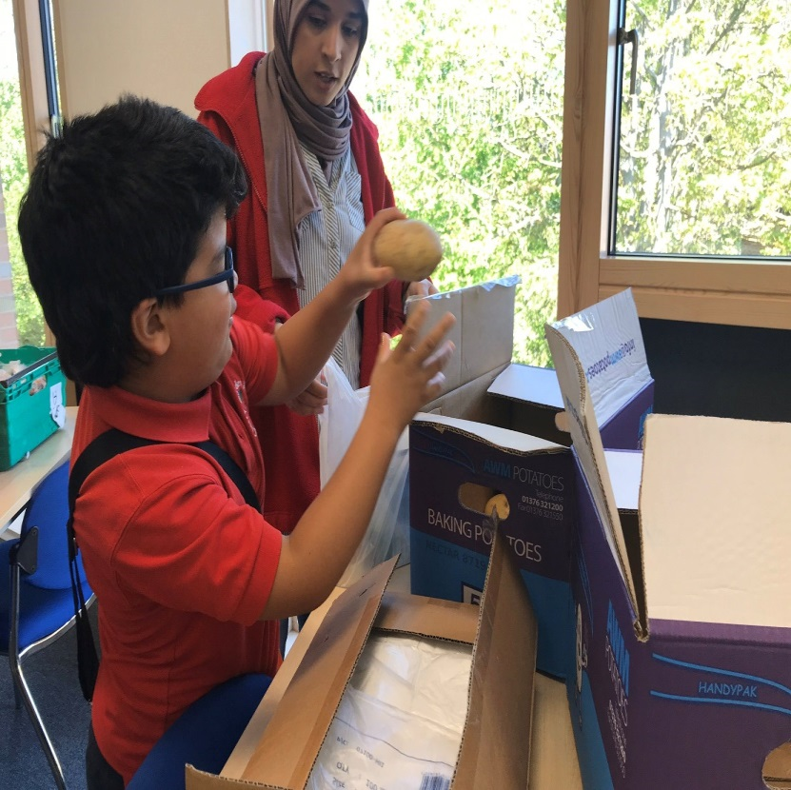

Slide 26
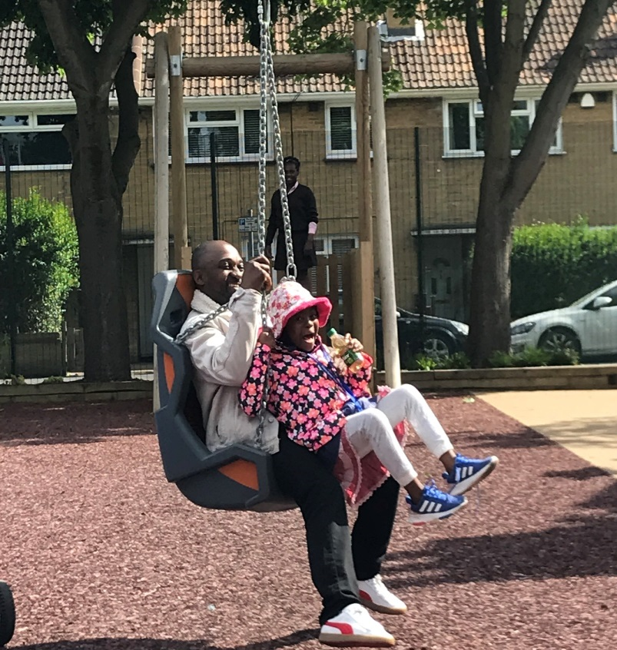
Playground initiative
After Easter we opened up one of the playgrounds for a different family to use after school each day. This has been very successful.

Slide 27
Home Learning
Weekly calls from teachers to check on welfare and learning programmes. All logged and sent to me and follow ups by me if needed.
Weekly emails with links to bespoke school videos/activities on Twitter, Instagram, Tapestry, u tube etc.
Videos/learning activities set by teachers and class staff every day in term time.
Speech and language therapist conducted weekly ‘Tele - therapy session’. Music therapist conducted sessions.
Class zoom social meetings and small group work with writing/reading focus.

Slide 28
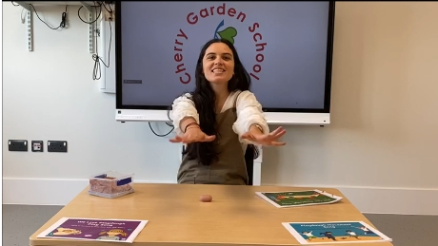

Slide 29
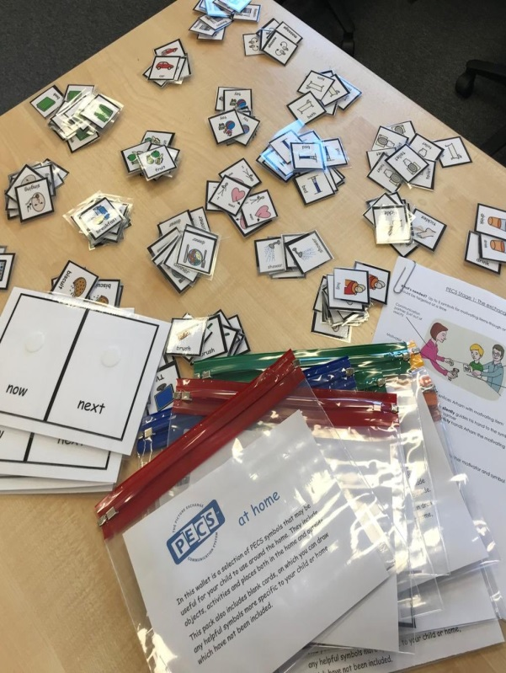
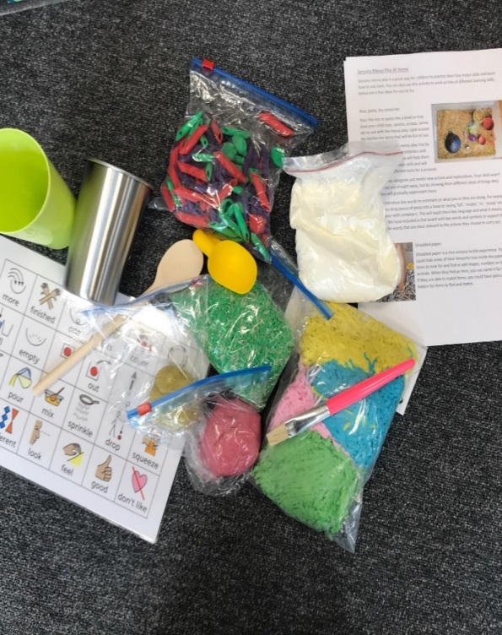
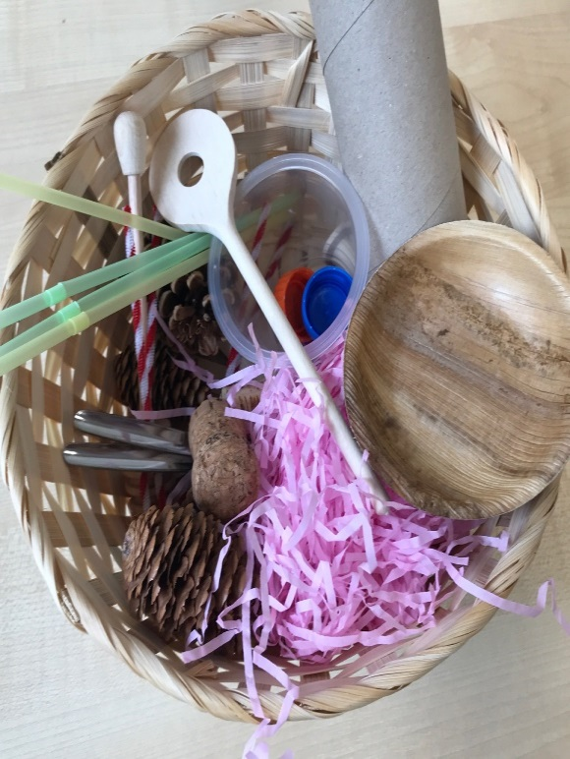
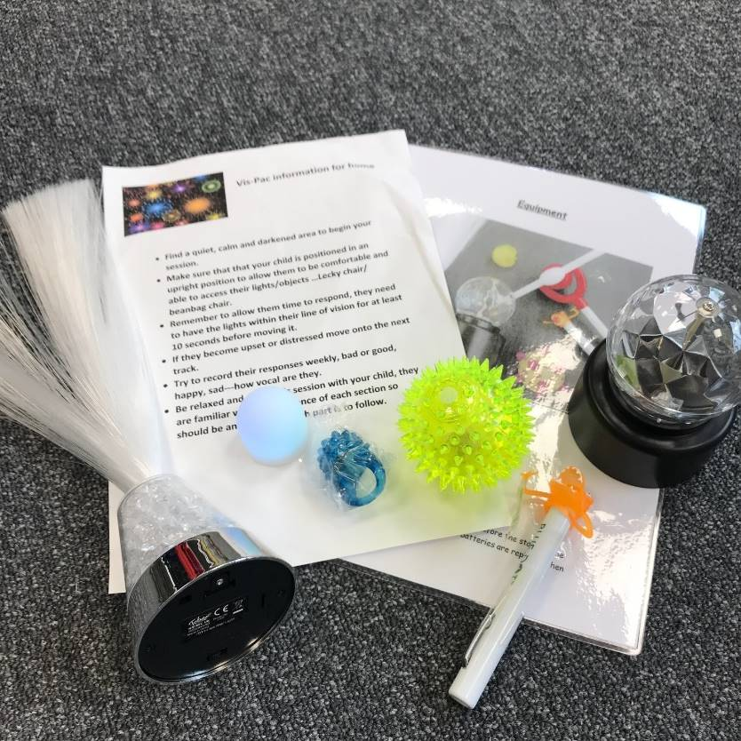
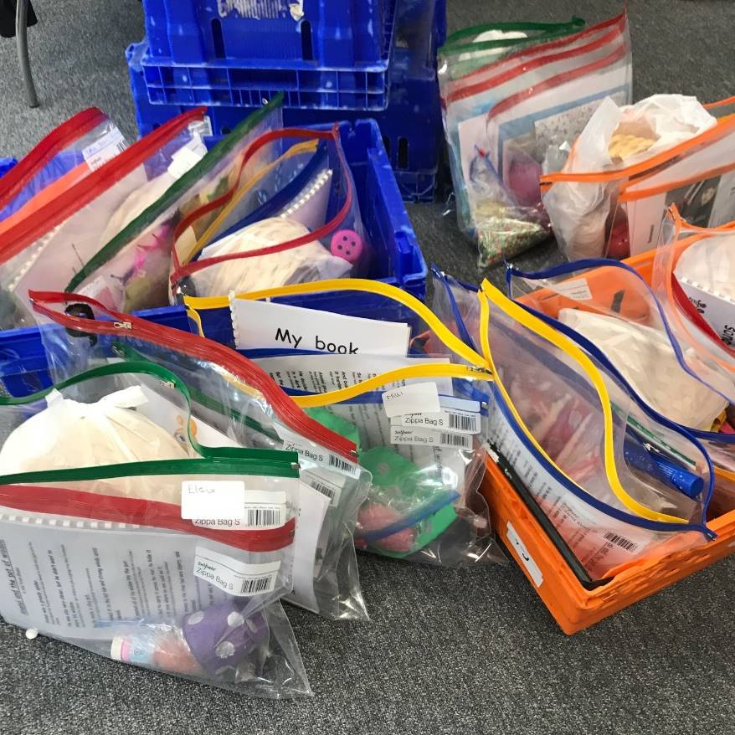

Slide 30
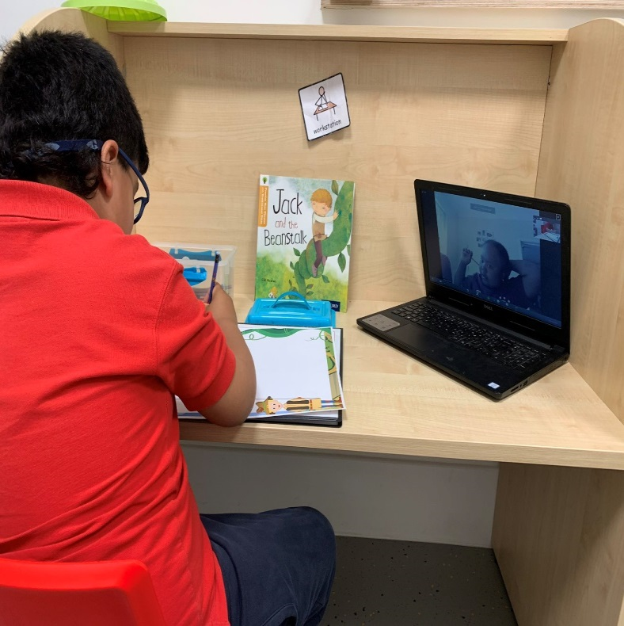
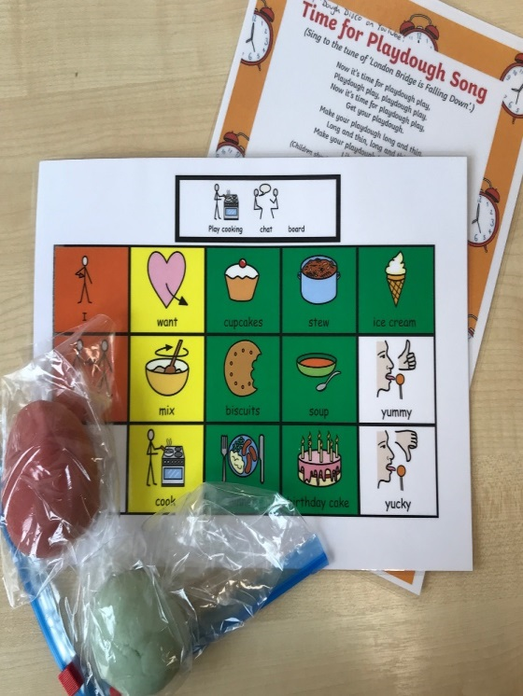
Home learning examples

Slide 31
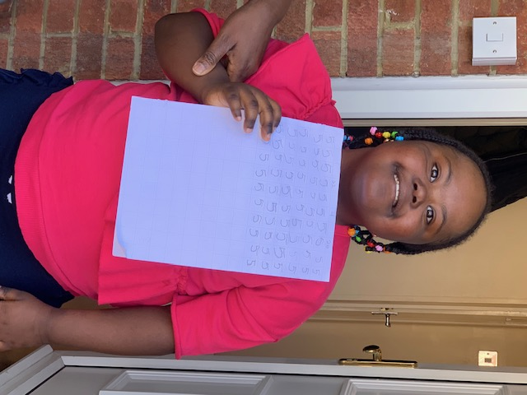

Slide 32
Shifting priorities
From 22nd June 60% of pupils will access school.
Set up a home learning team comprising of staff in vulnerable health category.
Focus is on making very bespoke sensory/visual resources for pupils with complex needs who will not return until Sept. 2020.
Transitioning for new children taking place.

Slide 33
Headteacher Journey
Beginning – Very challenging as we were a ship in the ocean with very few other ships around and unsure if we were steering in the right direction or whether might hit an iceberg. Confusing and conflicting Government advice has been challenging and media hype.
Middle – created a steady flow (new normal) we were comfortable with. All staff on a part-time rota and regular communications with all staff and parents.
End period (another new normal) – Ship has a clearer direction but still many uncertainties and the prolonged uncertainties take it’s toll on Headteachers and all staff.

Slide 34
Issues current/going forward
Staff shortage as due to staggered starts and half day Fridays in some schools. Potential staff shortages with self isolation/track and trace.
Different practises in different schools around public health guidance.
Clash of policies – Health and Education.

Slide 35
Questions?

Slide 36
Close
Dates of future meetings:
26 November 2020
25 March 2021
24 June 2021

Slide 37
Contact:
Martin Deutz, Chair
Mdeutz@compass-schools.com

