Slide 1
IMHARS. Sessions for parents and carers Building resilient families for the future

Slide 2
Introductions

Slide 3
The Southwark resilience framework
Improving Mental Health and Resilience in Schools (IMHARS) | Southwark Schools

Slide 4
The model describes the 10 components of school/ college life that can support and contribute to pupils’ positive mental health and resilience. Each section has some guidance, including questions for reflection and ideas for action, together with some useful quality assured resources. .

Slide 5
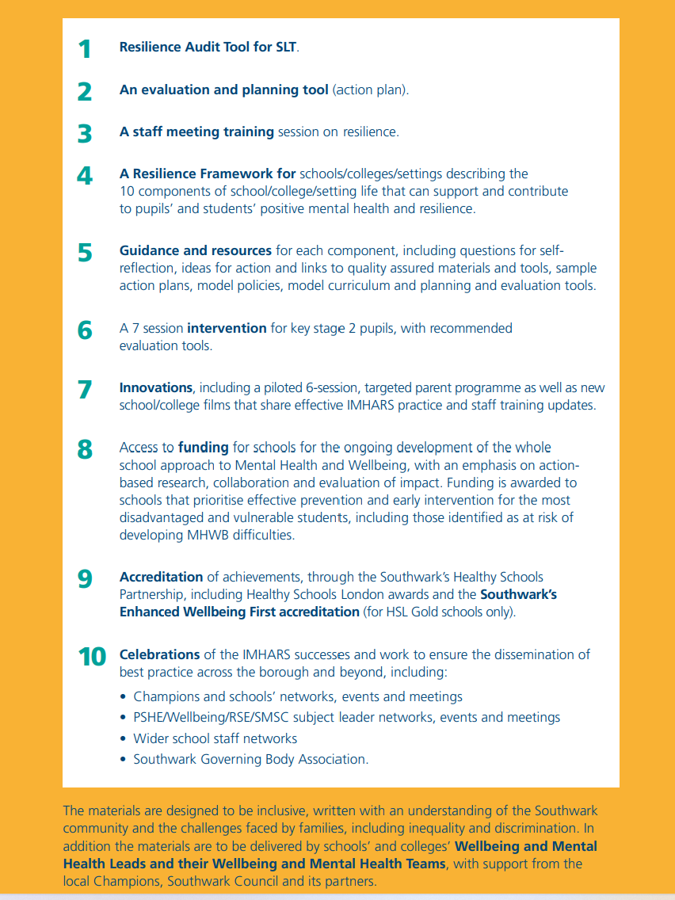

Slide 6
Evidence-base, research sources and funding
Southwark’s Wellbeing First IMHARS Guidance & Framework resource aimed at developing a whole school/college approach to improving mental health and resilience in schools and in local communities
Evidence-based and research-informed
Innovation: new schools-led collaboration, led by Rotherhithe Primary (River Hill Fed), in collaboration with Southwark Council, the Family Early Help service, the Educational Psychology Team, Southwark CAMHS service and Groundwork's The Nest open access service.
Designed for all educational settings including EYs, schools, and post-16 settings in Southwark
Signposts parents to resources from a range of organisations, including Public Health England and MindEd, The Anna Freud Centre and the NSPCC, etc
The programme was funded through Southwark Council’s IMHARS funding. The programme trialled in two Southwark schools and launched today

Slide 7
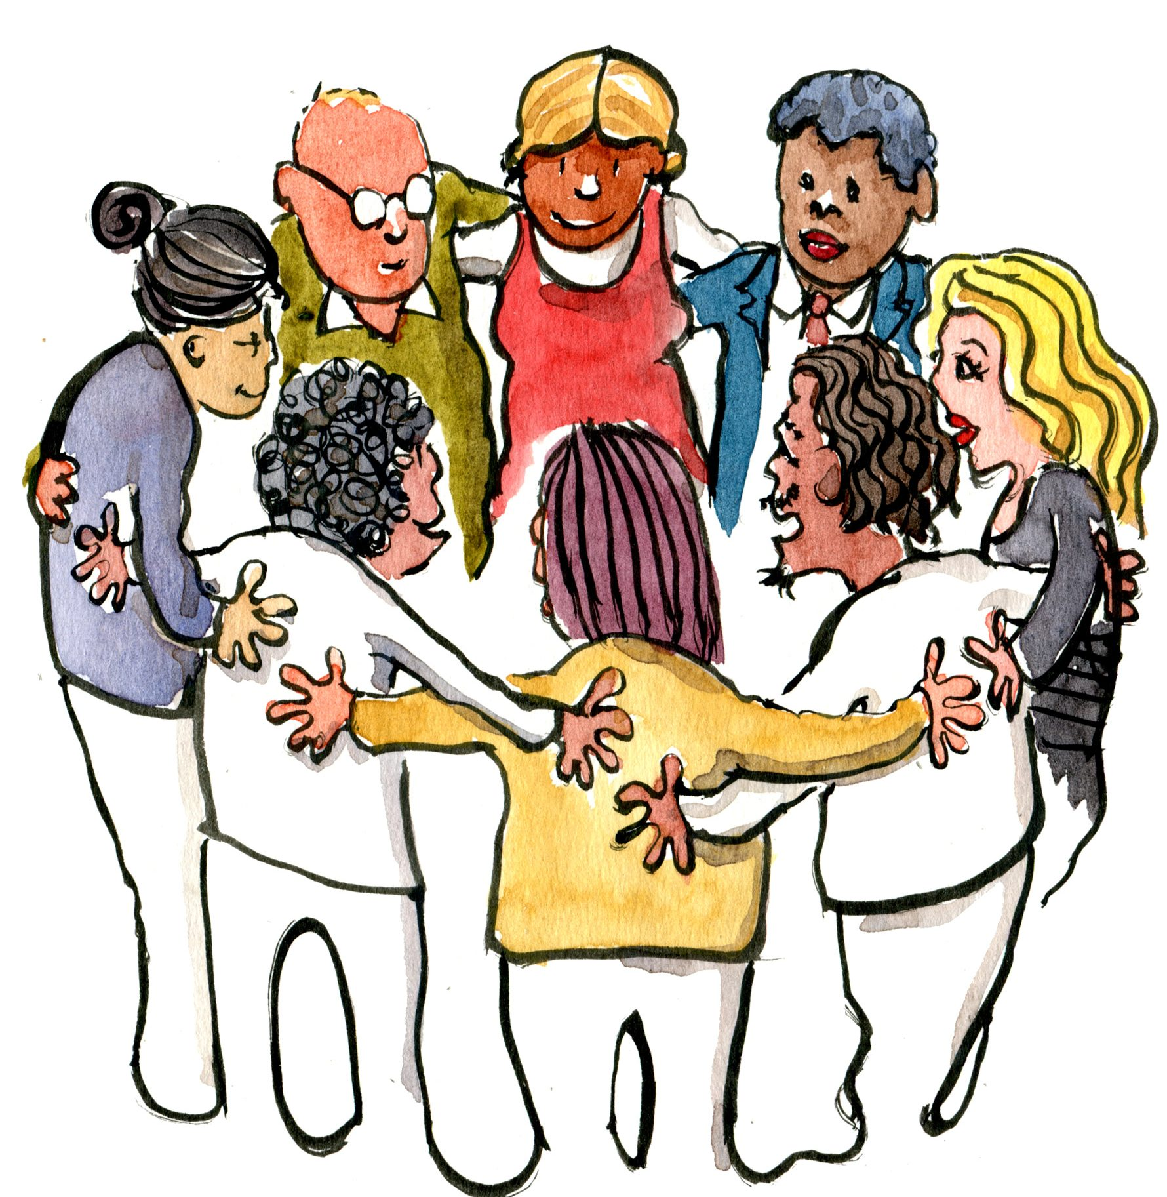
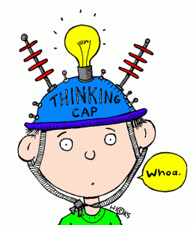
Action research approach
This Photo by Unknown Author is licensed under CC BY-SA-NC
This Photo by Unknown Author is licensed under CC BY-NC-ND
An innovative programme for all parents
Shaped by parents through their evaluation and contribution
Working in partnership with other services including The Nest.
Ensuring sustainability

Slide 8
Resilience
What does this mean to you?
This Photo by Unknown Author is licensed under CC BY-NC-ND

Slide 9
‘Resilience does not come from rare and special qualities but from the everyday magic of ordinary human resources in the minds, brains and bodies of ordinary children, in their families and relationships, and in their communities.’ Ann Masten, University of Minnesota

Slide 10
Why resilience
Resilience is defined by the NHS as “our bounce-back ability in the face of difficulty or challenges. Resilience is the ability to adapt and grow following adversity”.
Resilience is not a trait or a rare ability; in reality, it is found in the average individual, and it can be learned and developed by virtually anyone. Resilience should be considered a process. Most people face adversity and difficulties in their lives from time to time and it is through these experiences that we learn how to cope and develop strategies that will help us in the future.
Some children and families face many challenges in their everyday life that may weaken resilience or can become overwhelming. These can include, family problems, health difficulties, housing issues, isolation, trauma, discrimination, and poverty. Some families face more than one of these challenges in their daily lives. Learning resilient behaviours from an early age can help children and young people to gain agency over their own mental health and wellbeing and learn important strategies that can help them now and in the future.

Slide 11
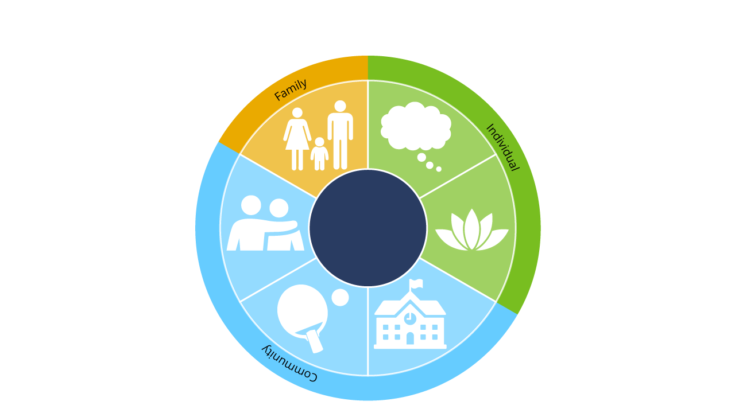
How Can We Learn To Be More Resilient?
Support steps to
help thinking positively
*Strong family relationships
*Supportive social networks
Self regulate and
manage stress
*Physical activities
*Enjoying school/college
(Masten 2014)

Slide 12
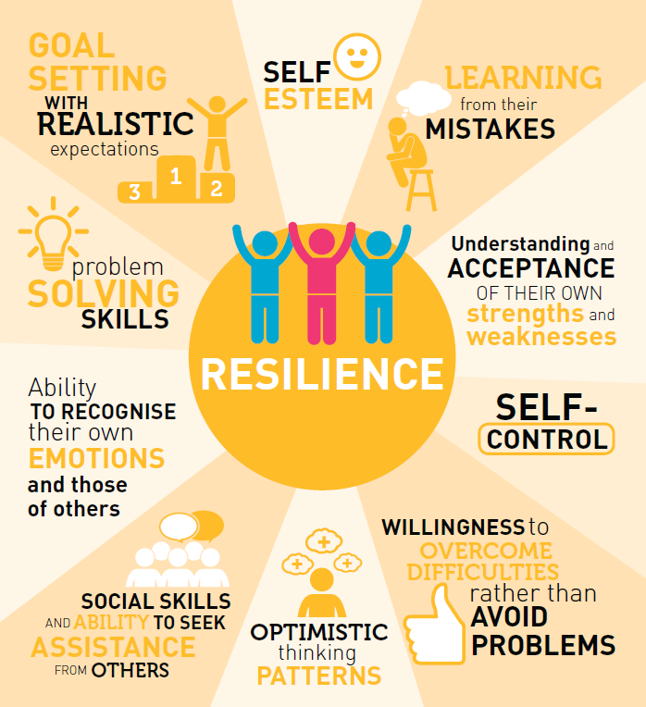
Looking at all the models in this training. Can you identify the components that contribute to building resilience?

Slide 13
Aims of the programme:
To provide an adaptable resource for schools and colleges to support parents and carers to
understand the provision the school has in place for children and young people to develop their emotional literacy including the PSHE and RSE curriculum currently being taught in school .To develop an understanding of how the schools approaches can be reinforced at home.
reflect on what resilience is and its importance in preventing later wellbeing and mental health difficulties
Understand the early signs of difficulties and where to seek help and support
Work together with other families to find ways of developing resilient behaviours as a family.
Become a parent mentor to help facilitate future courses and support other parents through the process.

Slide 14
Over view of the 7 sessions
Session 3: Building resilience: Looking after ourselves
Session 1:
Exploring resilience
Session 2:
understanding relationships and emotions
Session 4:
Building resilience: Supporting our children to stay safe when using technology
Session 6:
Building resilience: the importance of physical activity and creativity.
Session 7
Building resilience: Celebrating our resilience
Session 5: Understanding mental health and wellbeing difficulties in children

Slide 15
Wellbeing First :Building resilient families for the future
Session 1: Building resilience: Exploring resilience
Aims
To create a safe, emotionally warm and confidential space for working together
To understand the current context and focus in schools on developing resilience
To explore models and ideas of resilience.
Activities
Introductions, ground rules, creating a friendly safe and confidential space. Why are we here. Commitment to attending, survey/questionnaire. Setting expectations.
Why resilience and current mental health context, resilience pp
Explore our own resilience activity, hearing personal stories. Confirmation that we all have resilience, and we can teach this to our children
What are some of the barriers we are facing as families? Discussion
Outline the themes for planned sessions and what they will be covering and ask the group if there are other areas that they would like the sessions to include.
Reflection and discussion

Slide 16
Wellbeing First :Building resilient families for the future
Session 4: Building resilience: Looking after ourselves
Activities:
Revisit the model of resilience to place today’s themes in context
draw a social network map for your family, how could this be strengthened
Create a self-care plan
Identify activities and places for wellbeing in the local area.
Resources:
Public health England “Every Mind Matters” self-care tool kit. Video and free online plan
Self-care tips for parents Anna Freud
Reflection/discussion
Aims: To understand the importance of:
knowing ourselves and looking after our own needs
understanding our children through planned quality time
supportive social networks in the development of resilience
Homework: Choose two things from your selfcare plan to do this week and tell the group how it has made you feel.
Notes:
Each session has a set of resources presentations and guidance.
However :
In order to deliver this course you yourself will need to be knowledgeable yourself regarding the barriers facing families in Southwark have a clear understanding of resilience and the range of factors that influence it and have a trauma informed approach.

Slide 17
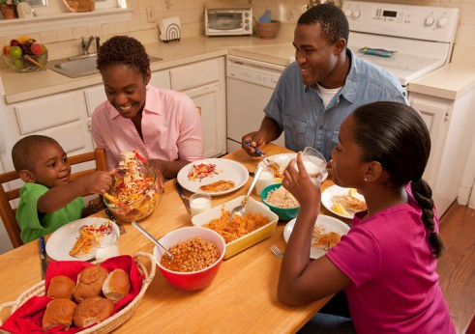
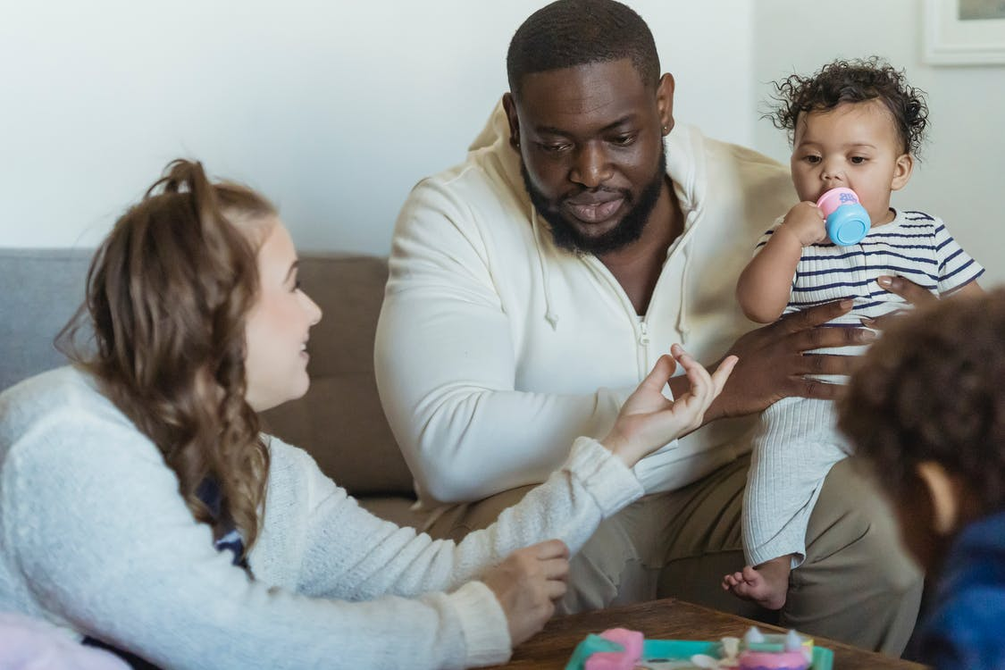
Who is this program for?
Identifying who is more at risk?
Targeted or universal?
This Photo by Unknown Author is licensed under CC BY
Choosing facilitators
Experienced with working with families
Collaborative/multi agency approach
Trauma informed
Mental health first aid trained
Understands resilience

Slide 18
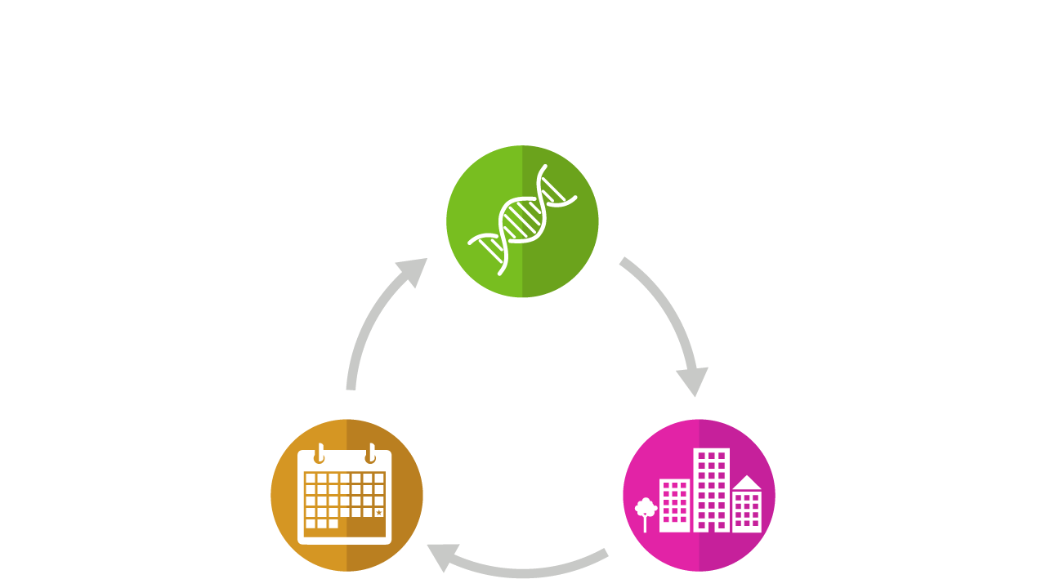
What Predicts Resilience?
Resilience (or lack of it) comes as a result of a complicated interaction between:
Nature
(what we are born with)
Events
(what happens to us)
Nurture
(what we grow up with)
(Shonkoff 2017)

Slide 19
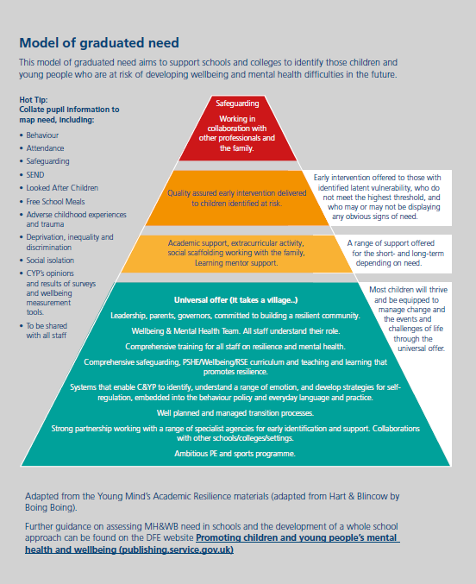

Slide 20
Schools trialling the parent sessions
Rotherhithe
Dog Kennel Hill
Achieved silver for their work on their whole school approach to IMHARS
Working on their gold
A champion school, who have achieved their Gold Healthy Schools award and with the current work on IMHARS on their way to achieving the enhanced award
Both schools are now ready to continue to provide this programme for parents.
1 trained member of staff and two parent mentors

Slide 21
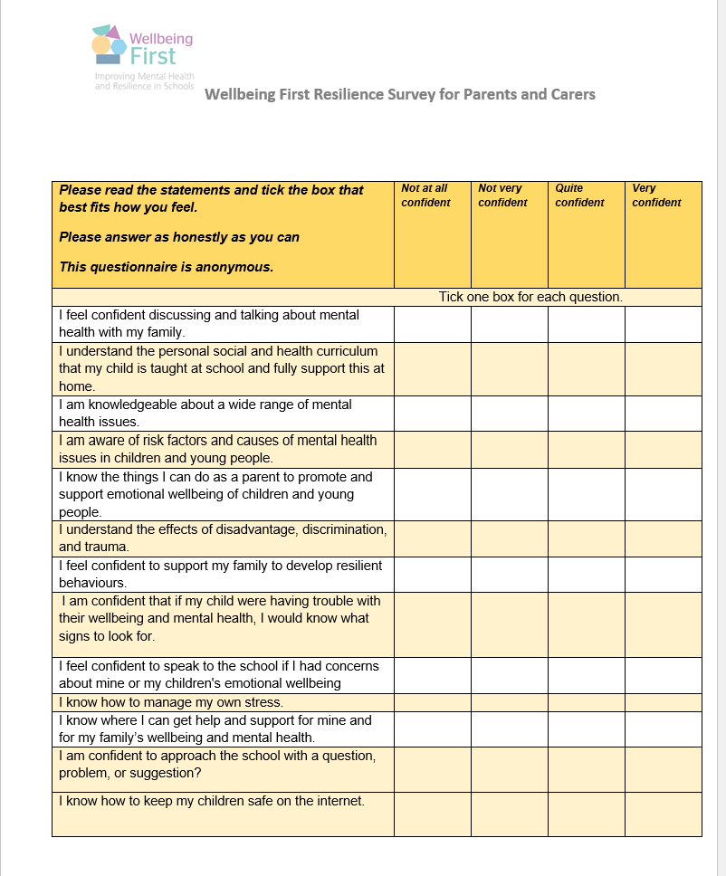
Evaluation the impact of the sessions
Parents are asked to complete this survey during the first session and again on the last.
This may need to be supported
Translated into different languages.

Slide 22
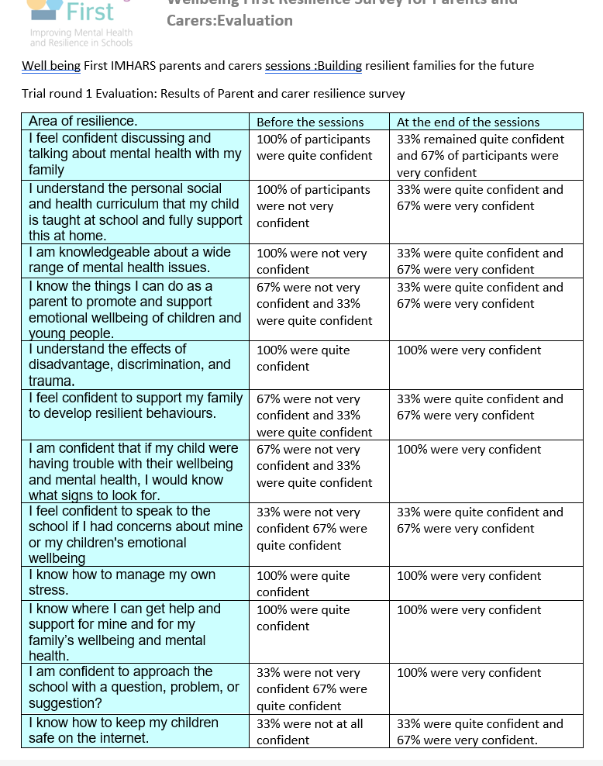
The results of the evaluation of first trial

Slide 23
Ways to engage parents
Lessons learned
Avoid the use of parenting or education language
Link headlines to success for learning and happy children
Use many ways of advertising and follow up with reminders and personal invitations
Encourage Parents to recruit other parents
Be prepared to respond to each groups different needs
Spend time creating the right ethos and developing relationships
Use a variety of publicity methods and what suits your parents/carers
Personally invite parents and take time to explain what the sessions are for
Be prepared to keep reminding
Provide childcare
Think about incentives to attend each course

Slide 24
Parents comments:
“I really enjoyed it, it made me really think about the amount of time we spend on screens and do I really know what is going on”
“It is very interesting to know what is happening in the school so that we can do the same and the children get the same teaching. I went home and talked about what zone I was in and my children were very surprised.”
“I liked the self-care session; I have learned to take care of myself better so that I can be there for my family.”
Parents suggestions for improvement for other parent/carer groups(trial 1)
“it would be really good if we could have more mindfulness, I really enjoyed that and I wanted to do that more and learn more about it. So if you could include mindfulness in every session that would be great.”
“I think you really need to think about how you advertise this course to parents. Many parents think that if it's for a parenting course and they are being asked to go that the school think that they are bad parents and they are somehow going to be watched and that's why people stay away from them. I think you really need to tell them that this course is about sharing information that's really important to keep their children safe and to help their family be happy and for the kids to be better learners.”

Slide 25
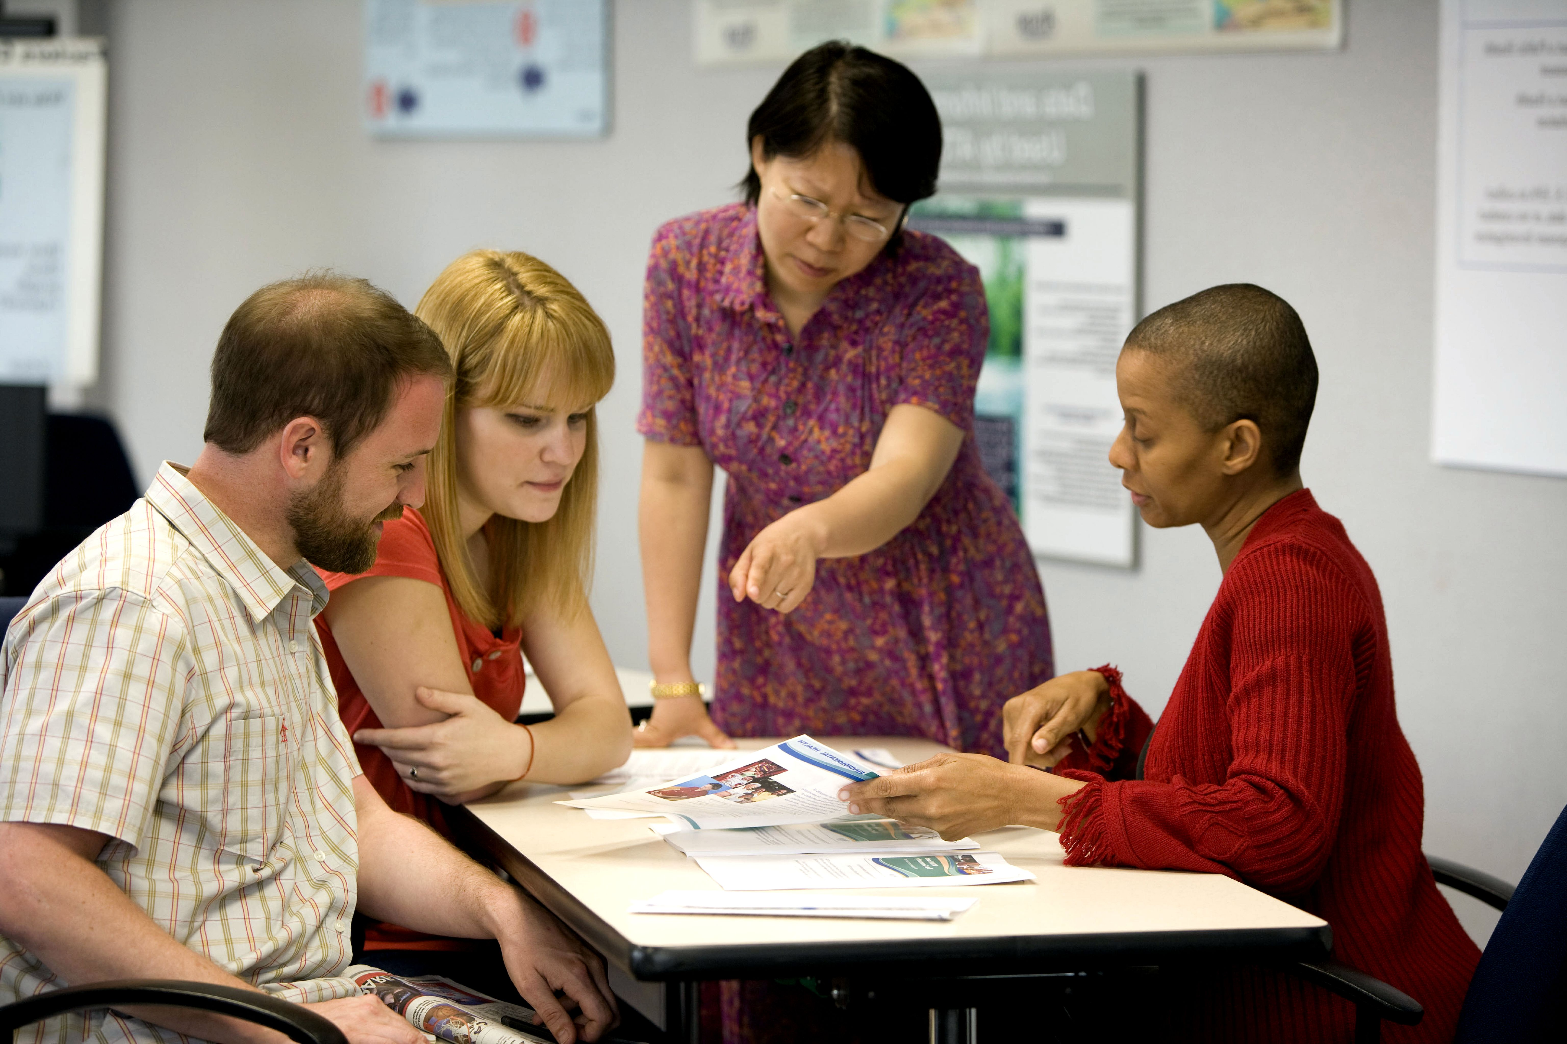
Creating sustainability: developing parent mentors
Providing support and training, including:
Creating an empowering environment
Safeguarding training
Adult mental health training
The experience of a parent mentor

Slide 26
For more info. on this new Wellbeing First IMHARS Parent Programme, email:
Lisa Christiansen: LChristiansen@rotherhithe.southwark.sch.uk
or
learningandachievement@southwark.gov.uk

