Slide 1
IMHARS Celebration Event
Friday 8th July 2022
Improving lives and outcomes for all

Slide 2
How effective partnerships support children and young people at St George’s CE Primary School

Slide 3
About St George’s
https://vimeo.com/704585951
Single form entry Church of England school
171 pupils on roll.
59% Pupil Premium. High levels of socio-economic deprivation.
7.6% EHCPs (13 currently), Southwark 2.9%, National 2.1%
22.2% overall SEN, Southwark 17.4%, National 14.6%
Diverse community: 38% Black Nigerian, 23% Black Caribbean, 13% Latin/South/Central America, 13% Black Sierra Leonian, 9% Black Ghanaian, 8% White British
43% EAL
9 refugee children (number has fluctuated throughout the year)- some have experienced traumatic journeys including small boat crossings

Slide 4
Goals in partnership working
Providing an intervention that cannot be replicated through day to day classroom experience- if a child is being withdrawn from classroom learning there need to be clear justifications and potential longer term benefits as to why we are doing so.
High levels of effective communication and engagement with partners. As a school we need to understand really well what the intervention/project is and what it’s goals are in order to select the pupils where it may have the highest impact.
Ensuring liaison between partners and classroom staff, particularly class teachers. If the class teachers don’t understand the `why’ , the `how’ and the `what’ how can aspects be transferred back into the classroom?

Slide 5
Across all schools/colleges in Southwark, the IMHARS framework model describes the 10 components of school/college life that can support and contribute to pupils’ positive mental health and resilience. Each section has some guidance, including questions for reflection and ideas for action, together with some useful quality assured resources.
1-1
ELSA
Small Groups
Classroom Interventions
Whole School Interventions
Notes:
Talk about the work you engaged in with Southwark champions group, particularly on developing a whole school approach and the schools journey to date. How this action plan is building on all of the work achieved so far with the PSHE/RES PE curriculum and all of the work on targeted approaches to MHWB and how to further embed a whole school approach across both schools.

Slide 6
Partnership work at St George’s
IMHARS project: Drama therapy
The Nest
ELSA
Gardening project

Slide 7
Drama therapy- our IMHARS funded project
Identification process
Children targeted were largely early stage EAL learners, including some who are also refugees, who were experiencing observable levels of anxiety and/or distress at being thrown into an unfamiliar language process
Two further children with high levels of emotional vulnerability.
Eight children across two groups, all KS2 but mixed age groupings.
Parental consent sought

Slide 8
Drama therapy- our IMHARS funded project
The intervention
Little Beings emerged as an aspect of Sam’s ongoing Dramatherapy practice in schools to meet with increased need within inner London communities since the global Covid pandemic. Crucially, this model facilitates active listening, relating, and processing, that doesn’t rely on verbal language alone. It promotes and encourages a safe playful and performative environment that nurtures increased resilience, self-esteem, confidence, and the ability to emotionally regulate. Little Beings are human-like flexible figures made using tissue paper and wool. Pupils are taught how to make their very own little being. Alongside creating them over the 10-week program, via kinesthetic performative learning, pupils are also guided through a recurring story-process that enables them to develop an origin story for their little being which they share with other pupils in their group.

Slide 9
Drama therapy- our IMHARS funded project
Impact
See evaluation but in summary:
Increased English vocabulary and confidence in speaking English from EAL learners
Increased confidence and participation in class
Reduced levels of emotional upset
Difficulties
Lack of sustained funding for the project
Would like Sam to work more closely with class teachers to share techniques that may translate into day to day practice

Slide 10
The Nest Southwark: -Free & confidential mental health & wellbeing support (11-25yrs) -Under 11's service -Strengthening Families -School Engagement Team – (KS1, KS2 & KS3)
Unit 4, Co-Operative House, Rye Ln, London SE15 4UP

Slide 11
Targeted Wellbeing Group 6 sessions (1hr)
Targeted wellbeing groups are offered for up to 6 student identified as needing more support.
Professional referrals, parental consent and 1:1 assessments completed prior to groups start date.
Groups are led by 2 wellbeing coaches each week.
Wellbeing groups run to date include:
Fears & Worries
General Wellbeing
Transitions
Supporting students at risk of exclusion
Notes:
Important to note that these are not therapeutic interventions and therefore pupil suitability should be checked prior to referrals being made.
Note that 'supporting students at risk of exclusion' is not the official name

Slide 12
St George's CoE Primary General Wellbeing Group Year 4
Each session contained the following:
Visual aid (PowerPoint presentation)
Discussion point
Creative activity (e.g. clay molding, drawing, collage)
Interactive game
Reflection
Weekly Topics:
Naming emotions (comfortable and uncomfortable)
Where do we feel emotion in our body? (e.g. psychosomatic presentations of uncomfortable emotions)
Strategies to support emotional regulation (self-led & supported methods)
Who can support us with uncomfortable emotions?
Promoting self-esteem (e.g. 'What are my strengths' 'Being the best me')

Slide 13
Pupil Feedback
Group efficacy is measured by asking pupils the following questions upon group completion:
I have enjoyed being part of the wellbeing sessions
I can name 3 uncomfortable emotions and when I am most likely to feel these emotions
I can name and demonstrate 2 strategies to manage uncomfortable emotions
I can name 3 people I should ask for help if I need more support with managing my uncomfortable emotions
Notes:
When pupils are unable to answer questions and/or demonstrate they need further support, school/ parent/carer will be contacted and signposted to appropriate services
Pupils are asked to name strategies and people to ensure they can recall what they have learnt in sessions.

Slide 14
Staff Training The Impact of Trauma on CYP's
Staff Training- 60 Minutes (Option of in person or virtual delivery)
Optional meeting with school lead prior to training to discuss specific need.
Information on different types of trauma (e.g. Neglect, racial trauma, bullying, mental & physcial abuse).
The impact of trauma on brain, behaviour and learning.
Discussion around common presentations of CYP's affected by trauma.
Strategies to support CYP's impacted by trauma.
Signposting to The Nest & other relevant wellbeing organisations.
Data collection

Slide 15
" Made me want to explore more ways that we could support children who have experienced trauma.”
“Very informative. I have a better understanding of how trauma impacts upon children’s lives and how this can affect them in school.”
" Training was effective and well-delivered.”
Qualitative Feedback :
*Quantitative Feedback:
83%
KPI1- 80% positive awareness raising for the Nest
KPI2- 80% positive responses on topic knowledge
85%
*Average of staff trainings to date

Slide 16
Universal Whole Class Workshops Identity & Self Esteem: 'Being the Best Me!'
50 Minute Workshop:
Optional meeting with school lead prior to training to discuss specific need.
Class discussion on 'Identity' (e.g. What does it mean? What makes up our identity? What similarities and differences to we have as a class?)
Video & class feedback - Why is it important to celebrate difference?
Creative activity aimed at highlighting strengths as individuals and strengths as a class
Feedback form completion
Notes:
Workshops tweaked for different year groups to cater to different levels of understanding

Slide 17
82%
78%
81%
86%
82%
86%
85%
Notes:
KPI- 80% - for positive answers ('a little' or 'a lot')
The only KPI not met was 'Do you know how to contact The Nest' - this one is tricky with primary ages as they are not making direct contact with The Nest

Slide 18
ELSA (Emotional Literacy Support Assistant)
https://www.elsanetwork.org/ Elsa@southwark.gov.uk
Teaching assistants trained by Educational Psychologists to deliver bespoke interventions to develop emotional literacy
St George’s has two trained ELSAs
Sustainable model- enables school to provide early intervention support for children who may be experiencing emotional difficulties, stressful life events or have neurodevelopmental conditions (such as ADHD or autism) that may make emotional and interactional aspects of day to day socialisation
Identification
Children flagged by class teachers, Senior Leadership Team or other staff members. This is usually triggered by behaviours that indicate difficulties in the emotional realm e.g. difficulties in social interactions and making friends, catastrophising and shutting down, difficulties in managing big emotions
Parental consent sought

Slide 19
ELSA (Emotional Literacy Support Assistant)
The Intervention
Minimum 6 sessions either 1:1 or in bespoke pairs or groups (depending on what is needed)
Review after these sessions as to whether further sessions needs or whether strategies are sufficiently embedded
Liaison with class staff as to application of strategies on a day to day basis
Impact
More application of strategies by pupils
Ongoing supervision sessions on half-termly basis with EP service support problem solving

Slide 20
Gardening project
Project led by one of the school governors, Pascale Vissie
Identification
Children with SEND, EAL or social and emotional difficulties
Small groups (4-6) from all classes
Impact
“In the Autumn term 2020, the school head and I were keen to develop some outdoor educational activities for the pupils. A greenfingered former pupil who was struggling with the lockdown was willing (press ganged!) into rebuilding the raised beds and giving advice on what to plant. We ran monthly gardening sessions with all the school and met on Saturdays to tend the beds. The children's enthusiasm for nature and gardening - last year we grew tomatoes, kohl rabi, onions and sunflowers in small raised beds - has been wonderful. This year, with the support of parents and local residents we've explored and maintained some of the wilder parts of the school grounds and started composting with the school catering team. Groups of six children have been chosen from each year group to attend weekly gardening sessions and the whole school joins in every 4-6 weeks. The children have been fascinated to explore the bugs and slugs and learn more about pollinators. We've planted-up some old planters in the playground with lavender, chard and calendula and teams of pupils are taking responsibility for watering. Receiving the Bee Garden will be a tremendous boost to our burgeoning gardening club and we are excited that the launch will bring in more parents and local residents to enjoy the garden and support the young gardeners. Year 6 and Year 5 pupils have taken the #GrowWell challenge to spread happiness and mental wellbeing by growing and sharing calendula plants. We will be taking some to a local Caribbean Day Centre for Elders and chatting with them about their experiences of gardening."

Slide 21
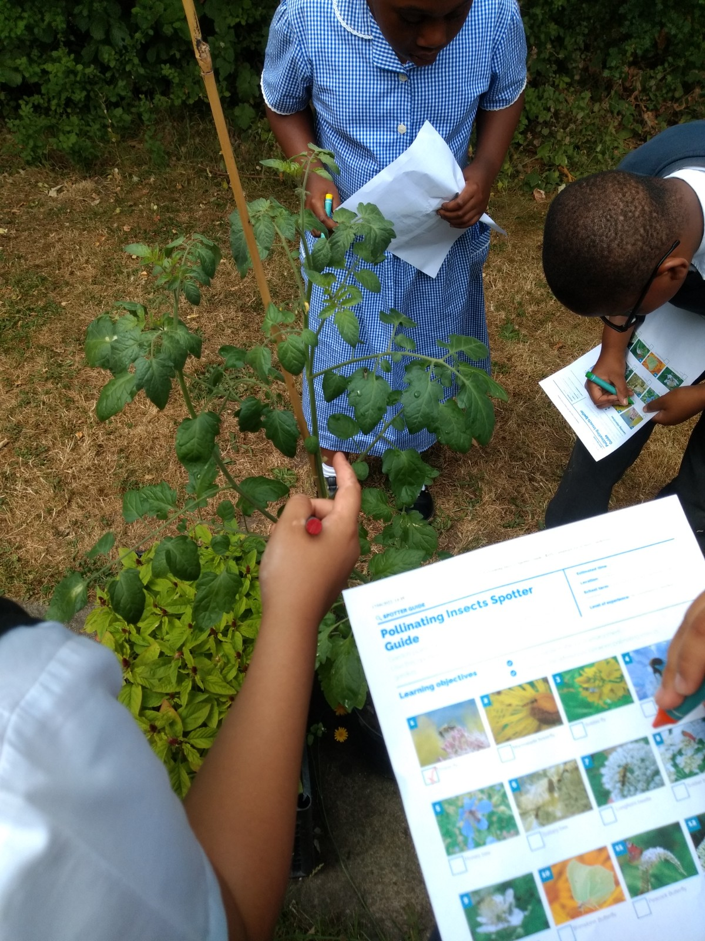
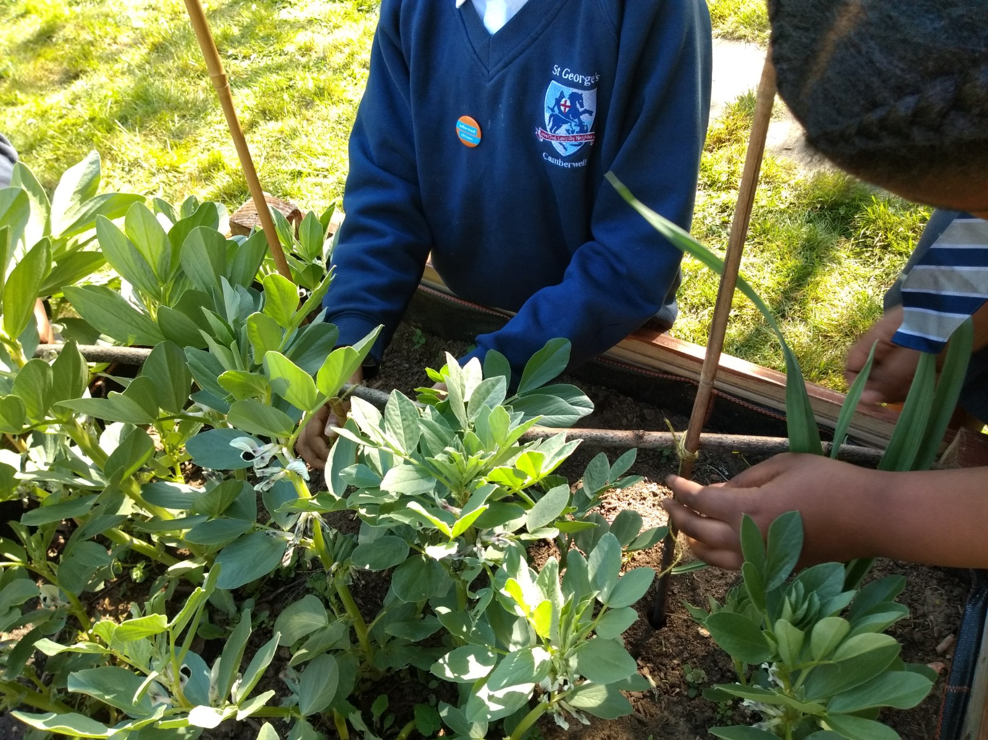
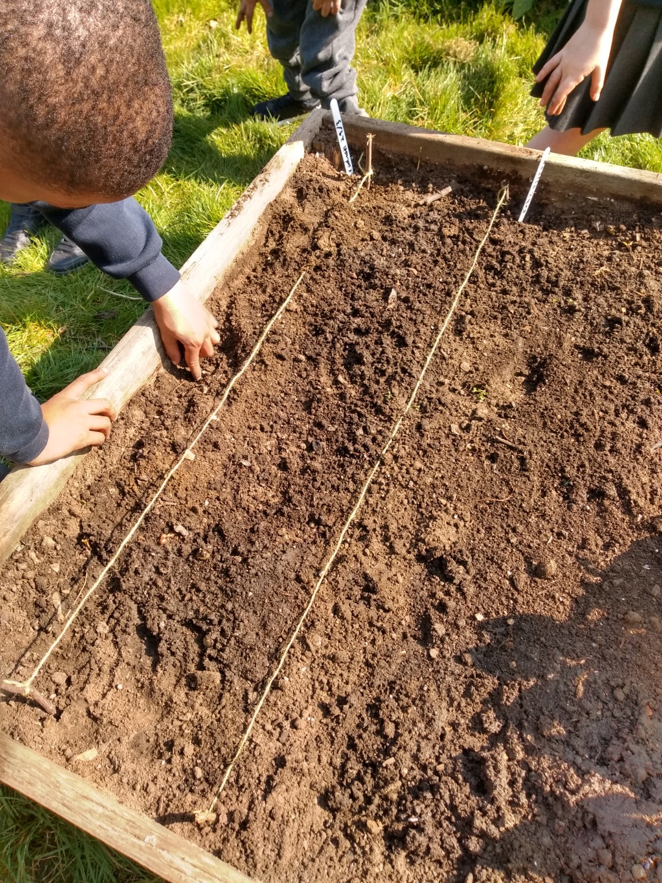
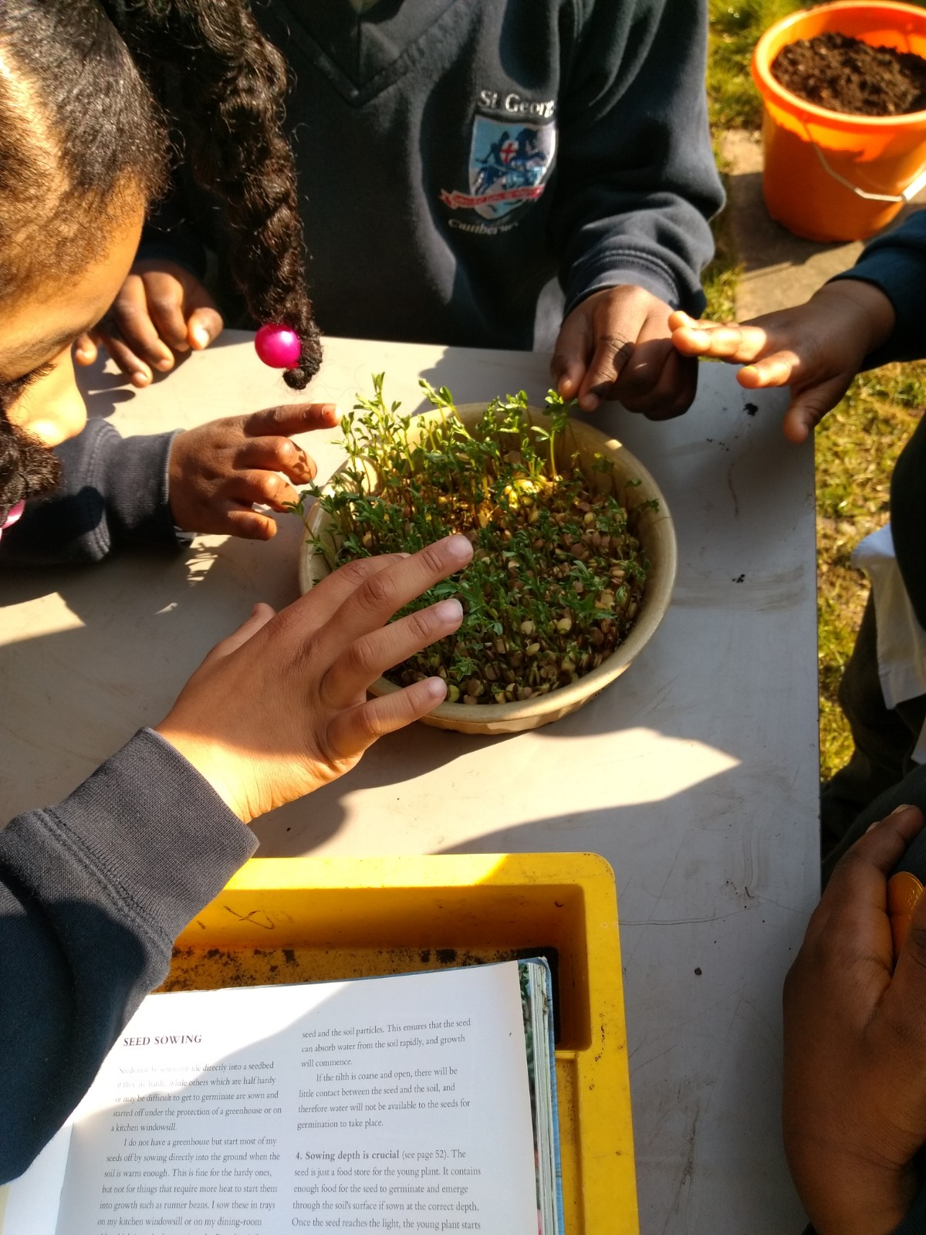
Gardening project

Slide 22
What partnerships do you have for pupil well-being, mental health and resilience?

