Slide 1

Improving Mental Health & Resilience in Schools/Colleges (IMHARS) through a whole school/college, inclusive approach and building on our success through effective collaboration and partnership
lee.souter@southwark.gov.uk
learningandachievement@southwark.gov.uk
Oct 22

Slide 2


What qualities would you want this child to have by the time they leave your school?
Improving lives and
outcomes for all
Notes:
Come back to these later

Slide 3
IMHARS Strategic Programme Board
“Improving Mental Health & Resilience in Schools”, aligned to Council’s Plan and H&WB Board’s Ambition:
‘100% of Southwark children and young people get access to emotional wellbeing or mental health services so that the need (and waiting times) for specialist services is reduced; and to ensure that children and young people (and their families) who must wait for specialist services are well supported.”
Programme aim:
One overarching aim is to build resilience through schools so that:
-children and young people can cope with life challenges and,
-by ensuring more children live in stronger families.
We aim to deliver a sustainable, universal infrastructure across all schools.

Slide 4







Improving Mental Health and Resilience in Schools (IMHARS) Programme – prevention focus
92 schools received funding to improve mental health & resilience in schools, benefiting over 30,000+ pupils across 5 nursery, 64 primary, 6 special and 17 secondary schools
350+ Mental Health First Aiders across 95 schools
£
103 schools have received IMHARS funding and/or have a Mental Health First Aider
100% of schools have engaged with Southwark’s Wellbeing First IMHARS programme and wider offer
85+ schools have achieved Southwark’s “Wellbeing First IMHARS” or Healthy Schools London awards, with 25+ with Enhanced or Gold
14 IMHARS & Healthy Schools Champions supported 30+ schools, through school-to-school work and/or sharing IMHARS practice during 21/22
101 delegates from 48 schools have participated in “Wellbeing First IMHARS” training/CPD/workshops during 21/22
20 Headteachers have participated in leadership coaching to support school effectiveness during 21/22

Slide 5
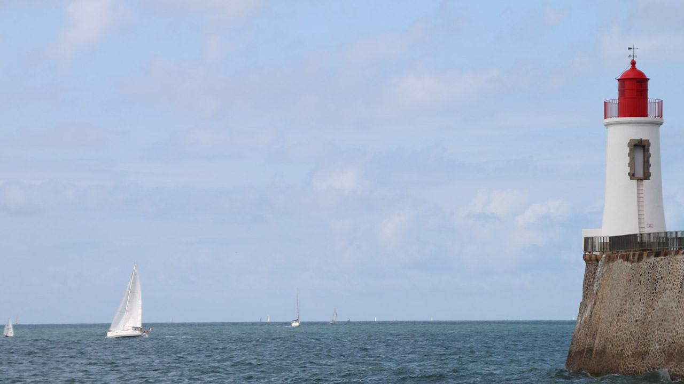

Your success…
Many people will retain their wellbeing and resilience.
Some will need more support to recover.
A Whole School/College approach which:
builds relationships and flexible coping as well as renews a sense of agency
values emotional wellbeing
and re-affirms safety and routines
will maximise learning and growth
Schools and Colleges truly can be... guiding lighthouses and safe havens in a sea of uncertainty
Y
Photo by Théophile Péron on Unsplash
(Whole School SEND 2020)
Notes:
LS
We hope you enjoyed the pre-course reading, activities and Qs – and we look forward to hearing more from you.
MindEd Guidance for Trainers
Key idea:
This slide is a recap of what we have been learning and implementing across Southwark for many years through the offer for schools/colleges (e.g. as part of Healthy Schools London accreditations, PSHE & Wellbeing Education incl. Relationships Education, training and CPD incl. Mental Health First Aid, Tackling Domestic Abuse, EPS, from the Council’s partners and collaborations like health, social care, voluntary sector, etc) so far as applied to Staff but of equal relevance to children, young people, parents and carers.

Slide 6
Schools/Colleges
Are guiding lighthouses and offer safe harbours ...havens in a sea of uncertainty
Provide predictability,
consistency, availability,shared identity and the promise of change
…are engines of growth in time of turmoil
Photo by Théophile Péron on Unsplash
Notes:
This lighthouse slide links with the “key points” slide at the start of webinar one – what schools/colleges excel at across Southwark
MindEd Guidance for Trainers
Key idea:
This slide presents a summary of the ways schools/colleges synergise with this recovery and wellbeing agenda.

Slide 7
Southwark’s Wellbeing First: IMHARS Framework
Framework and model created by IMHARS & HS School Champions for all schools/colleges across Southwark: Improving Mental Health and Resilience in Schools (IMHARS) | Southwark Schools
Includes IMHARS Guidance and schools’ IMHARS films: Improving Mental Health and Resilience in Schools (IMHARS) | Southwark Schools

Slide 8
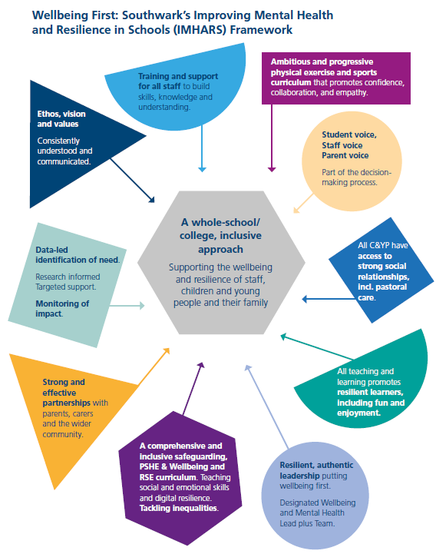
Across all schools/colleges, Southwark’s IMHARS framework describes the 10 components/principles of school life that promote mental health & emotional wellbeing as part of IMHARS whole school/college, inclusive approach:
The components support and contribute to pupils’ positive mental health and resilience. Each component has some guidance, including questions for reflection and ideas for action, together with some useful quality assured resources.
1-1
ELSA
Small Groups
Classroom Interventions
Whole School Interventions
Notes:
Talk about the work you engaged in with Southwark Champions Group, particularly on developing a whole school approach and the schools journey to date. How this action plan is building on all of the work achieved so far with the PSHE/RES PE curriculum and all of the work on targeted approaches to MHWB and how to further embed a whole school approach across both schools.

Slide 9
Success Stories–Schools’ IMHARS films
https://schools.southwark.gov.uk/pshe-healthy-schools/imhars

Slide 10

IMHARS Champions: school for school collaboration work
Wellbeing First IMHARS Guidance & Framework: school to school support, sharing practice and awards scheme
Model PSHE/RSE & HE Curriculum, policies & assessment group: Southwark’s model curriculum framework, resources banks, reading lists and assessment tools up to date and in line with current thinking, support curr. training, plus school to school work
Funding Assessment Panel and Evaluation & Moderation: Assess, evaluate and moderate applications for funding, action plans for HSL bronze, silver and gold and/or Wellbeing First IMHARS awards
Training & CPD:
where appropriate, deliver training/support on own expertise in the field
Quality Assurance and Lead school for the localities: support QA-processes and will plan regular termly meetings in schools and the focus of those meetings.

Slide 11
Success Stories, Celebration & Closing
School IMHARS films:
https://schools.southwark.gov.uk/pshe-healthy-schools/imhars

Slide 12
PSHE & Wellbeing Education

Slide 13
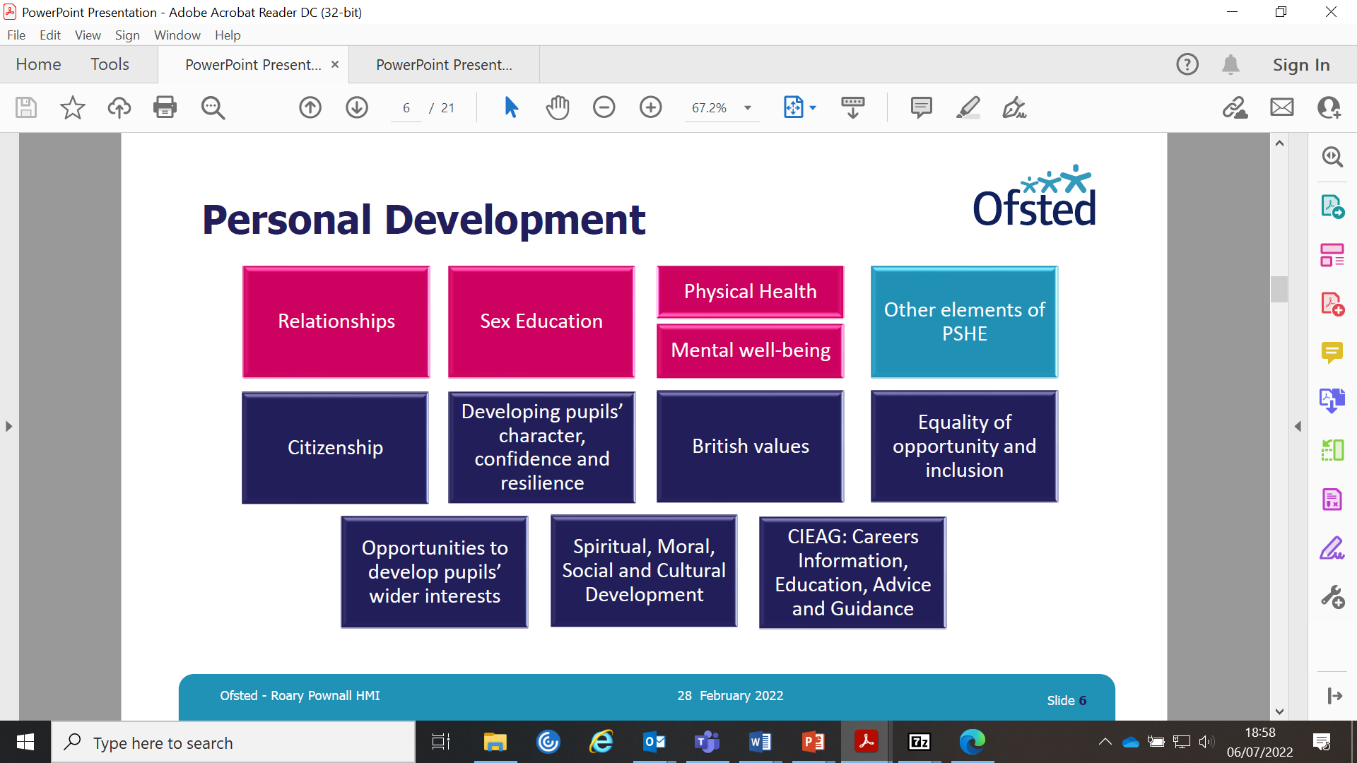

Slide 14
Updates & priorities
Golden threads - “Tackling & Preventing Inequalities” and “Promoting Inclusion, Diversity & Equalities” (SST)
Sharing practice - IMHARS materials, Framework & Guidance, curriculum framework development & films
Innovations:
  schools-led collaborations, launch of “Resilient Families Programme”
  coaching & professional supervision pilot & new WB First support programmes
Strengthen schools-led collaborations (e.g. QA process, special projects, new Learning Hub, new resilience programmes, etc)

Slide 15
Updates & priorities
Golden threads - “Tackling & Preventing Inequalities” and “Promoting Inclusion, Diversity & Equalities” (SST)
Innovation funding & Special Projects (e.g. prevention focus in EYs & Family Hubs, SEND, etc)
Enhanced accreditation (e.g. Centres of Excellence)
Enhance PA/fitness/PE/Sports offer for schools
Bespoke training/CPD
DfE’s Link Programme:
  Development of integrated working to promote rapid and better access to support
  Use of outcome measures

Slide 16
School updates
Mental Health First Aid (MHFA) 2 Day Course,, Book your place
Whole Staff Training: Trauma and Mental Health-Informed Schools & Communities, 11th Nov, Register here
Building Resilience Through Social & Emotional Learning, 1st Nov, Register here
Free Subscription to PSHE Association & Planning Framework for Pupils with SEND (pshe-association.org.uk)
Resources, including digital assets to share on your social media pages at promote.kooth.com Eleanor Cammegh - ecammegh@kooth.com
Black History Month in October -for resources that you can use for teaching or learning: Black History Month 2022 - Time for Change: Action Not Words and Historical Association – the UK national charity for history
Anti-Bullying Week -Mon 14th - Friday 18th Nov, with the theme Reach Out. Find out more here

Slide 17
Your takeaways…sustainability
“Wellbeing First IMHARS” two-hr timeslot for a “support visit”, sign up (see staff)
WER & IMHARS funding – wave 5 & innovations funding
Collaborations, partnerships & networks
Ongoing CPD & training offer
School IMHARS films, plus support with “creating your own IMHARS films”
All new “Wellbeing First” resources - https://schools.southwark.gov.uk/pshe-healthy-schools/imhars
Your homework – one-hour of pure happiness
x

Slide 18
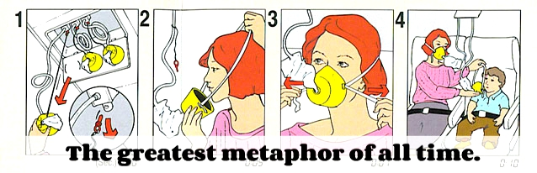
Looking after yourself
Just as you would on an aircraft, ensure that you put the oxygen mask on yourself, before trying to support everyone else.
If you are not emotionally well and resilient, you cannot look after anyone else.

Slide 19
Celebration – Awards Ceremony
Nikki Tilson, Principal Adviser for Southwark SELA Team

Slide 20

Healthy Schools Bronze Award
  Michael Faraday Primary
  John Keats Primary
  Ivydale Primary
  Riverside Primary

Slide 21
Healthy Schools Silver Award
  Bellenden Primary School
  Heber Primary School
  Michael Faraday Primary School

Slide 22
Healthy Schools Gold Award
  Heber Primary School

Slide 23

New First Steps (Enhanced)
  Beormund Primary School
  St Joseph's Camberwell Catholic Schools' Federation
  Rye Oak Primary School

Slide 24
New Enhanced
  Beormund Primary School
  Peter Hills with St Mary's & St Paul's
  Rotherhithe Primary School
  Southwark Park Primary School
  Harris Girls’ Academy East Dulwich

Slide 25
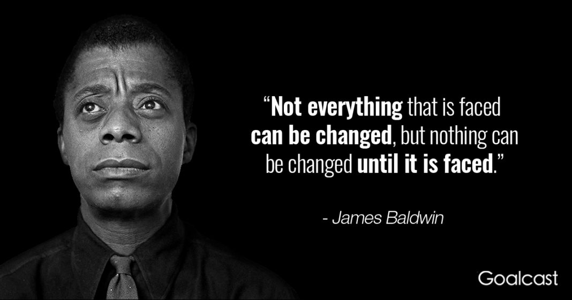
Remain inspired..courtesy of James Baldwin

