Slide 1
IMHARS Celebration Event
Thursday 13th October 2022
Improving lives and outcomes for all

Slide 2
Becoming Trauma Informed

Slide 3
Across all schools/colleges in Southwark, the IMHARS framework model describes the 10 components of school/college life that can support and contribute to pupils’ positive mental health and resilience. Each section has some guidance, including questions for reflection and ideas for action, together with some useful quality assured resources.
1-1
ELSA
Small Groups
Classroom Interventions
Whole School Interventions
Notes:
Talk about the work you engaged in with Southwark champions group, particularly on developing a whole school approach and the schools journey to date. How this action plan is building on all of the work achieved so far with the PSHE/RES PE curriculum and all of the work on targeted approaches to MHWB and how to further embed a whole school approach across both schools.

Slide 4
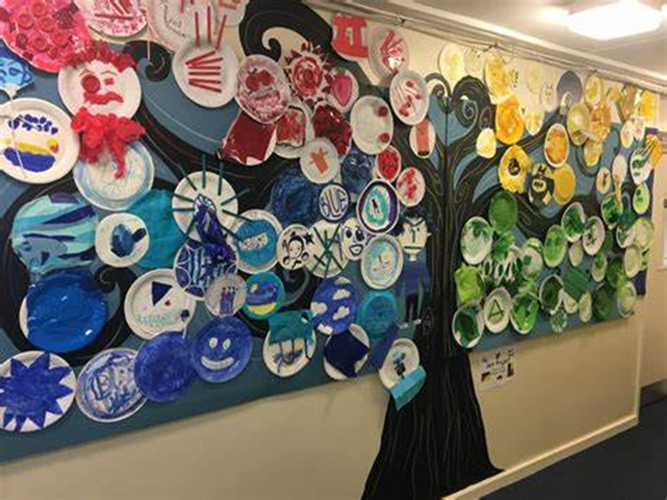
Demographics of our school
‘It’s a school filled with vibrant, intelligent, creative, challenging, kind, witty and resilient children who never fail to make you smile. It’s a setting where’s no two days are ever the same’

Slide 5
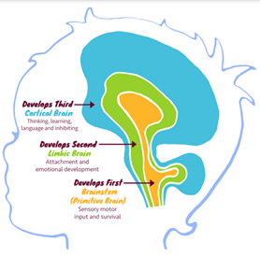
All pupils excluded from mainstream, all have an ACE score of 1 or above.
87% have an ACE score of 3 or above. As ACE score increase so does risk of mental illness and attachment issues.
Grown up in unpredictable & stressful environments that have resulted in prolonged exposure to stress and high levels of cortisol.
Polyvagal theory
Threatened = SOCIAL DEFENCE SYSTEM – fight or flight, primitive brain, CRF,
high levels of cortisol. Primitive brain doesn’t turn off.
Neuroception – Can’t spot safety ques
Higher regions of the brain don’t work if children are stuck in brain stem.
Safe = SOCIAL ENGAGEMENT SYSTEM – Oxytocin & Opioids
(P) R,R,R
Staff training and awareness of the impact of ACES
Personalisation meetings – Sharing of ACEs & Emotional profiles.
Protective factors – Be the Emotionally Available adult, bring down stress

Slide 6
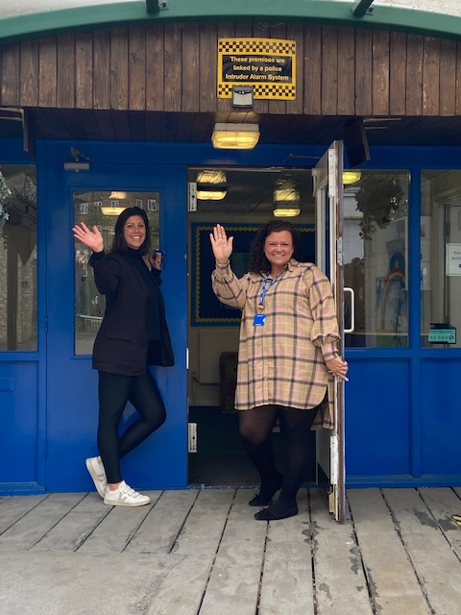
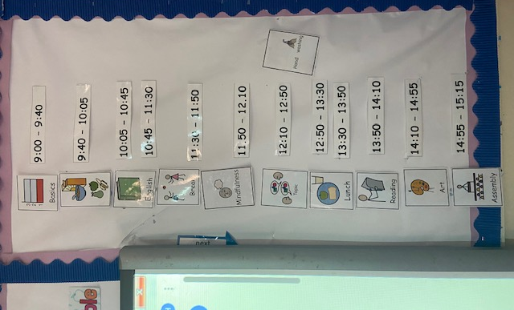
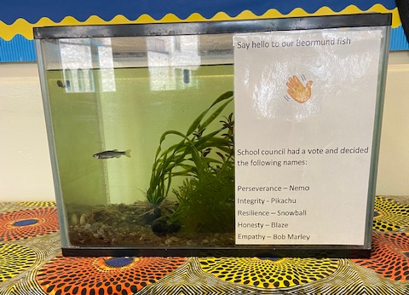
Whole school approach to Protect by increasing safety cues and ACTIVATING THE SOCIAL ENGAGEMENT SYSTEM.
Meet and Greet
Show them that we care – Names, Haircuts & Hobbies
Our bodies – Welcoming stance, eye contact, hugs and high 5’s
Warmth, tone of voice & facial expressions.
Stress reducing environment
Safe stress - Reducing cortisol so it doesn’t reach dangerous levels.
Familiar faces - consistency
Opioids / Oxytocin = Anti aggression / Anti – anxiety
Animals, Music & Laughter
Predictable
‘We start everyday as a new day’

Slide 7
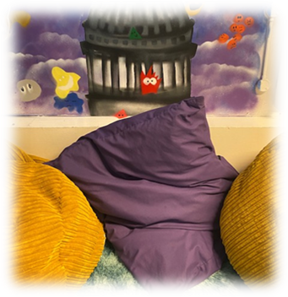
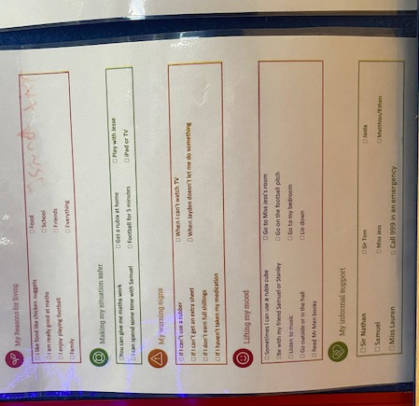
SMILE ☺
Process blank faces as threatening trigger social defence system
Signals safety/ activates the Social engagement system.
Shows you care, promotes self esteem.
Vital need to provide safety cues.
‘I didn't even notice I wasn’t smiling until I started making an effort to smile, then it just felt like the smiling was contagious ’ – Teaching & Learning Assistant
Stop asking why and WINE
Key relational skills, empathetic responses & active listening.
If you don’t have the time – find the time.
Each child has an individualised safety plan.
Who are their emotionally available adults both in school and at home.
What helps them reduce stress levels.

Slide 8
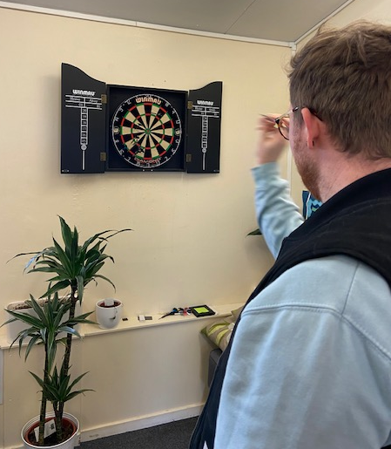
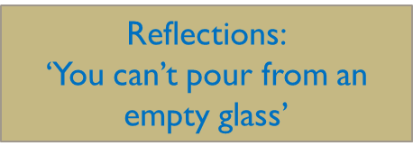
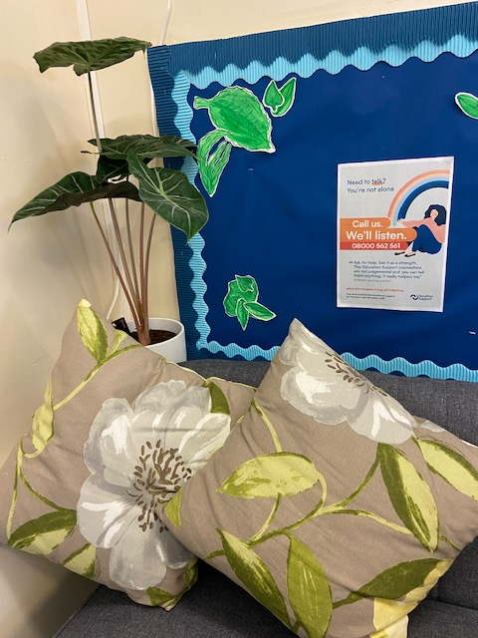
Clinical Supervision for staff / Staff wellbeing
Supporting Emotional Wellbeing of staff team:
Extended Support staff hours. Daily Debriefs in class –
Offering a non-judgemental ear to talk to
Staff are also provided with regular training on how to support children
move from toxic / tolerable stress and emotional regulation.
Policy – Supporting staff to recognise their own window
of tolerance and stress.
Reflections:
High staff turnover, EEA adults leave.
Children need support to grieve the loss of their EEA.

Slide 9
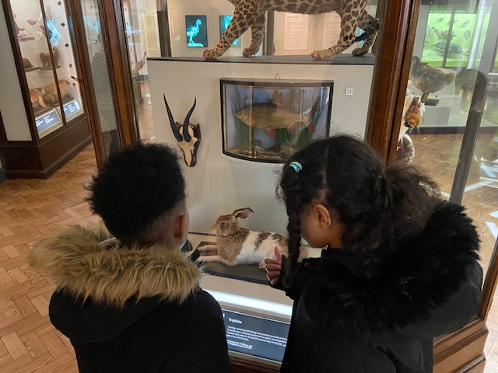
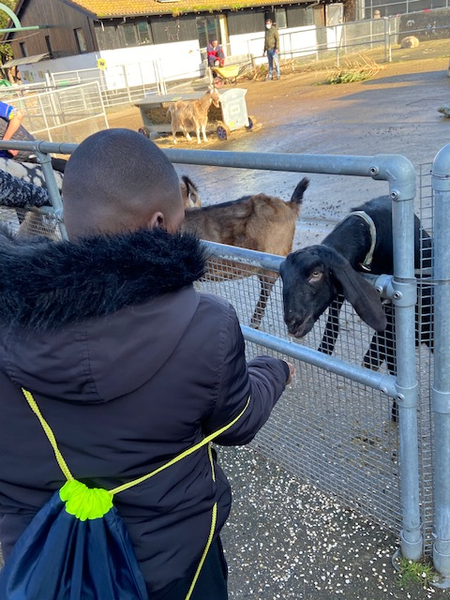
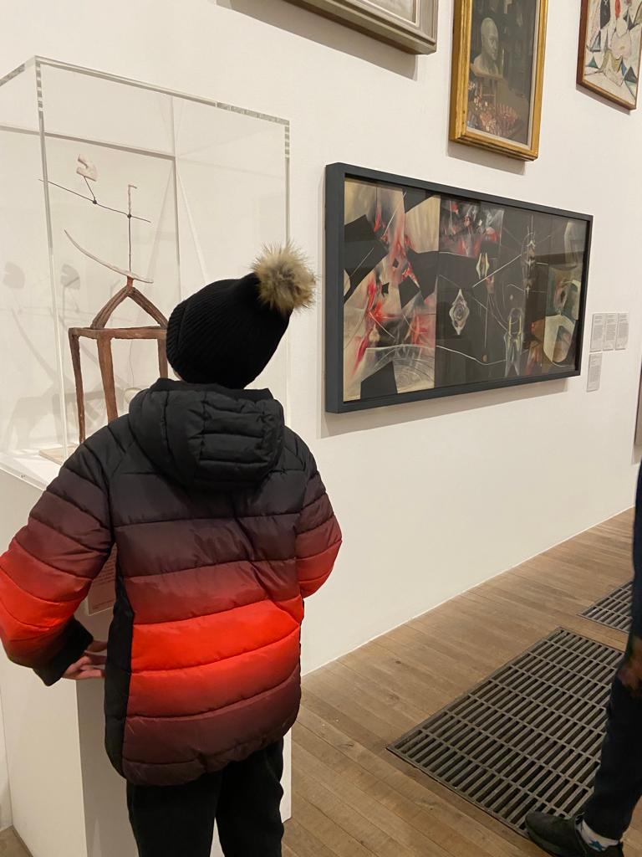
Activities that activate that SEEKING system.
Children with underactive SEEKING system lack curiosity and the desire to learn
Enriched environments turn on BDNF & IGF which
protects against cell death from stress
Being with nature and animals reduces stress

Slide 10
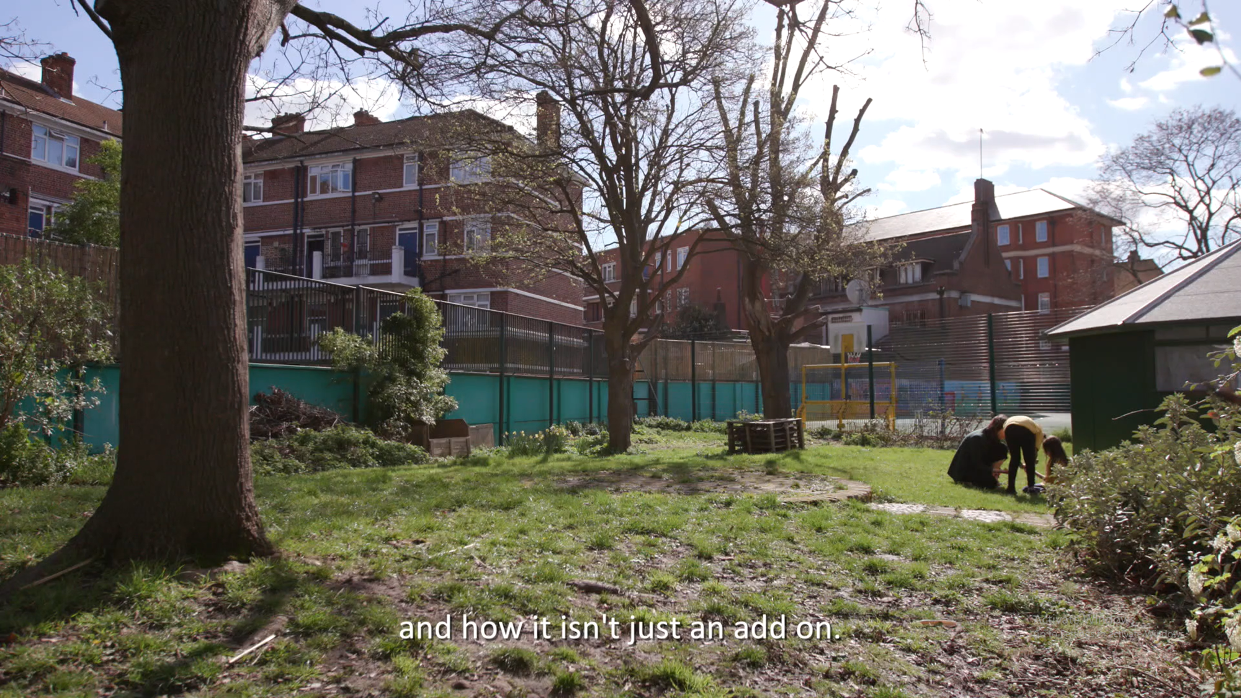

Slide 11
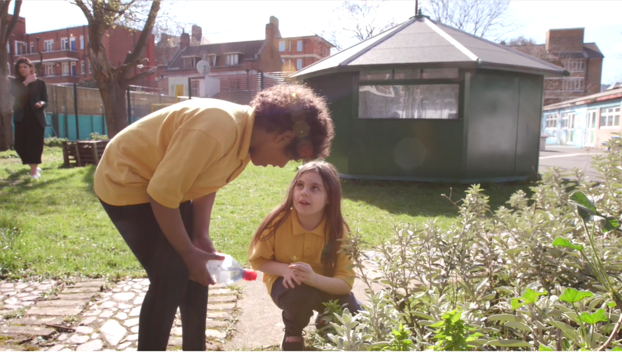
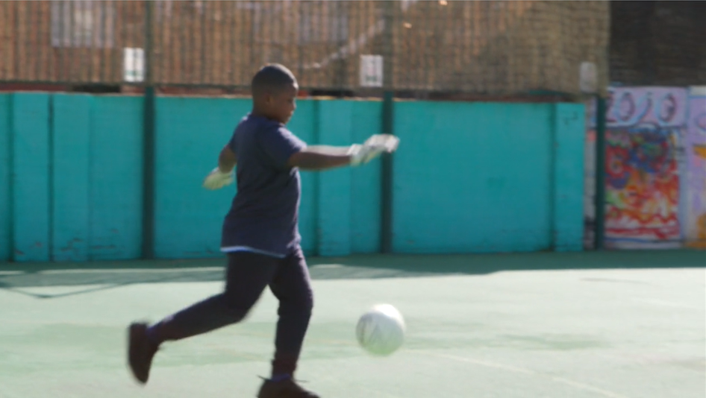
Development of emotional literacy
Improved emotional regulation
Increased expertise around the school
Reduction in Thinking Time
Reduction in Physical Interventions
Increase in Shillings attained – class and school averages.
Greater access to learning
Reduction in FTE

