Slide 1
IMHARS Sharing Practice & Celebration Event
Friday 15th March 2024
Improving lives and outcomes for all

Slide 2
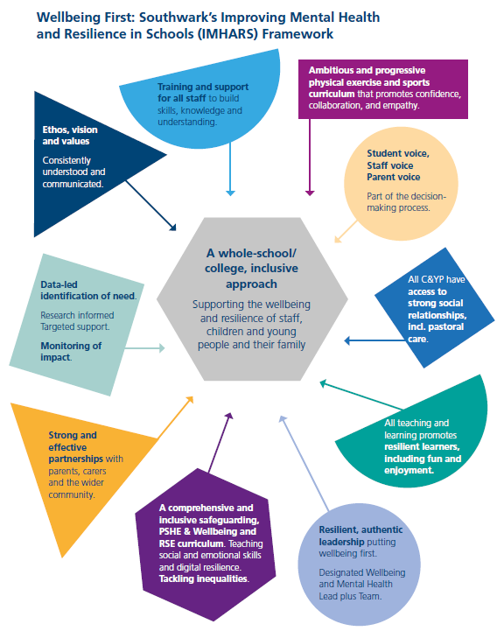
Across all schools/colleges, Southwark’s IMHARS framework model describes the 10 components of school/college life that can support and contribute to pupils’ positive mental health and resilience.
Each section has guidance, including questions for reflection and ideas for action, together with some useful quality assured resources.

Slide 3
IMHARS Celebration Event
Friday 15th March 2024
Improving lives and outcomes for all

Slide 4
DULWICH Hamlet Junior school
Three-form entry junior school in Dulwich, Southwark
14.53% pupil premium
14.25% SEND (excluding EHCP)
5.31% EHCPs

Slide 5
OUR VISION: wellbeing and mental health
Dulwich Hamlet is a school where: The community considers the wellbeing of all stakeholders in everyday practices.
Everyone in the community is committed to removing the stigma attached to mental health by emphasising that everyone has mental health.
Everyone in the community shares an understanding of how we talk about mental health.
Everyone in the community has access to mental health first aid and, where necessary, is signposted to additional and/ or external services.

Slide 6
OUR AIMS: IMHARS
New, mindfulness-based PSHE curriculum covering RSE, health and relationship education
Improved lunchtime provision: staffing, resources and activities to ensure every child has access to a stimulating and safe break, reducing incidents of bullying and self-reporting; playground mentor programme to activate peer to peer support
Mental health first aid provision to put mental health on an equal level with physical health for all pupils; training of a Mental Health First Aider attached to each year group to offer support
In-school Learning and Resilience Coach to support children identified as requiring support outside of the class
Identification of whole school training requirements and delivery to improve quality first teaching

Slide 7
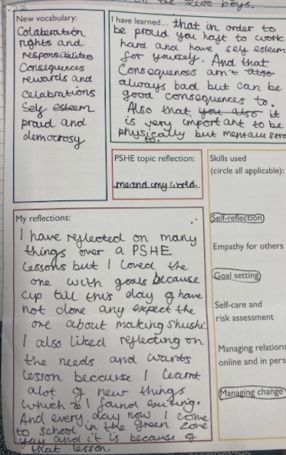
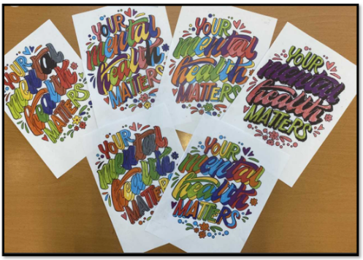
PSHE curriculum
Pupil voice: “You can say what you feel. It’s a time to talk to everyone.” Year 6 “I like learning about friendships and accepting that people are different.” Year 5 “In Dreams and Goals, you can reflect on the future and what you’re good at.” Year 4

Slide 8
Lunchtime provision
The playground resource library led to a ‘playground leader’ initiative which supported children with low self-esteem to boost their confidence via taking responsibility for organising resources, leading games and supporting inclusion in the playground.
In their role as Playground Buddies, the school council suggested the purchase of a ‘Buddy bench’ and we held a competition to design a sign for this bench, which now has pride of place in the playground!

Slide 9
Mental health support
Trained Mental Health First Aiders on the playground every day – identifiable by hot-pink hi-vis jackets!
Following engagement with a workplace charity which supports individuals without work into placements we were able to appoint a trained play therapist (Place2Be) to work with our children. This professional has since become a valued, full time member of staff.
This term, we have welcomed a new, fully trained Art Therapist to support children with identified need and provide ‘drop in’ sessions during lunchtimes.

Slide 10
Whole school training
Annual wellbeing INSET in January – focus on improving and maintaining staff wellbeing through a variety of approaches and initiatives, including annual wellbeing days
Annual RSE training in January to support high-quality delivery of RSE teaching
This year, we have undertaken Trauma Informed Schools training as an INSET (3 hours) and for 6 members of SLT, leading to an updated trauma-informed approach for high-needs children in our setting

Slide 11
IMPACT
PSHE CURRICULUM
“A carefully considered programme of personal, social and health education (PSHE) helps pupils learn how to stay safe, and teaches them about healthy relationships.” OFSTED 2023
LUNCHTIME PROVISION
“Pupils support each other to behave well, for example some act as play leaders who help to regulate activities at social times… The very wide range of clubs and activities are well attended by pupils. These help to develop pupils’ interests and talents, for example in yoga, cookery, street dance and capoeira.” OFSTED 2023
The playground teams are more cohesive and joined up than ever before. The regular use of training meetings led to an improvement in morale and a sense that they were being listened to, valued and trusted.

Slide 12
IMPACT
MENTAL HEALTH SUPPORT
In our pupil survey from academic year 2021/22 only 2% (7/349) of pupils felt the school failed to ‘encourage me to look after my mental health’.
In our pupil survey from academic year 2021/22, exactly 7.5% (24/349) of participants disagreed that there was an adult to talk to (improved from 12.53%).
In our parent/carer survey from academic year 2021/22 3.6% (4/111) of parents were dissatisfied with our response to bullying (improved from 19.2%).
WHOLE SCHOOL TRAINING
“Leaders develop staff expertise through a high-quality programme of ongoing professional development. This includes teachers who are new to the profession and support staff.” OFSTED 2023

Slide 13
Sustainability, partnership and best practice
PSHE HUB
Sharing best practice in teaching PSHE with primary schools across the Charter Schools Educational Trust
Making links with secondary schools to review effective transition and share resources, including cooking facilities
Periods Workshop for pupils and parents
TCSET CONFERENCE
Teach-Meet on PSHE, Mental Health and Wellbeing best practice
CPD
Lead Practitioner accreditation

